Slide 1
Safety Principles Revisited
to Identify AI Applications to Nuclear Industry
Hyeonil Kim*, S.G. Kim**, Y.G. Yoo**
* Versatile Reactor Technology Development Div., hyeonilkim@kaeri.re.kr
**AI A&S Team
May 19, 2022.

Slide 2
Contents
Intro
Safety Principles
AI
Applications to Nuclear Industry

Slide 3
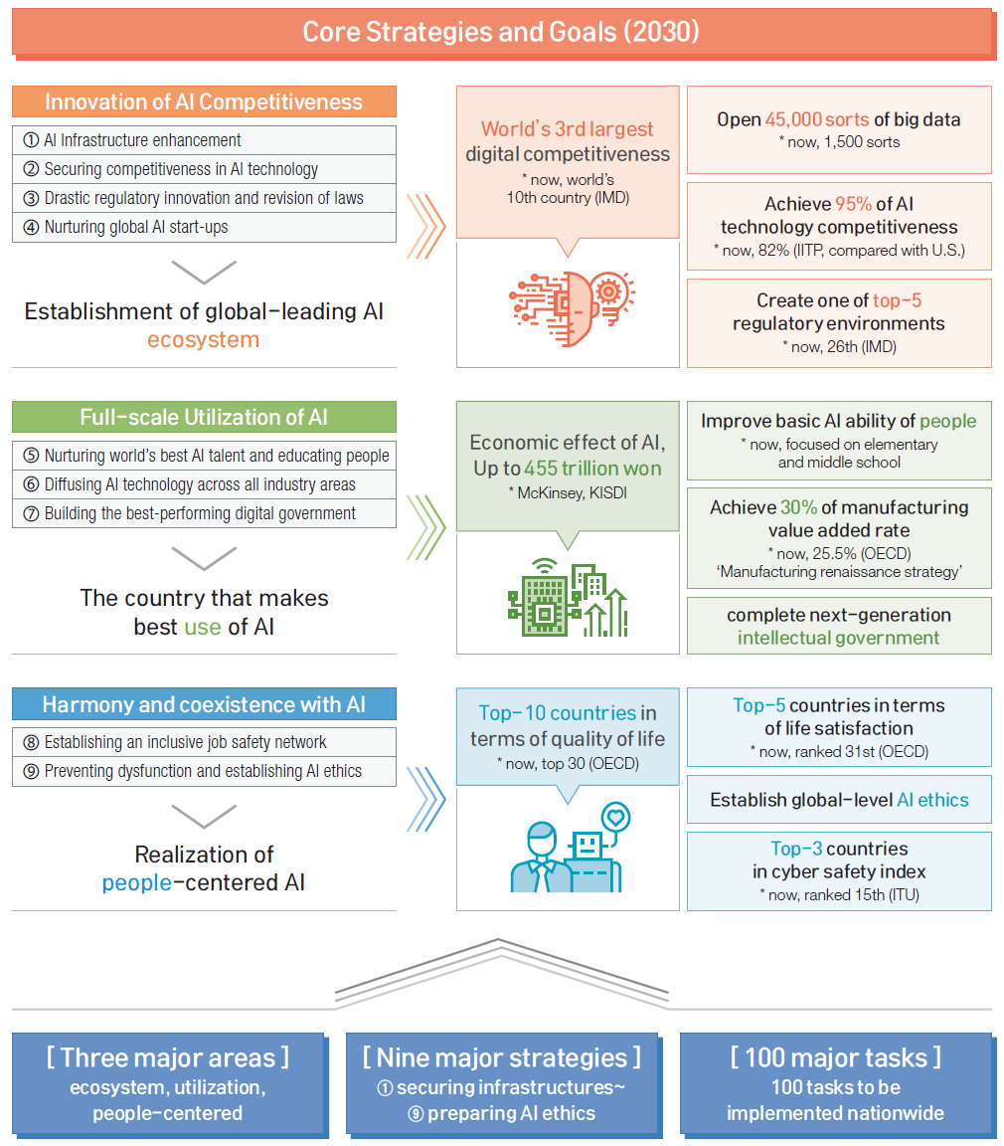
Introduction

Slide 4
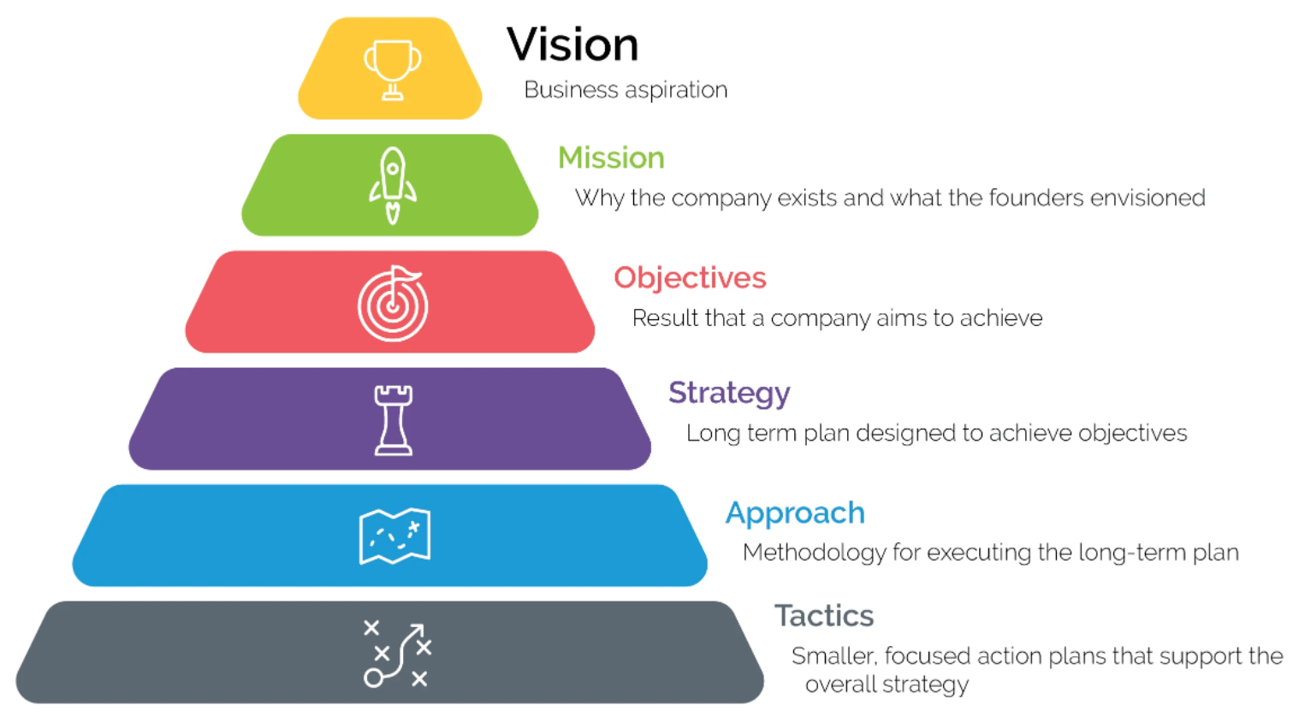
6 elements of effective strategic planning. (2022, April 30). https://www.thespurgroup.com/blog/the-6-elements-of-effective-strategic-planning

Slide 5
Introduction
Need to Transform How We Use DATA
Only 57% of projects finish within their initial budgets and 51% within their initial schedule (The Pulse of the Profession, 2017).
Up to 95% of construction industry data is not used, but wasted (The Futures Report 2020, RICS).
Eighty percent of US CEOs think AI will significantly change the way they will do business in the next five years (PwC survey, 2019).
AI could deliver a 10% increase in UK GDP in 2030 (AI Roadmap, AI Council, 2021)
Nawal Prinja. (2022, Feb. 24). AI in support of the Nuclear Energy Sector, GEN IV International Forum.

Slide 6
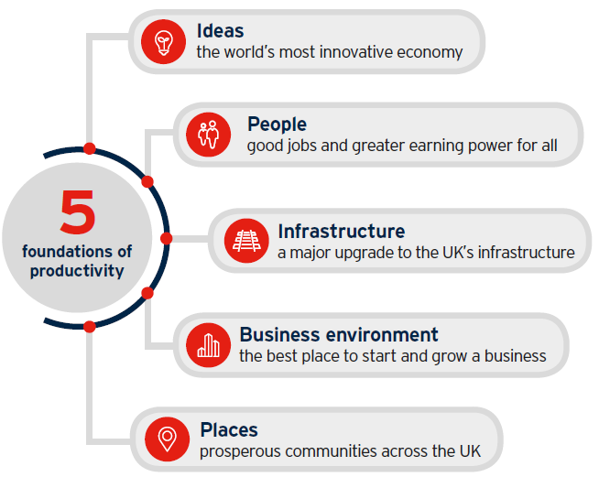
Introduction
UK Policy paper
UK Nuclear Sector Deal calls (Department for Business, Energy & Industrial Strategy of UK, 2018)
30% reduction in the cost of new build projects by 2030
Savings of 20 per cent in the cost of decommissioning compared with current estimates by 2030
40 per cent women in nuclear by 2030
Up to 2 bn pounds domestic and international contract wins by 2030
Nuclear Sector Deal, A sector deal between government and the nuclear industry, 27 June 2018

Slide 7
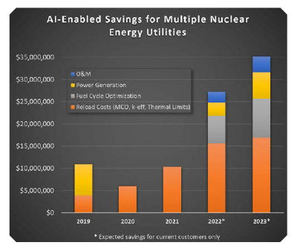
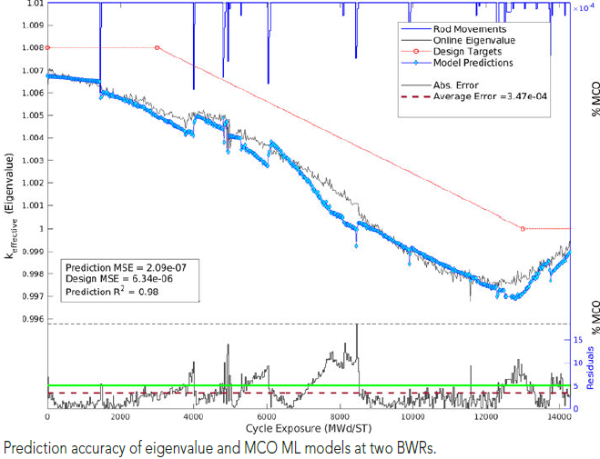
Introduction
US
Cost reduction by using AI in Fuel loading, control, management system (DOE, 1985)
Cost reduction from O&M (60~70% of generation costs) focused on aging (Office of Nuclear Energy, 2019)
Cost Saving up to 10M $ from reload cost (Bluewave AI, 2022)
Long-term strategic agreement w/Constellation
TIP Award at NEI conf.
DoE Awards Nearly $7 M
Artificial Intelligence and Nuclear Power, DOE/NE-0064, 1985.
Application of Machine Learning for Enhanced Diagnostic and Prognostic Capabilities of NPP Assets, USDOE/ONE, 2019.
Reduce costs by improving efficiency, performance, and safety with AI and Machine Learning. (2022, April 30). https://www.bluewaveailabs.com/ai-machine-learning-nuclear-power-plants/ ((2022). Powering our nuclear fleet with artificial intelligence. Nuclear News 65(2).)

Slide 8
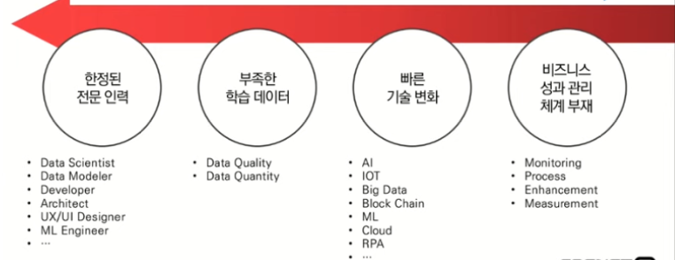
Introduction
DX/AI conference. AI Times. 2022.

Slide 9
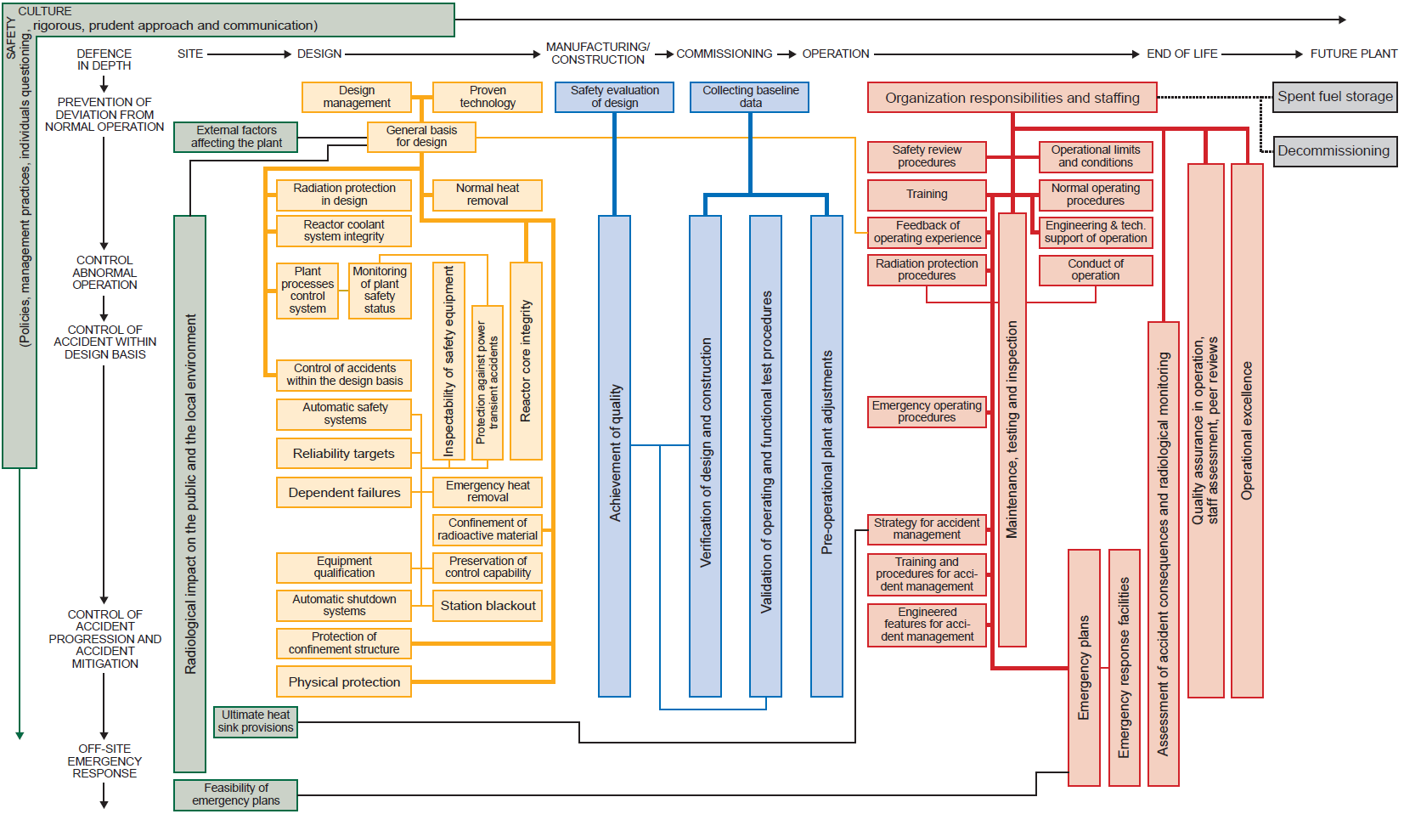
8 Specific Safety Principles
INSAG-12. Basic Safety Principles for Nuclear Power Plants. 75-INSAG-3 Rev.1. 1999.

Slide 10
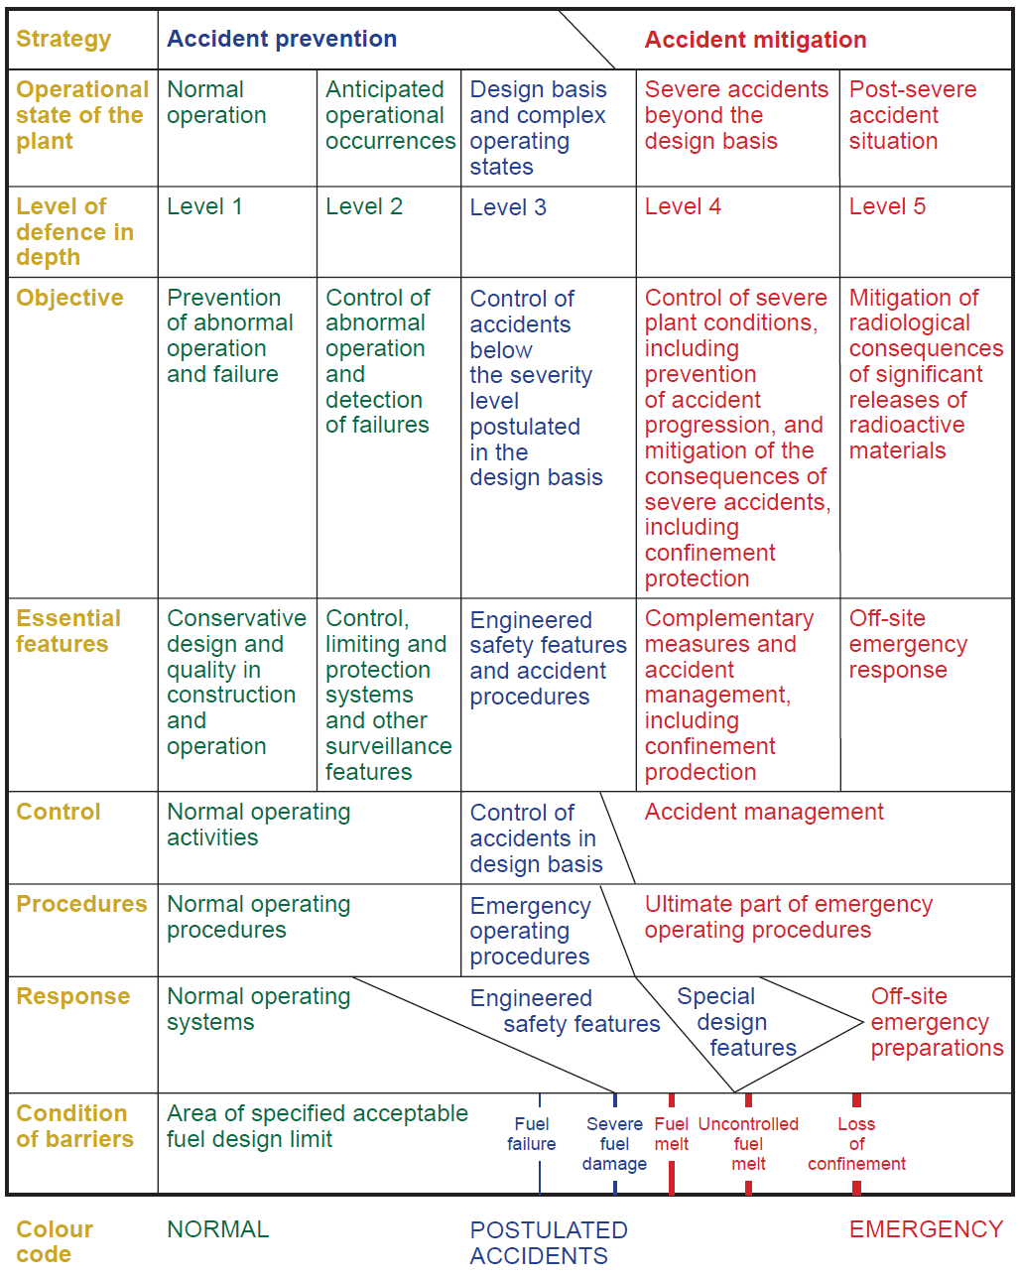
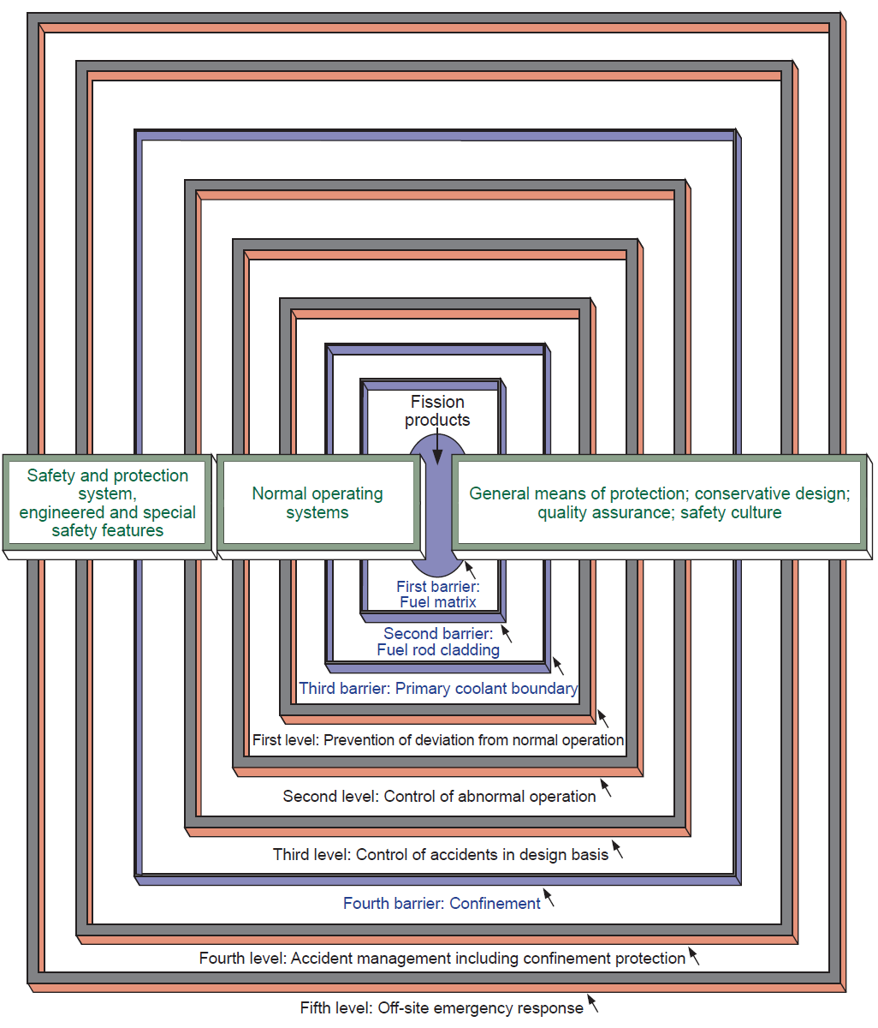
8 Specific Safety Principles

Slide 11
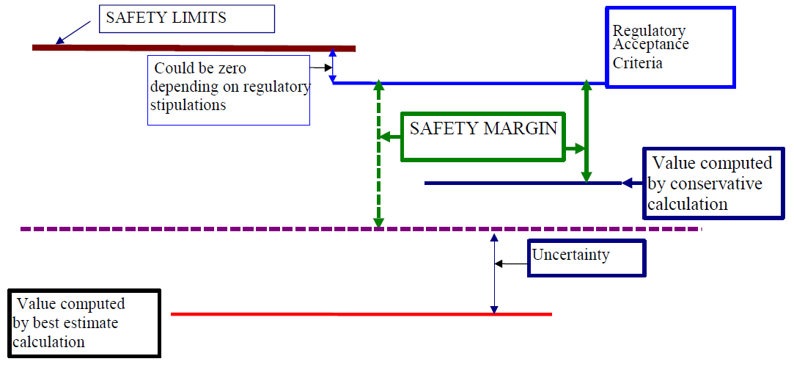
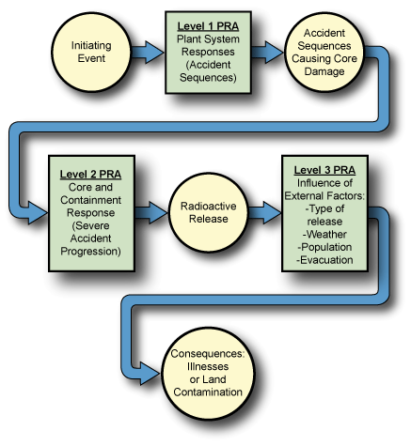
Methodologies to implement Safety Principles

Slide 12
Activities to implement Safety Principles
Total Life Cycle
Design
Construction
O&M
Inc. Commissioning
Certified Design
Requirements
Owner
Operation
Maintenance
Updates
Contract
Approval
by Owner
Issues
Installations
Conformance
to requirements
License Basis
Design Basis
Change Control
Requirements
Definition/
Assignment
Suppliers
Updates
Private Communication with Choongsub Yeom. 2022.

Slide 13
Key Attributes (1/2)
Generic AI | AI in Science
Focus on deployment and efficiency | Focus on theory (e.g. accuracy bounds, uncertainty quantification)
More concerned with “could it work?” then “might it fail ?”; trial and error mindset | Concerned with robustness and accuracy; The costs of mistakes may be high
Benchmark performance -> innovation | Find shortcomings -> understanding
Imitate human intelligence | Augment human intelligence
Recognize patterns in iid data | Adapt to new conditions
Computer vision Natural language processing Chess, Go, Jeopardy | Complex physical systems Integration with critical infrastructure High-consequence decision making
Rebecca Willett. AI FOR SCIENCE From Atoms to the Cosmos. ANL. 2021.

Slide 14
Key Attributes (2/2)
Key Attributes | Challenges | Remarks
Life Cycle | Extremely Long | Longer than 60 years (much longer if design development is included)
Complexity | Project managements | Electricity market, Fuel cycles, Supply Chains, O&M Radioactive wastes
 | Quality Assurance | Shortage in Experienced personnel Difficulties in Technology Transfer from G. to G.
 | Configuration Management | Longer than 60 years
Safety | Conservatism | Continually Strengthened demands Risks and Costs
Regulatory Documents | Quality Assurance | Shortage in Experienced personnel Difficulties in Technology Transfer from G. to G.
 | Configuration Management | Longer than 60 years

Slide 15
6 elements of effective strategic planning. (2022, April 30). https://www.thespurgroup.com/blog/the-6-elements-of-effective-strategic-planning

Slide 16
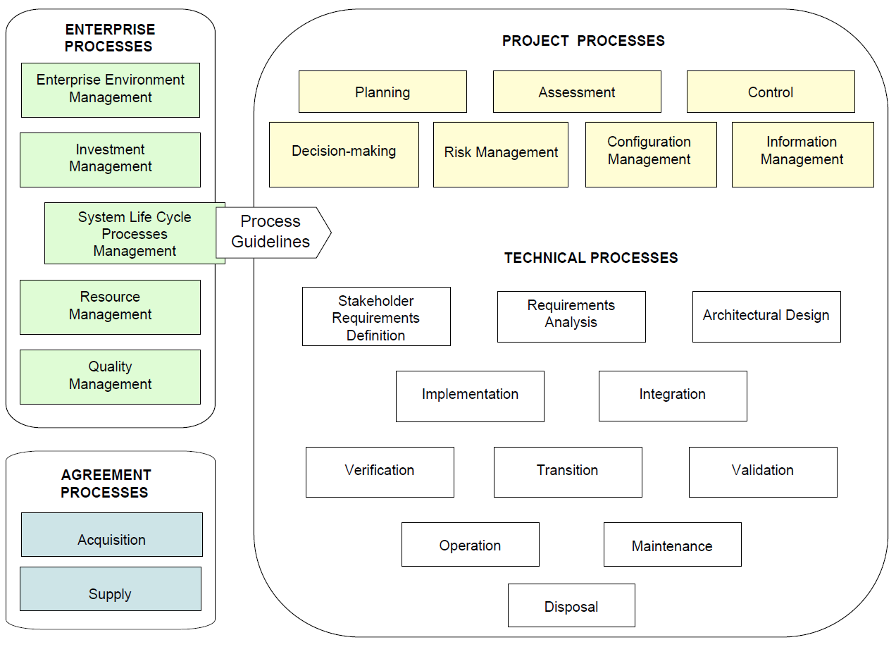
SE Process
INCOSE Systems Engineering Handbook v.3, June 2006.

Slide 17
Growth, Productivity
Nuclear R&D
Tech. Innovation
Infra. (network, DB, S/W)
Administration ($, MH)
Policy(incentives)
Cultural change(mind)
6 elements of effective strategic planning. (2022, April 30). https://www.thespurgroup.com/blog/the-6-elements-of-effective-strategic-planning

Slide 18
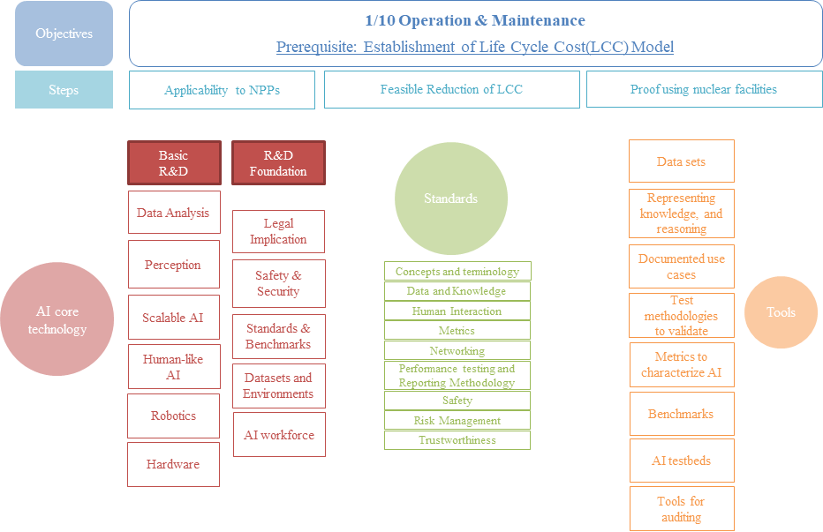
A Reference Process for Data-driven Models
Hyeonil Kim, Research on AI R&D Strategy for Nuclear Application I, KAERI/TR-8854/2021

Slide 19
Concluding Remarks
Nuclear Safety principles ensured by
Uncertainty Quantification
Optimization
Automation
eXplainable AI (XAI)
Open and Connected networks in multidisciplinary teams and diverse perspectives
Super Long Life Cycle management (Quality Assurance, Configuration Management)
All will be supported by AI

Slide 20
From the start
Consistent and Coherent
Goal and Objectives
To the end

Slide 21
Artificial intelligence is reshaping business – though ...
AI will add $13 trillion to the global economy over the next decade.
- Many organizations’ efforts with it are falling short.
- Only 8% of firms engage in core practices that support widespread adoption.
- Most firms have run only ad hoc pilots or are applying AI in just a single business process.
- It’s a reflection of a failure to rewrite the organization.
- AI initiatives face formidable cultural and organizational barriers.
Making the shift
- One of the biggest mistakes leaders make is to view AI as a plug-and-play technology with immediate returns.
- Leaders also often think too narrowly about AI requirements.
3 shifts:
- from siloed work to interdisciplinary collaboration
- from experience-based, leader-driven decision making to data-driven decision making at the front lines
- from rigid and risk-averse to agile, experimental, and adaptable
Harvard Business Review. Building the AI-Powered Organization. 2019.

Slide 22
Setting Up for Success (1/2)
Explaining why
- Leaders have to provide a vision that rallies everyone around a common goal.
- Workers must understand why AI is important to the business and how they’ll fit into a new, AI-oriented culture.
Anticipating unique barriers to change
- A company’s culture may also have distinctive characteristics that contribute to resistance.
(siloed processes can inhibit the broad adoption of AI. Organizations that assign budges by function or business
unit may struggle to assemble interdisciplinary agile teams, for examples.)
Budgeting as much for integration and adoption as for technology
- nearly 90% of the companies that engaged in successful scaling practices
had spent more than half of their analytics budges
on activities that drove adoption, such as workflow redesign, communication, and training.
Balancing feasibility, time investment, and value
- a portfolio of initiatives with different time horizons.

Slide 23
Setting Up for Success (2/2)
Organizing for Scale / Organizing AI for Scale
- hub and spokes
- Gray area
*Deciding where responsibility should lie within an organization is not an exact science,
but it should be influenced by 3 factors (must be considered in totality) :
- the maturity of AI capabilities (ultimately within the spokes)
- Business model complexity (too complex? Then consolidate in the hub and assign out as needed ...)
- the pace and level of technical innovation required
Oversight and execution
two things in common
- A governing coalition of business, IT, and analytics leaders.
- Assignment-based execution teams (interdisciplinary teams within the spokes)
Educating Everyone
- Leadership
- Analytics
- Translator
- End user

Slide 24
Reinforcing the Change
Walk the talk
Role modeling is essential.
- For starters, leaders can demonstrate their commitment to AI by attending academy training.
- They also must actively encourage new ways of working (ask questions and reinforce the value of diverse perspectives).
Make businesses accountable
- It’s the business units that must lead projects and be responsible for their success.
- Sometimes organizations assign different owners at different points in the development life cycle
(for instance, for proof of value, deployment, and scaling).
That’s a mistake! It can result in loose ends or missed opportunities.
- A scorecard that captures project performance metrics for all stakeholders is an excellent way
to align the goals of analytics and business teams.
Track and facilitate adoption
- Comparing the results of decisions made with and without AI can encourage employees to use it.
- Teams that monitor implementation can correct course as needed.
(Business units must lead AI projects and be responsible for their success.)
Provide incentives for change
- Acknowledgement inspires employees for the long haul.
- Firms have to check that employees’ incentives are truly aligned with AI use.
(to recognize the trade-off between profits and the incentives).

Slide 25
Conclusion
A Virtuous Circle
- The move from functional to interdisciplinary teams initially brings together the diverse skill and perspectives ...
- Workers across the organization absorb new collaborative practices
- As they work more closely with colleagues in other functions and geographies, employees begin to think bigger
- The speed of innovation picks up as the rest of the organization begins to adopt the test-and-learn approaches
that successfully propelled the pilots
The ways AI can be used ... Keep expanding.
- New applications will create fundamental and sometimes difficult changes in work flows, roles, and culture,
which leaders will need to shepherd their organizations through carefully.

