Slide 1

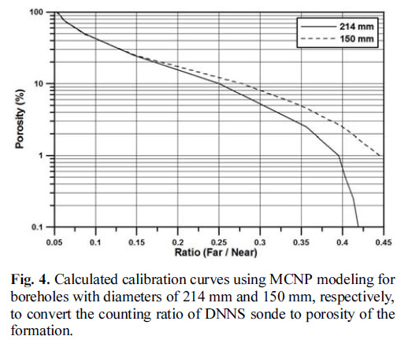
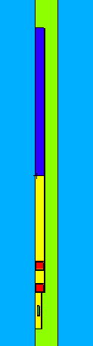
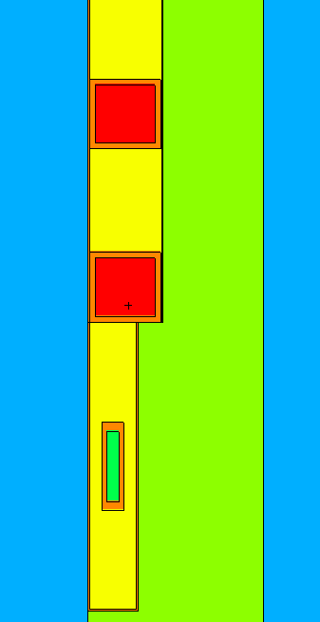
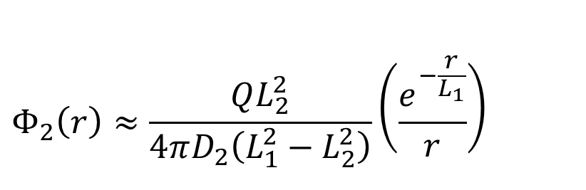
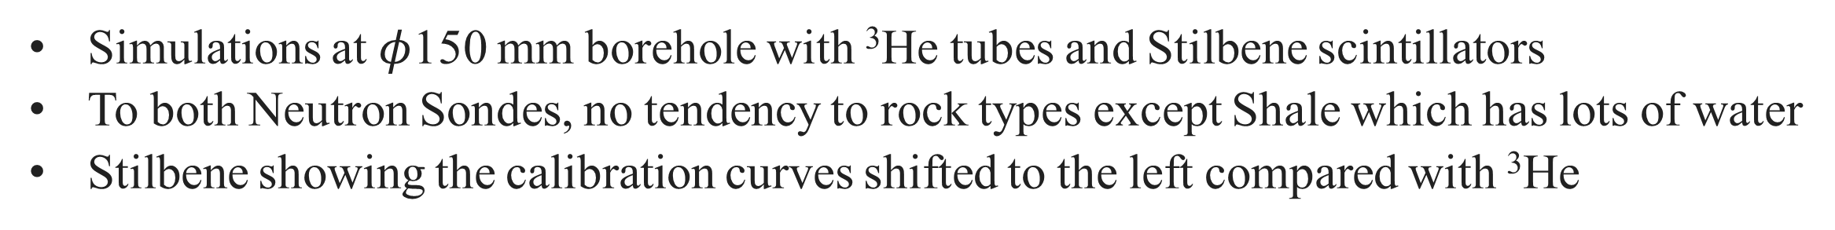
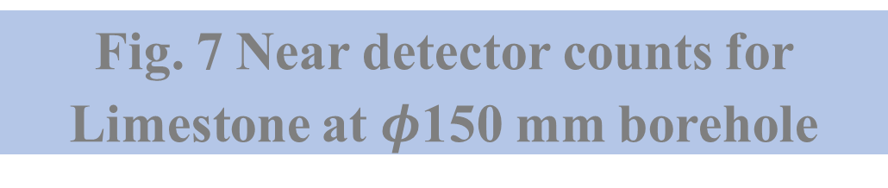
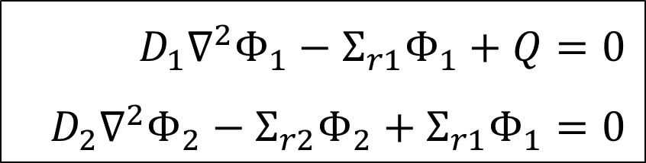
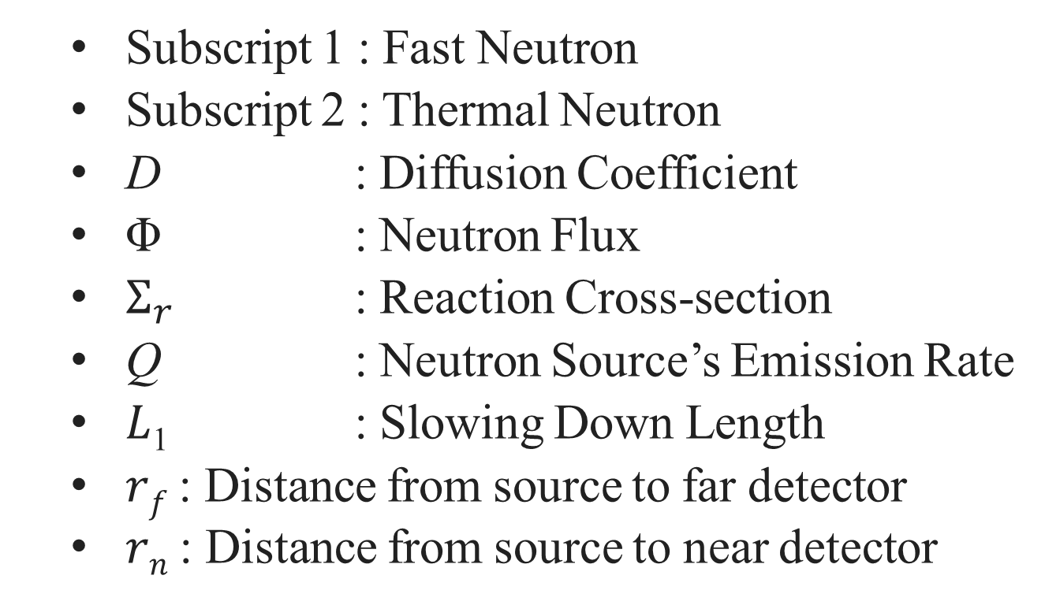
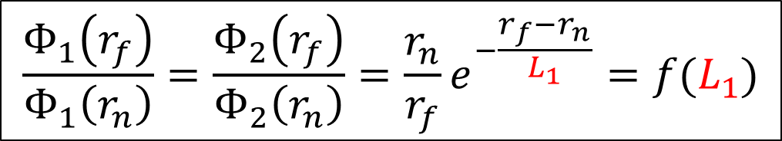

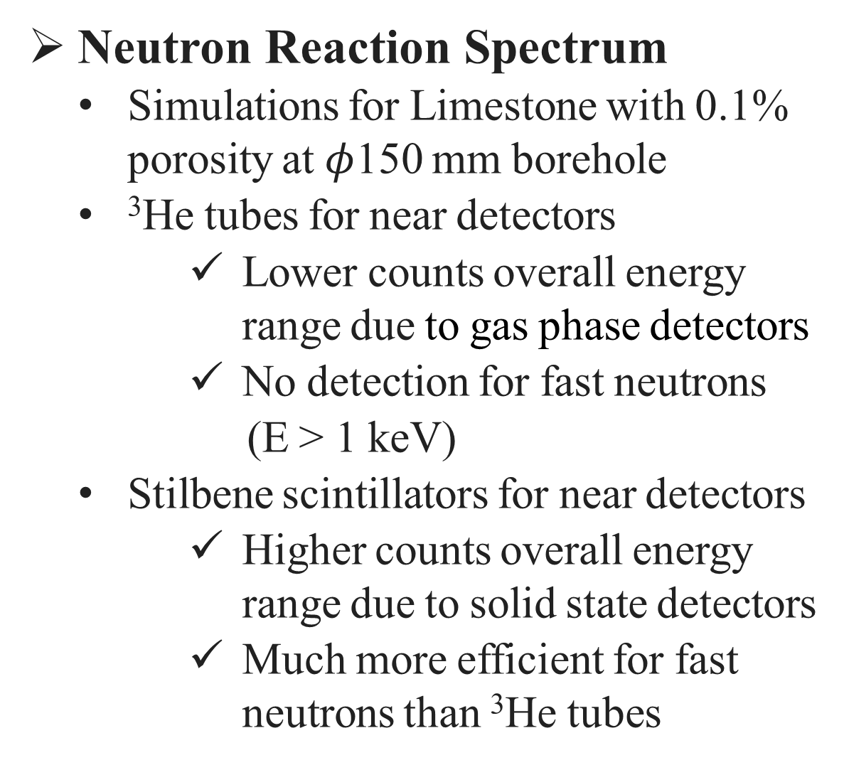

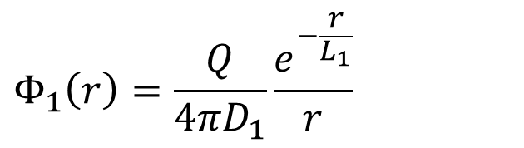
A Comparison of Performance between
Stilbene and ³He Detectors for Neutron Sonde
Ill-hyuk Han, Geehyun Kim*
Department of Nuclear Engineering, Seoul National University, 1, Gwanak-ro, Gwanak-gu, Seoul, Korea
^{*Email : gk.rs@snu.ac.kr}
INTRODUCTION
Porosity Calibration Curve by Each Rock Type
Neutron Logging Sonde
The method for configuring porosity
or rock type of stratum
Consisting of two neutron detectors
(Near detector & Far detector)
and one neutron source
³He Proportional Counter
Gas proportional counter
Increasing demands and cost of ³He
Neutron Reaction
³He(n, p)³H : ~ 940 barns (@ ~ 1 eV neutrons)
Stilbene Scintillator
Neutron detection with PSD technique (Pulse Shape Discrimination)
Neutron Reaction
¹H(n, n′)¹H : ~ 1 barn (@ ~ 1 MeV neutrons)
Simulations at $φ$150 mm borehole with ³He tubes and Stilbene scintillators
To both Neutron Sondes, no tendency to rock types except Shale which has lots of water
Stilbene showing the calibration curves shifted to the left compared with ³He
(a)
(b)
Fig. 1 Porosity calibration curve
of Neutron Sonde
Fig. 4 Porosity calibration curves by each rock types of two Neutron Sondes
METHODS
(a) ³He proportional counters (b) Stilbene scintillators
Porosity Calibration Curve by Each Borehole Diameter
Monte Carlo Simulation (MCNP 6.2)
Neutron Sonde design : Dual Neutron Probes of Robertson Geo.
Formation of stratum : Radius = 5 m, Height = 12 m
Simulations for Limestone with ³He tubes and Stilbene scintillators
The borehole diameter proportional to the amount of water, resulting in the decrease of the Far/Near Ratio
Sonde Diameter
6.5 cm
Borehole
Table. 1 Variables of MCNP 6.2 simulation
(a)
(b)
Far Detector
2＂X 2＂
Rock
Simulation Variables
Detector | ³He tubes (or Stilbene scintillators)
Rock Type | Limestone, Granite, Sandstone, Basalt, Shale
Porosity | 0% – 100%
Temperature | 27°C
Neutron Source | ²⁴¹Am-Be (1.1×10⁷ n/s, 3 Ci)
Borehole Fluid | Water
Borehole Diameter | 14.0 cm – 22.0 cm
Shielding Material | Plastic(Polyethlene)
$$n_{thermal}$$
Plastic
Air
Slowing Down
Near Detector
2＂X 2＂
Water
$$n_{fast}$$
²⁴¹Am-Be Source
Fig. 5 Porosity calibration curves by each borehole diameters of two Neutron Sondes
SUS 409 housing
(a) ³He proportional counters (b) Stilbene scintillators
Fig. 2 MCNP 6.2 simulation geometry
Reasons for the Reduced Far/Near Ratio by Stilbene Scintillator
Neutron Diffusion Equation
$$Φ_{1}\left(r\right)=\frac{Q}{4πD_{1}}\frac{e^{−\frac{r}{L_{1}}}}{r}$$
More possible for fast neutrons to pass shielding materials between neutron source and near detector rather than thermal neutrons
Decreasing statistical error of the ratio by Stilbene scintillators due to higher neutron detection efficiency
$$D_{1}∇^{2}Φ_{1}−Σ_{r1}Φ_{1}+Q=0$$
$$D_{2}∇^{2}Φ_{2}−Σ_{r2}Φ_{2}+Σ_{r1}Φ_{1}=0$$
$$Φ_{2}\left(r\right)≈\frac{QL_{2}^{2}}{4πD_{2}\left(L_{1}^{2}−L_{2}^{2}\right)}\left(\frac{e^{−\frac{r}{L_{1}}}}{r}\right)$$
Subscript 1 : Fast Neutron
Subscript 2 : Thermal Neutron
D : Diffusion Coefficient
Φ : Neutron Flux
$Σ_{r}$ : Reaction Cross-section
Q : Neutron Source’s Emission Rate
𝐿₁ : Slowing Down Length
𝑟_{𝑓} : Distance from source to far detector
𝑟_{𝑛} : Distance from source to near detector
$$\frac{Φ_{1}\left(r_{f}\right)}{Φ_{1}\left(r_{n}\right)}=\frac{Φ_{2}\left(r_{f}\right)}{Φ_{2}\left(r_{n}\right)}=\frac{r_{n}}{r_{f}}e^{−\frac{r_{f}−r_{n}}{L_{1}}}=f(L_{1})$$
Near Detector Count Increase
𝐿₁ depends on the amounts of
hydrogen in porous rock
12 times
Thermal
Fast
RESULTS AND DISCUSSIONS
Fig. 6 Schematic diagram
about diffusion of
thermal and fast neutron
Fig. 7 Near detector counts for
Limestone at $φ$150 mm borehole
Neutron Reaction Spectrum
Simulations for Limestone with 0.1% porosity at $φ$150 mm borehole
³He tubes for near detectors
Lower counts overall energy range due to gas phase detectors
No detection for fast neutrons
(E > 1 keV)
Stilbene scintillators for near detectors
Higher counts overall energy range due to solid state detectors
Much more efficient for fast neutrons than ³He tubes
CONCLUSIONS
Stilbene can replace 3He detectors due to the following reasons
Both detectors having a same tendency in the porosity calibration curves
Higher neutron detection efficiency than ³He
The Far/Near Ratio of Stilbene scintillator is decreased due to increasing near detector counts, however, statistical error of the ratio is reduced
Acknowledge
Fig. 3 Neutron counts of two neutron detectors by channels
This work was supported by Korea Environment Industry & Technology Institute (KEITI) through Subsurface Environment Management (SEM) Project, funded by Korea Ministry of Environment (MOE) (2018002440004).
Spring Meeting of the Korean Nuclear Society – ICC, Jeju, Korea, May 18-20, 2022

