Slide 1
Design and construction of pulsed magnetic mirror device
¹D. O, ¹S. Hwang, ²B. K. Jung, ¹M. Choi, ¹G. Baek, ¹C. Sung
¹KAIST, ²KAERI
Korean Nuclear Society Spring Meeting
Jeju, Korea, May 19, 2022
E-mail: choongkisung@kaist.ac.kr

Slide 2
Contents
Introduction
Design of the KAIMIR system
Initial plasma operation test
Summary / Future work

Slide 3
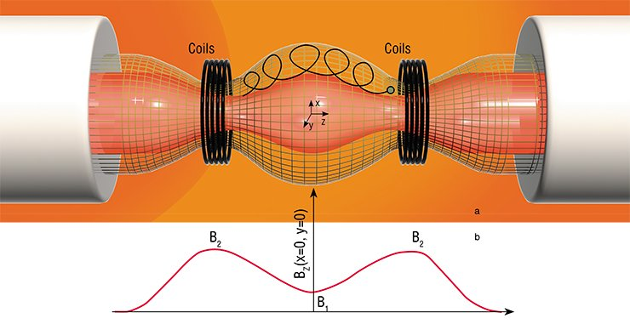
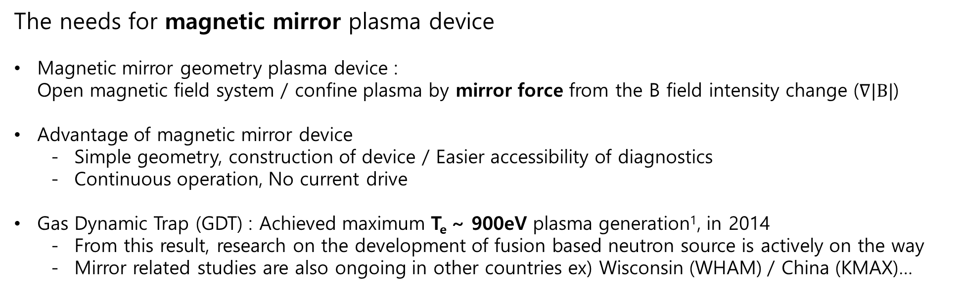
Introduction
The needs for magnetic mirror plasma device
Magnetic mirror geometry plasma device :
Open magnetic field system / confine plasma by mirror force from the B field intensity change ($∇|B|$)
Advantage of magnetic mirror device
  Simple geometry, construction of device / Easier accessibility of diagnostics
  Continuous operation, No current drive
Gas Dynamic Trap (GDT) : Achieved maximum T_{e} ~ 900eV plasma generation¹, in 2014
  From this result, research on the development of fusion based neutron source is actively on the way
  Mirror related studies are also ongoing in other countries ex) Wisconsin (WHAM) / China (KMAX)…
Schematics of plasma confinement in mirror geometry²
[1] Bagryansky, P. A., et al. Physical review letters 114.20 (2015)
[2] https://scfh.ru/en/papers/trap-f-o-r-fusion-/

Slide 4
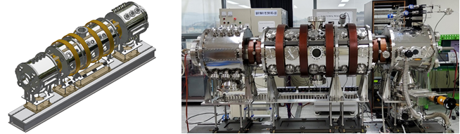
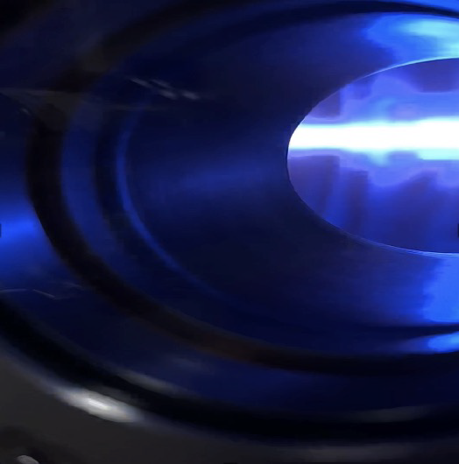
Introduction
Development purpose of KAIst MIRror plasma system (KAIMIR) device
Basic plasma physics study in magnetic mirror geometry
  Physical analysis of instability in mirror plasma system
  Wave – plasma interaction in mirror plasma system
Fusion / Industrial plasma application study
  Base research for Fusion based neutron source
  Research of industrial plasma source
  Edge plasma in fusion and divertor region physics study
Schematic of KAIMIR device
Actual photograph of KAIMIR device
Example of KAIMIR plasma discharge

Slide 5
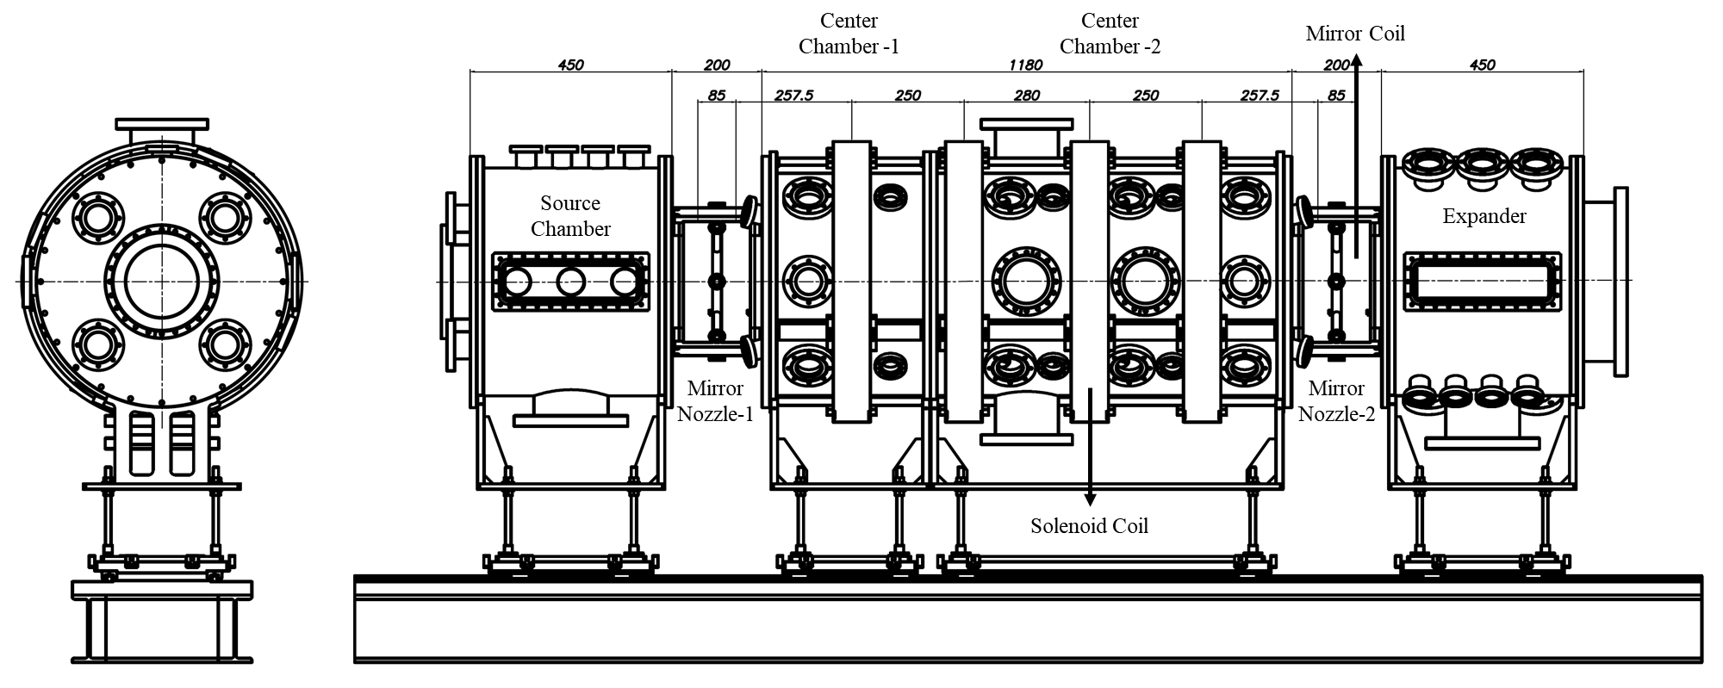
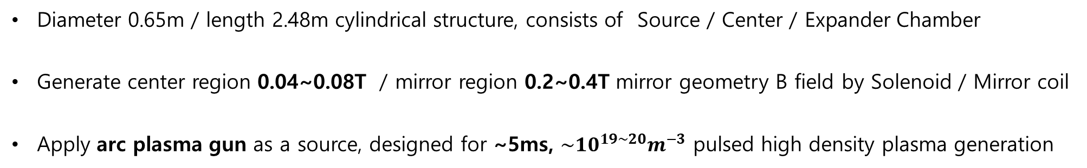
Design of the pulsed plasma system
Overall system
Drawing of KAIMIR device
Diameter 0.65m / length 2.48m cylindrical structure, consists of Source / Center / Expander Chamber
Generate center region 0.04~0.08T / mirror region 0.2~0.4T mirror geometry B field by Solenoid / Mirror coil
Apply arc plasma gun as a source, designed for ~5ms, $\sim {10}^{19\sim 20}m^{−3}$ pulsed high density plasma generation

Slide 6
Design of the pulsed plasma system
Magnetic field simulation
B_{z} along r = 0
Mirror / Solenoid coil current : 150A / 150A in simulation
Nearly uniform at center of the chamber
0.08T at center / 0.44T at mirror nozzle → Mirror ratio ~ 5
Aims to Max. 300A current discharge to coil (150A in present)

Slide 7
Design of the pulsed plasma system
Magnetic field measurement
Magnetic field measurement / simulation results
by changing Axial location
Magnetic field measurement / simulation results
by changing coil current value (Location : mirror nozzle)
Apply current 10A / 10A in mirror / solenoid coil, measure B field by axial location
  Mirror region 340G / center region 65G, formation of mirror ratio ~5, B field geometry
B field measurement by changing coil current in the center of mirror coil
  Verified linear proportionality of B field intensity by current value change
Measured / simulated data agree each other in Axial location / Current value
(Gauss meter calibration factor: 0.9)

Slide 8
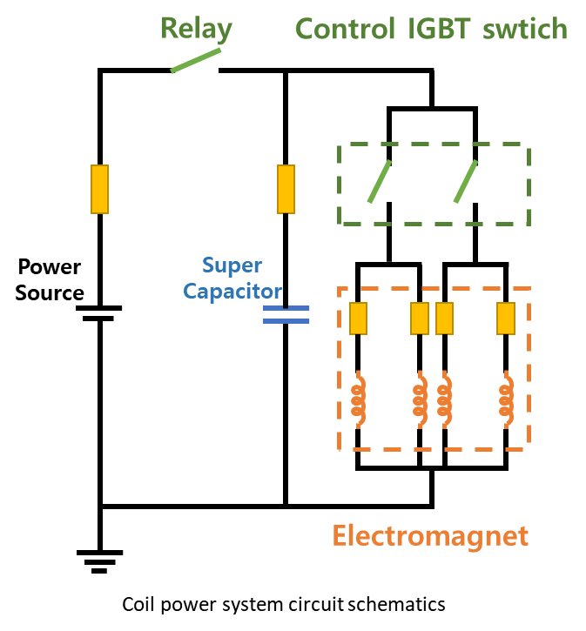
Design of the pulsed plasma system
Magnetic coil power system
Power module
Series connection of 2.7V / 2000F capacitor
[60ea (Solenoid) / 80ea (mirror)]
→ Max. possible voltage charge : 162V (Solenoid) / 216V (mirror)
Applies power to four electromagnetic coils connected in parallel
Steady magnetic field generation after ~0.1s
Time evolution of Coil V / I / B field
(solenoid coil, 10V, 0.5s pulse,
measured center of the coil)

Slide 9
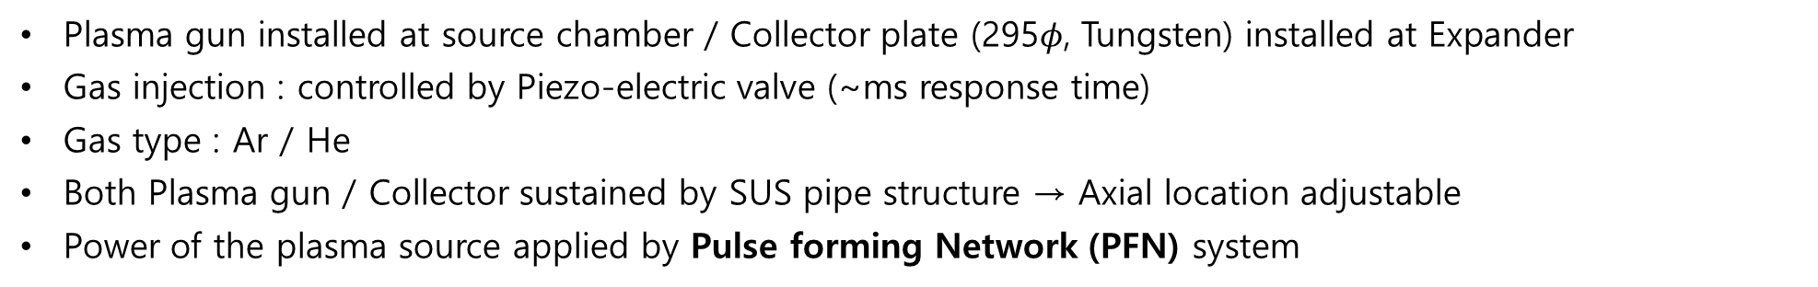
Design of the pulsed plasma system
Plasma source / Collector
Source chamber
Center
chamber
Expander
Gas line
Piezo-electric
valve
Cathode
Plasma
Plasma gun
Cath-anode
Collector
PFN
4kΩ
Plasma gun installed at source chamber / Collector plate (295$φ$, Tungsten) installed at Expander
Gas injection : controlled by Piezo-electric valve (~ms response time)
Gas type : Ar / He
Both Plasma gun / Collector sustained by SUS pipe structure → Axial location adjustable
Power of the plasma source applied by Pulse forming Network (PFN) system

Slide 10


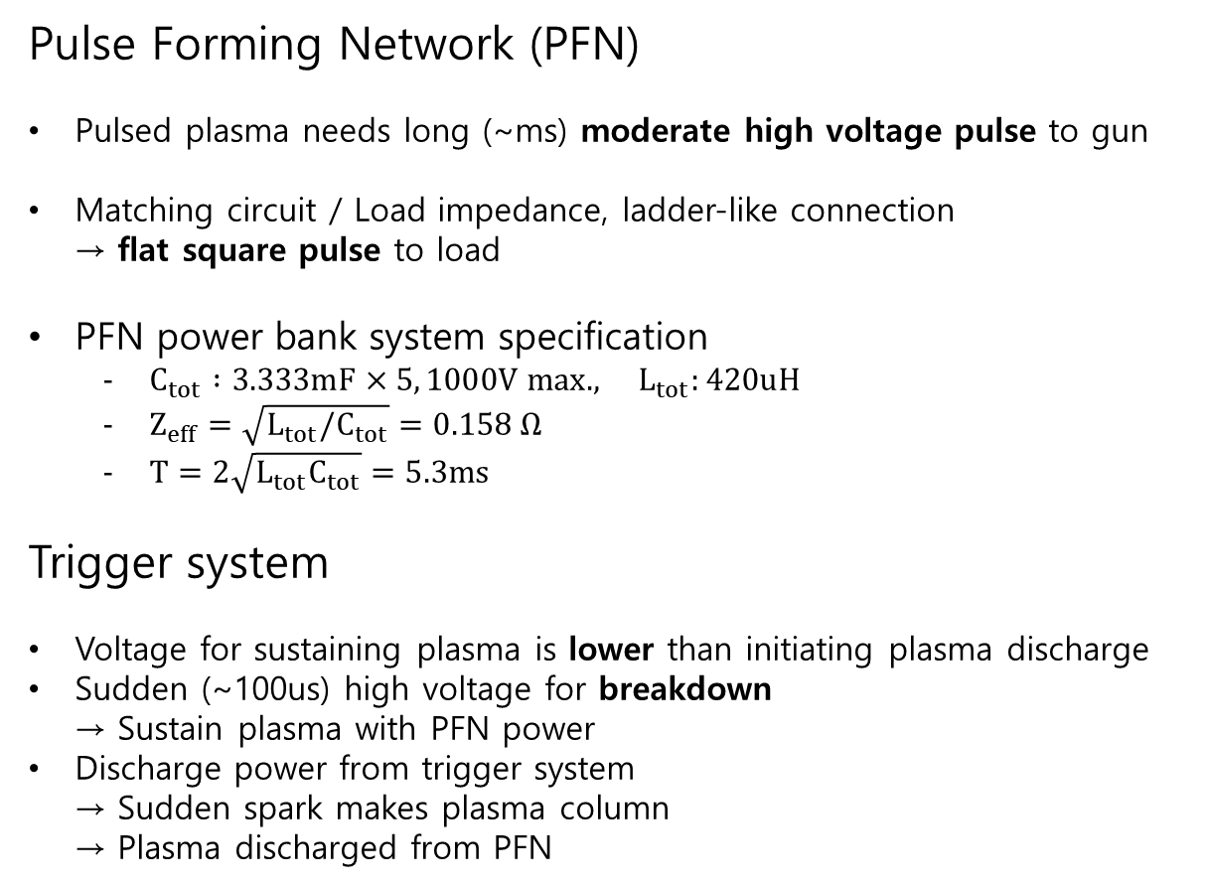
Design of the pulsed plasma system
PFN power system
Trigger
$$I_{Gun}$$
Pulse Forming Network (PFN)
Pulsed plasma needs long (~ms) moderate high voltage pulse to gun
Matching circuit / Load impedance, ladder-like connection
→ flat square pulse to load
PFN power bank system specification
  $C_{tot} :3.333mF×5, 1000V max., L_{tot}:420uH$
  $Z_{eff}=\sqrt{L_{tot}/C_{tot}}=0.158 Ω$
  $T=2\sqrt{L_{tot}C_{tot}}=5.3ms$
Trigger system
Voltage for sustaining plasma is lower than initiating plasma discharge
Sudden (~100us) high voltage for breakdown
→ Sustain plasma with PFN power
Discharge power from trigger system
→ Sudden spark makes plasma column
→ Plasma discharged from PFN
Cathode
$$V_{Gun}$$
PFN
Cath-anode
Collector
PFN V / I simulation results
Notes:
R_load : 0.25 Ohm

Slide 11

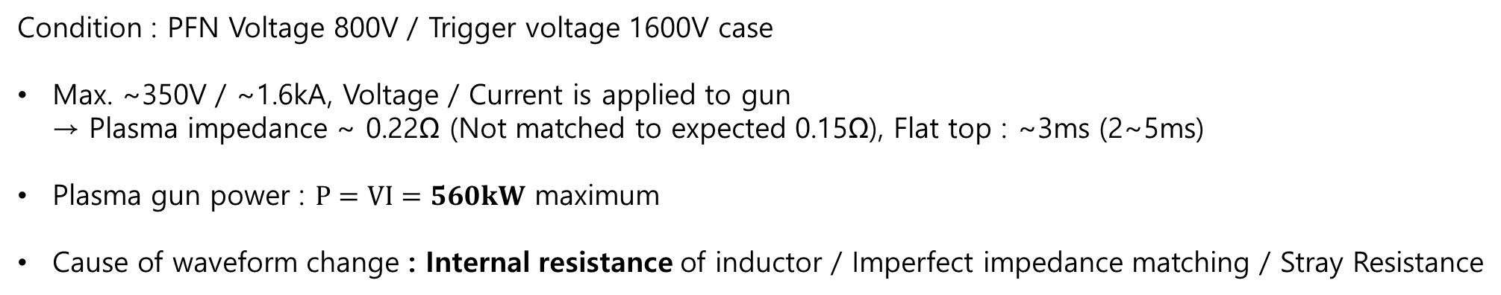


Initial plasma operation test
PFN power system
$$I_{Gun}$$
Flat top
Cathode
$$V_{Gun}$$
PFN
Cath-anode
R
Collector
PFN –Plasma gun circuit schematics
Time evolution of Gun Voltage / Current
Gun current simulation considering $R_{inductor}$
Condition : PFN Voltage 800V / Trigger voltage 1600V case
Max. ~350V / ~1.6kA, Voltage / Current is applied to gun
→ Plasma impedance ~ 0.22Ω (Not matched to expected 0.15Ω), Flat top : ~3ms (2~5ms)
Plasma gun power : $P=VI=560kW$ maximum
Cause of waveform change : Internal resistance of inductor / Imperfect impedance matching / Stray Resistance

Slide 12
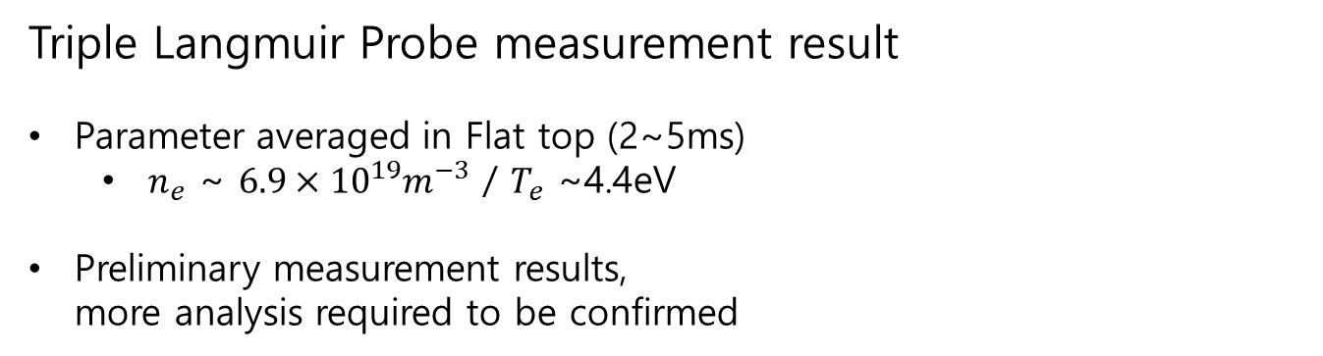
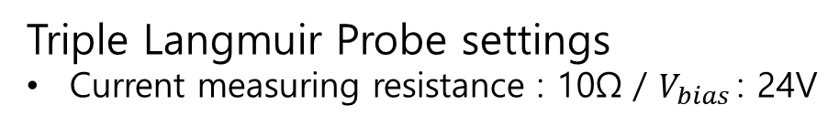
Initial plasma operation test
TLP measurement
Conditions
Magnetic field : (mirror region : 0.4T / center region : 0.078T)
TLP location : center chamber (-10cm from the center)
PFN : 800V / Trigger : 1600V
Base pressure ~3×10⁻⁷ Torr / Operating pressure ~ 1mTorr
Gas : Argon
Triple Langmuir Probe settings
Current measuring resistance : 10Ω / $V_{bias}$: 24V
Triple Langmuir Probe measurement result
Parameter averaged in Flat top (2~5ms)
  $n_{e}$ ~ $6.9×{10}^{19}m^{−3}$ / $T_{e}$ ~4.4eV
Preliminary measurement results,
more analysis required to be confirmed
Flat top

Slide 13
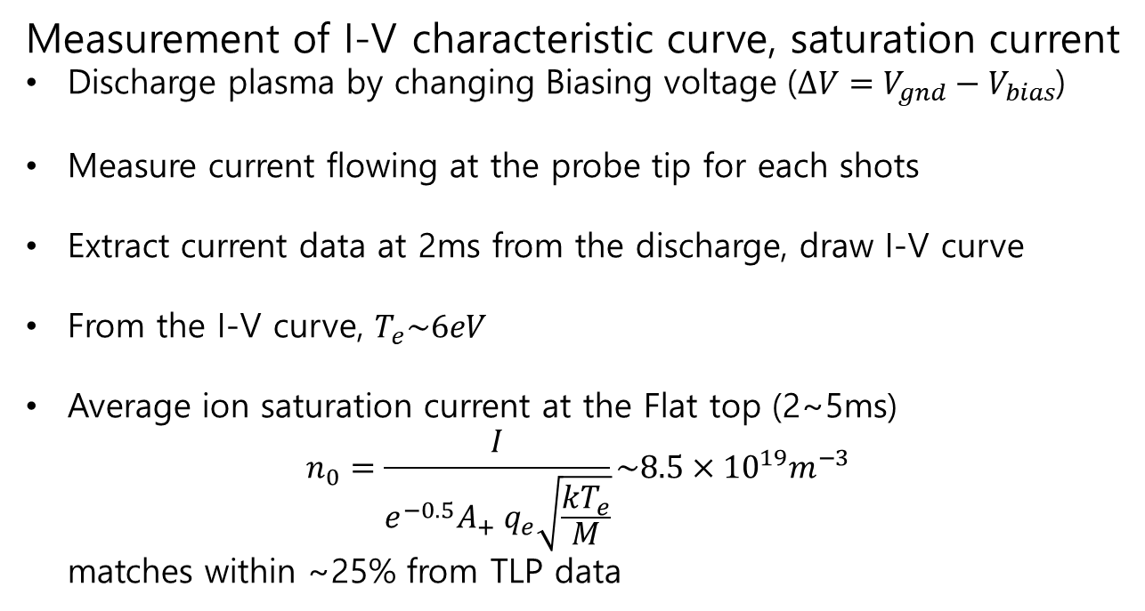
Initial plasma operation test
I-V curve / Ion saturation current measurement
Conditions
Magnetic field : (mirror region : 0.4T / center region : 0.078T)
TLP location : center chamber (-10cm from the center)
PFN : 800V / Trigger : 1600V
Base pressure ~3×10⁻⁷ Torr / Operating pressure ~ 1mTorr
Gas : Argon
Measurement of I-V characteristic curve, saturation current
Discharge plasma by changing Biasing voltage ($ΔV=V_{gnd}−V_{bias}$)
Measure current flowing at the probe tip for each shots
Extract current data at 2ms from the discharge, draw I-V curve
From the I-V curve, $T_{e}\sim 6eV$
Average ion saturation current at the Flat top (2~5ms)
$n_{0}=\frac{I}{e^{−0.5}A_{+} q_{e}\sqrt{\frac{kT_{e}}{M}}}\sim 8.5×{10}^{19}m^{−3}$
matches within ~25% from TLP data
Flat top

Slide 14
Summary / Future work
Summary
New pulsed linear magnetic mirror plasma device is constructed in KAIST
Research interests : Basic mirror plasma physics and fusion / industrial application
B field : center region 0.04~0.08T / mirror region 0.2~0.4T / Mirror ratio : 2.5 ~ 10
Plasma source : Arc plasma gun, ~350V / 1.6kA in initial experiments
Initial plasma parameter measurement : n_{e}~6.9×10¹⁹m⁻³ / T_{e}~4.4eV (by TLP)

Slide 15
Summary / Future work
Future work
  Diagnose plasma characteristics from experiments of diverse condition
    Check reproducibility of the experiments by repeating same shots in many different timing
    Measure plasma parameter by changing location of Plasma gun and Collector
    Conduct electrode biasing in Collector and analyze the effect to the plasma parameter
    Measure plasma characteristics by changing PFN / Trigger voltage
    Study plasma parameter by changing magnetic field geometry configuration
  Improvement of KAIMIR plasma diagnostics
    Microwave interferometry – plasma line-integrated density
    OES measurement – Plasma radiation spectrum
    Diamagnetic loop – Plasma internal energy
    Probe measurement - Modification of physical model / data processing

Slide 16
Thank you

Slide 17
Backup slide
Magnetic coil specification
Mirror coil
Coil resistance : 1.026Ω / Inductance : 43.07mH / Number of turns : 360
Coil diameter: 278mm / weight : 15.1kg
Install location : ±730mm / ±645mm (From center)
L/R time (risetime) : 42ms
Solenoid coil
Coil resistance : 0.746Ω / Inductance 15mH / Number of turns : 120
Coil diameter : 620mm / weight : 10.9kg
Install location : ±388mm / ±138mm (From center)
L/R time (risetime) : 20ms

Slide 18
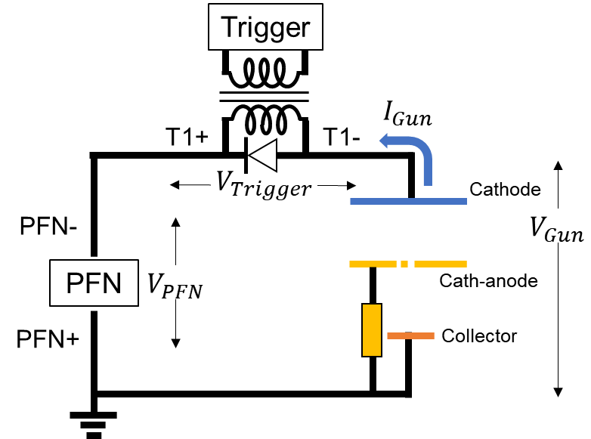
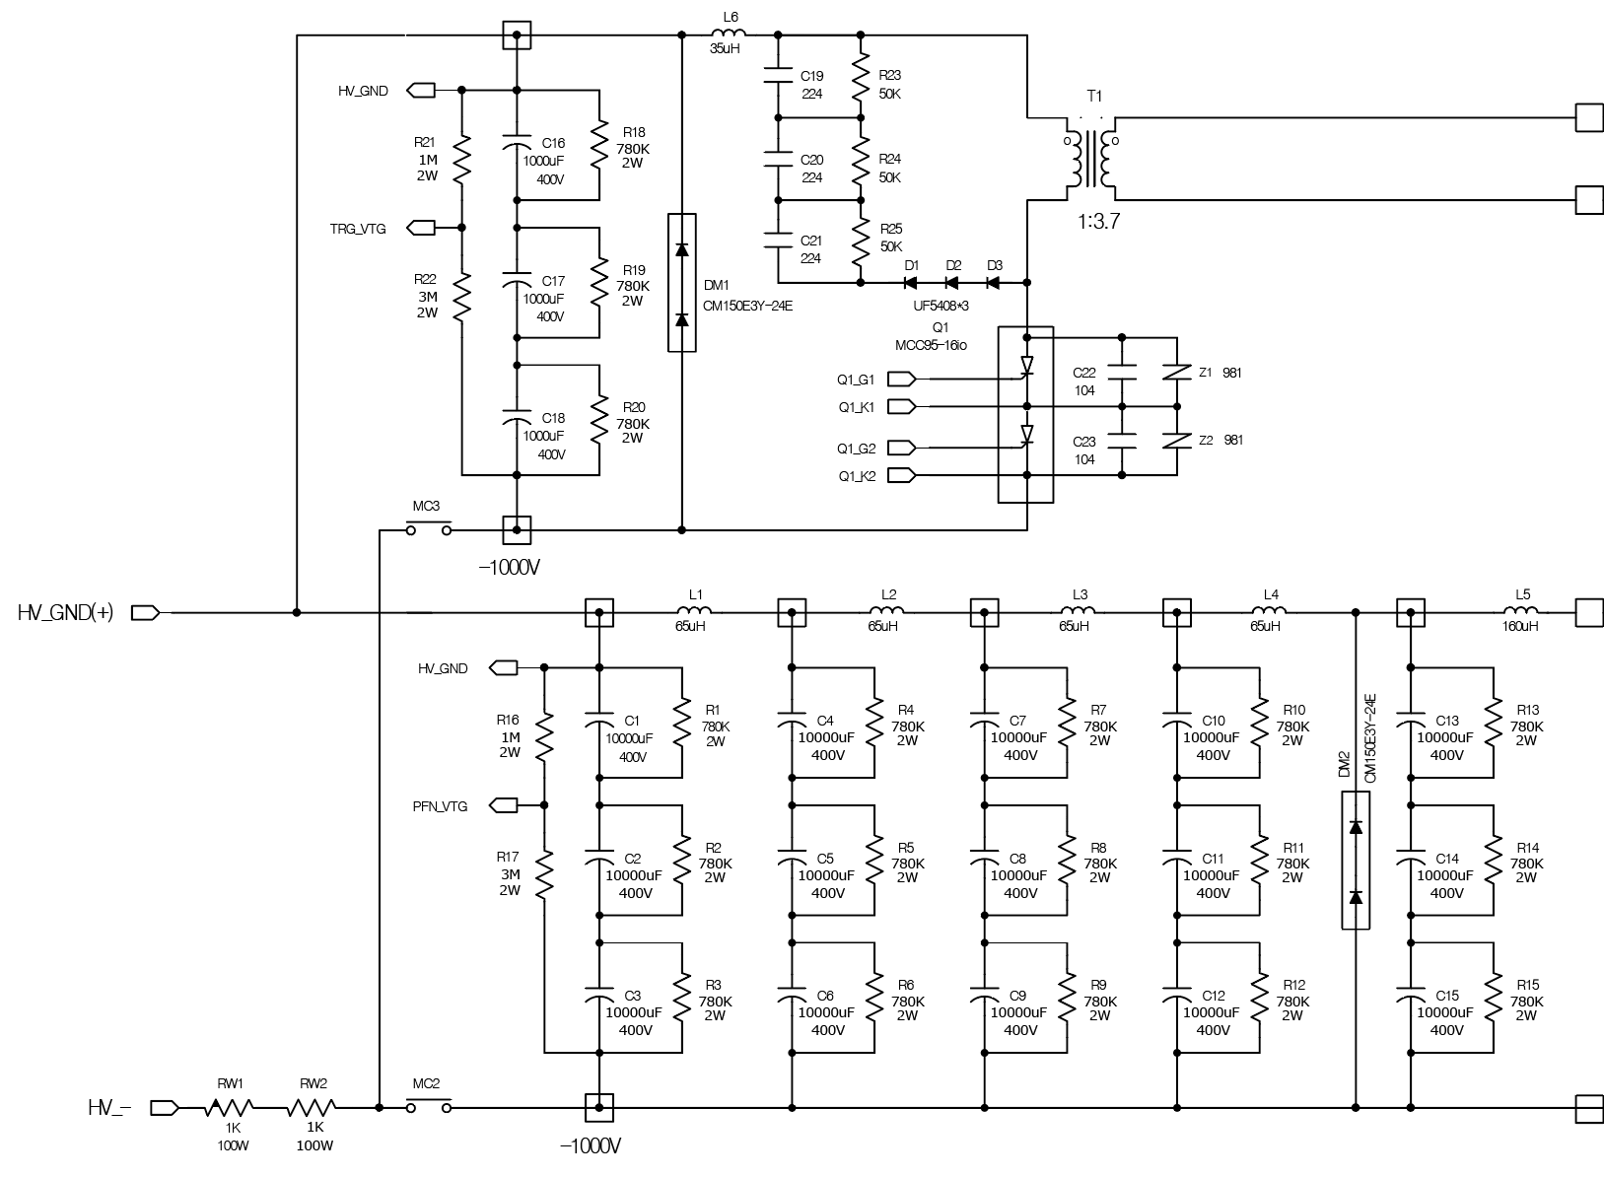
Backup slide
PFN power system
Sparker system
T1+
T1-
PFN system
PFN+
PFN-
PFN power system circuit schematics

Slide 19
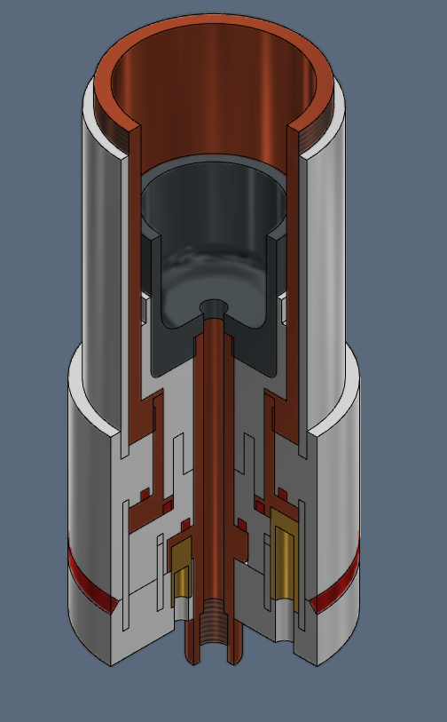
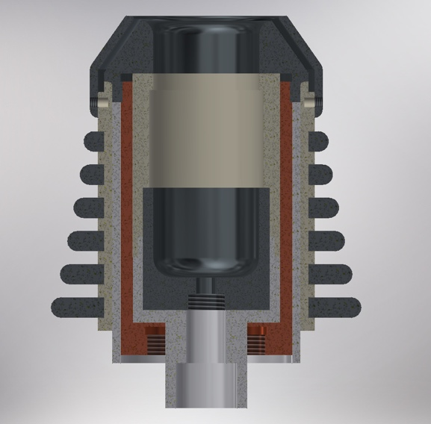
Backup slide
CAD model of Plasma gun

Slide 20
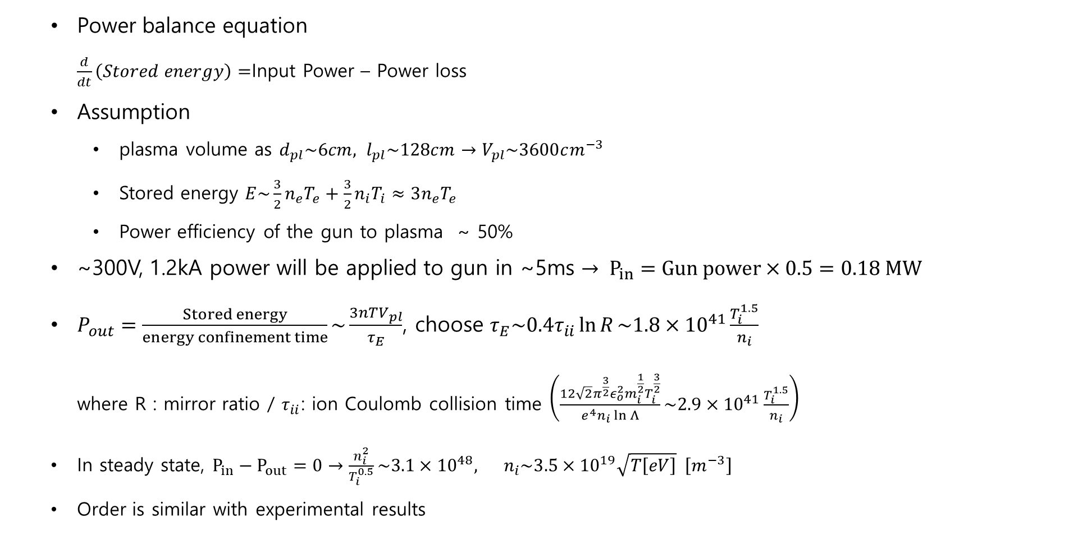
Backup slide
Power balance analysis
  Power balance equation
  $\frac{d}{dt}\left(Stored energy\right)=$Input Power – Power loss
  Assumption
    plasma volume as $d_{pl}\sim 6cm, l_{pl}\sim 128cm→V_{pl}\sim 3600cm^{−3}$
    Stored energy $E\sim \frac{3}{2}n_{e}T_{e}+\frac{3}{2}n_{i}T_{i}≈3n_{e}T_{e}$
    Power efficiency of the gun to plasma ~ 50%
  ~300V, 1.2kA power will be applied to gun in ~5ms $→ P_{in}=Gun power×0.5=0.18 MW$
  $P_{out}=\frac{Stored energy}{energy confinement time}\sim \frac{3nTV_{pl}}{τ_{E}}$, choose $τ_{E}\sim 0.4τ_{ii}\ln{R}\sim 1.8×{10}^{41}\frac{T_{i}^{1.5}}{n_{i}}$
  where R : mirror ratio / $τ_{ii}$: ion Coulomb collision time $\left(\frac{12\sqrt{2}π^{\frac{3}{2}}ε_{o}^{2}m_{i}^{\frac{1}{2}}T_{i}^{\frac{3}{2}}}{e^{4}n_{i}\ln{Λ}}\sim 2.9×{10}^{41}\frac{T_{i}^{1.5}}{n_{i}}\right)$
  In steady state, $P_{in}−P_{out}=0→\frac{n_{i}^{2}}{T_{i}^{0.5}}\sim 3.1×{10}^{48}, n_{i}\sim 3.5×{10}^{19}\sqrt{T\left[eV\right]} \left[m^{−3}\right]$
  Order is similar with experimental results

Slide 21






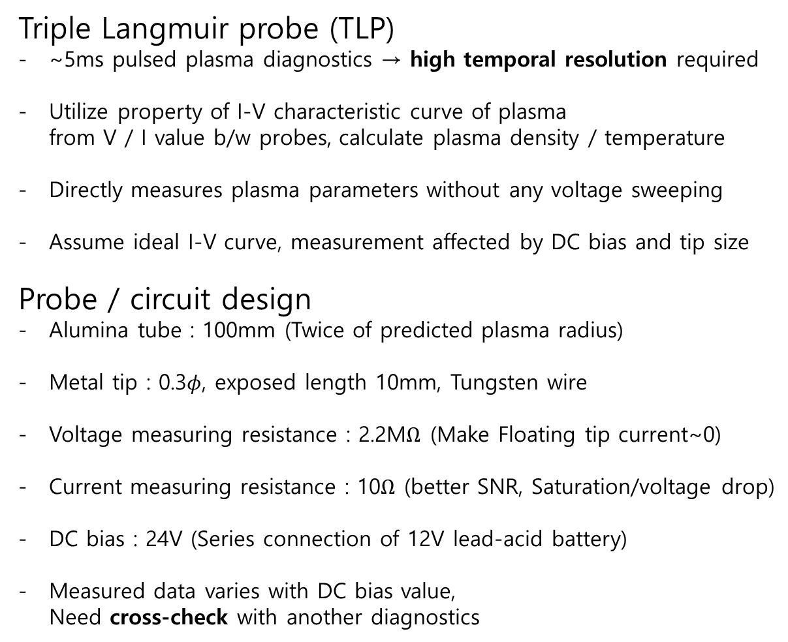


Backup slide
Triple Langmuir probe design
Triple Langmuir probe (TLP)
~5ms pulsed plasma diagnostics → high temporal resolution required
Utilize property of I-V characteristic curve of plasma
from V / I value b/w probes, calculate plasma density / temperature
Directly measures plasma parameters without any voltage sweeping
Assume ideal I-V curve, measurement affected by DC bias and tip size
Probe / circuit design
Alumina tube : 100mm (Twice of predicted plasma radius)
Metal tip : 0.3$φ$, exposed length 10mm, Tungsten wire
Voltage measuring resistance : 2.2M$Ω$ (Make Floating tip current~0)
Current measuring resistance : 10$Ω$ (better SNR, Saturation/voltage drop)
DC bias : 24V (Series connection of 12V lead-acid battery)
Measured data varies with DC bias value,
Need cross-check with another diagnostics
TLP Structure
10mm
100mm
200mm
DAQ
$$V_{sig}$$
Control box
$$I_{sig}$$
Circuit diagram
Isolation amplifier
$$V_{f}$$
$$V_{sig}$$
2.2M$Ω$
$$V_{+}$$
DC bias (24V)
$$I_{sig}$$
10$Ω$ (Gain)
$$V_{−}$$
Tungsten tip
Triple Langmuir probe structure / circuit schematics

Slide 22
Backup slide
Operation procedure / timing
KAIMIR Nominal Operation procedure / timing settings
Time line
Base pressure ~3×10⁻⁷ Torr / Coil, PFN power bank charged
B field generation
IGBT module of the coil is triggered
-200ms ~ 100ms
for both coil
-200ms
Gas injection
Plasma
Discharge
Piezo-electric valve is triggered
→ Operating pressure ~1mTorr
-100ms ~ -50ms
0ms
IGBT module of the PFN is triggered
0ms ~ 5ms
200ms
Plasma is discharged from the PFN power

