Slide 1




www.kaeri.re.kr
Preliminary Study for Oxidative Decladding
of Simulated Damaged Spent Fuel
Held in Vertical Position
2022.05.19
Ju Ho Lee, Sun Seok Hong, Jae-Won Lee,
Yung-Zun Cho and Jong Kwang Lee
Korea Atomic Energy Research Institute

Slide 2
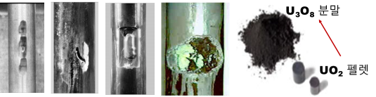
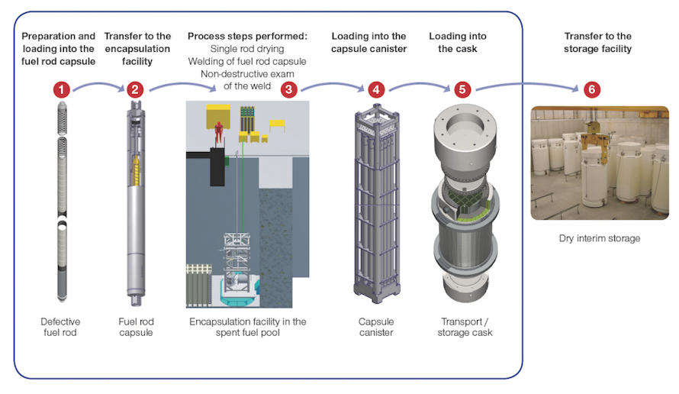
Stabilization of damaged used nuclear fuel
Damaged Spent Nuclear Fuel(SNF)
No internationally accepted definition of “damaged fuel”
Any SNF that requires non-standard handling to demonstrate compliance with applicable safety, regulatory or operation requirements* (Fuel with cladding defects greater than hairline cracks or pinholes, in USA)
Pinholes, hairline cracks, through-wall cracks, debris
Handling Technology for Damaged SNF
Repackaging technology(Encapsulation/Canning) mainly being considered for effective treatment for damaged SNF
However, in long-term storage and final disposal of damaged SNF, potential risk due to moisture not completely removed in repackaging technology
➔ Recycling technology as Ultimate solution for
Damaged SNF management
*Management of Damaged Spent Nuclear Fuel, IAEA Nuclear Energy Series
< ORANO technology>

Slide 3
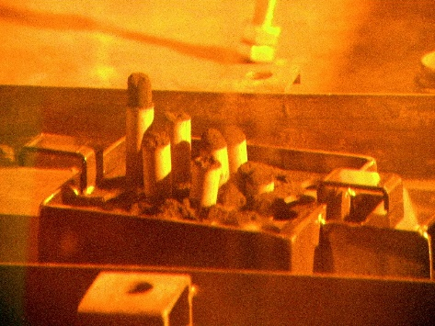
Concepts of stabilizing technology
Safeguards
Recovering fuels
as U₃O₈ powder
from damaged SNF
Fabrication of the stabilized pellet
Fabrication of stabilized fuel rod
Management
of stabilized fuel rod
Improvements
of U₃O₈ powder
Key 1 process
Key 2 process
Key 3 process
Milling or
Oxidation-Reduction Cycles
Compaction
Sintering

Slide 4
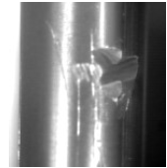
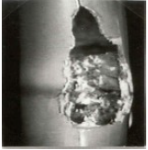
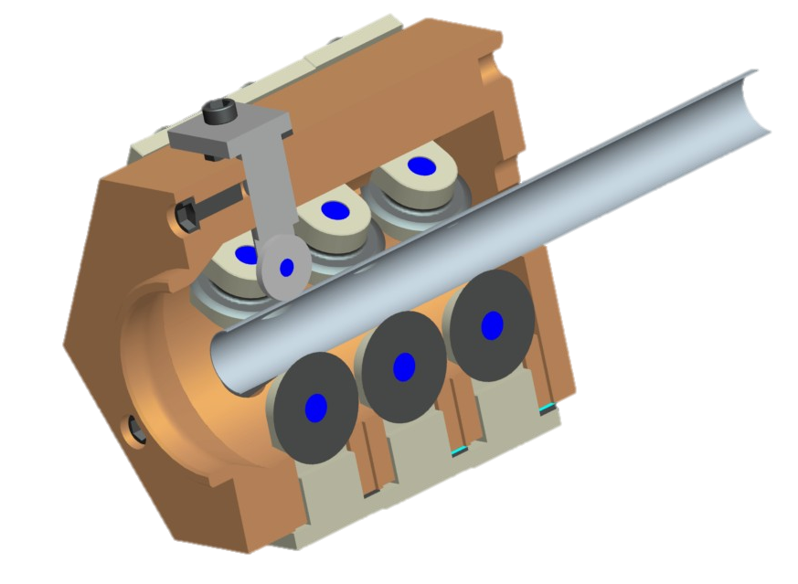
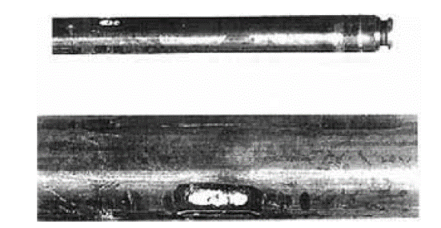
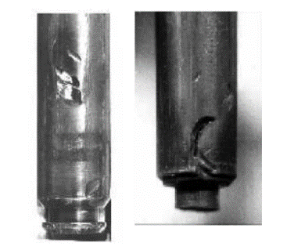

Suitable decladding method to Damaged SNF
Mechanical Decladding
Mechanically separation of pellet and cladding by passing rod-cut through slitting module
Not applicable to Damaged SNF due to defect and flaws in cladding
X
< 누출연료봉 >
< 손상연료봉 >
Oxidative Decladding
Separation of pellet and cladding by volume expansion effect of UO₂ oxidation leading to U₃O₈ pulverization
Not affected by defect and flaws in cladding of damaged SNF
< 지지격자-연료봉 프레팅 >
< 이물질 프레팅 >

Slide 5
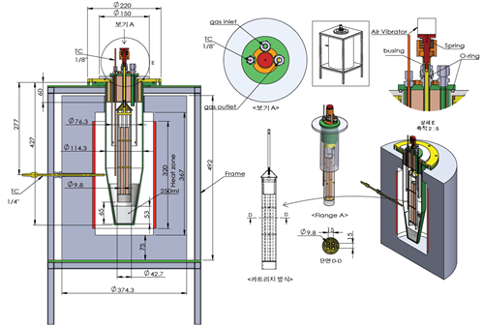
Motivation
Preliminary study for Derivation of Oxidation condition for KAERI Oxidative Decladding equipment
Feasibility Study of oxidative decladding for 20 cm rod
Evaluation of the time required for completely oxidation for 20 cm
Optimal Condition for reduced oxidation time
20 cm
Vertical
vibration
U₃O₈
powders
Oxidant
< Schematic drawing of KAERI
oxidative decaldding equipment>
< Decladding Concept >
0.8 cm

Slide 6
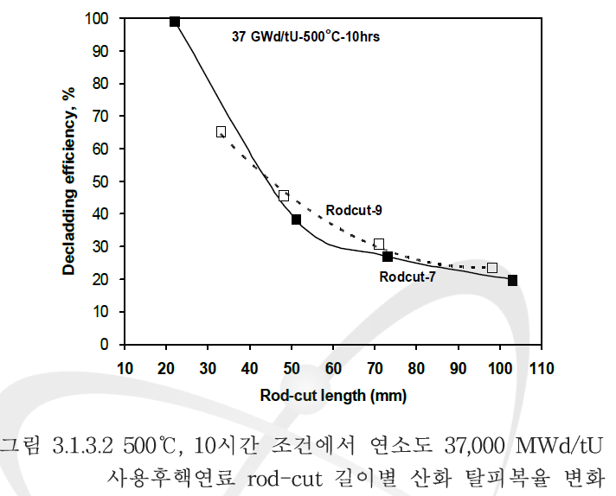
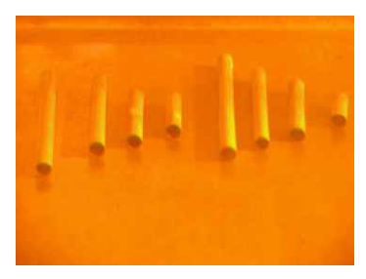
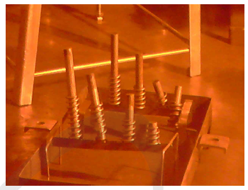
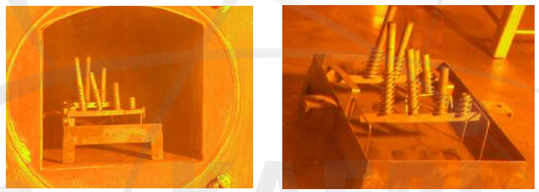
Previous study of KAERI (I)
Vertical Oxidative Decladding Experiment for SF rod-cut at 2009
Decreased decladding efficiency for high-burnup rod-cut
No complete decladding for rodcut of length higher than 30 mm
Jeong-Won Lee, KAERI/RR-3131/2009
0.8 cm

Slide 7
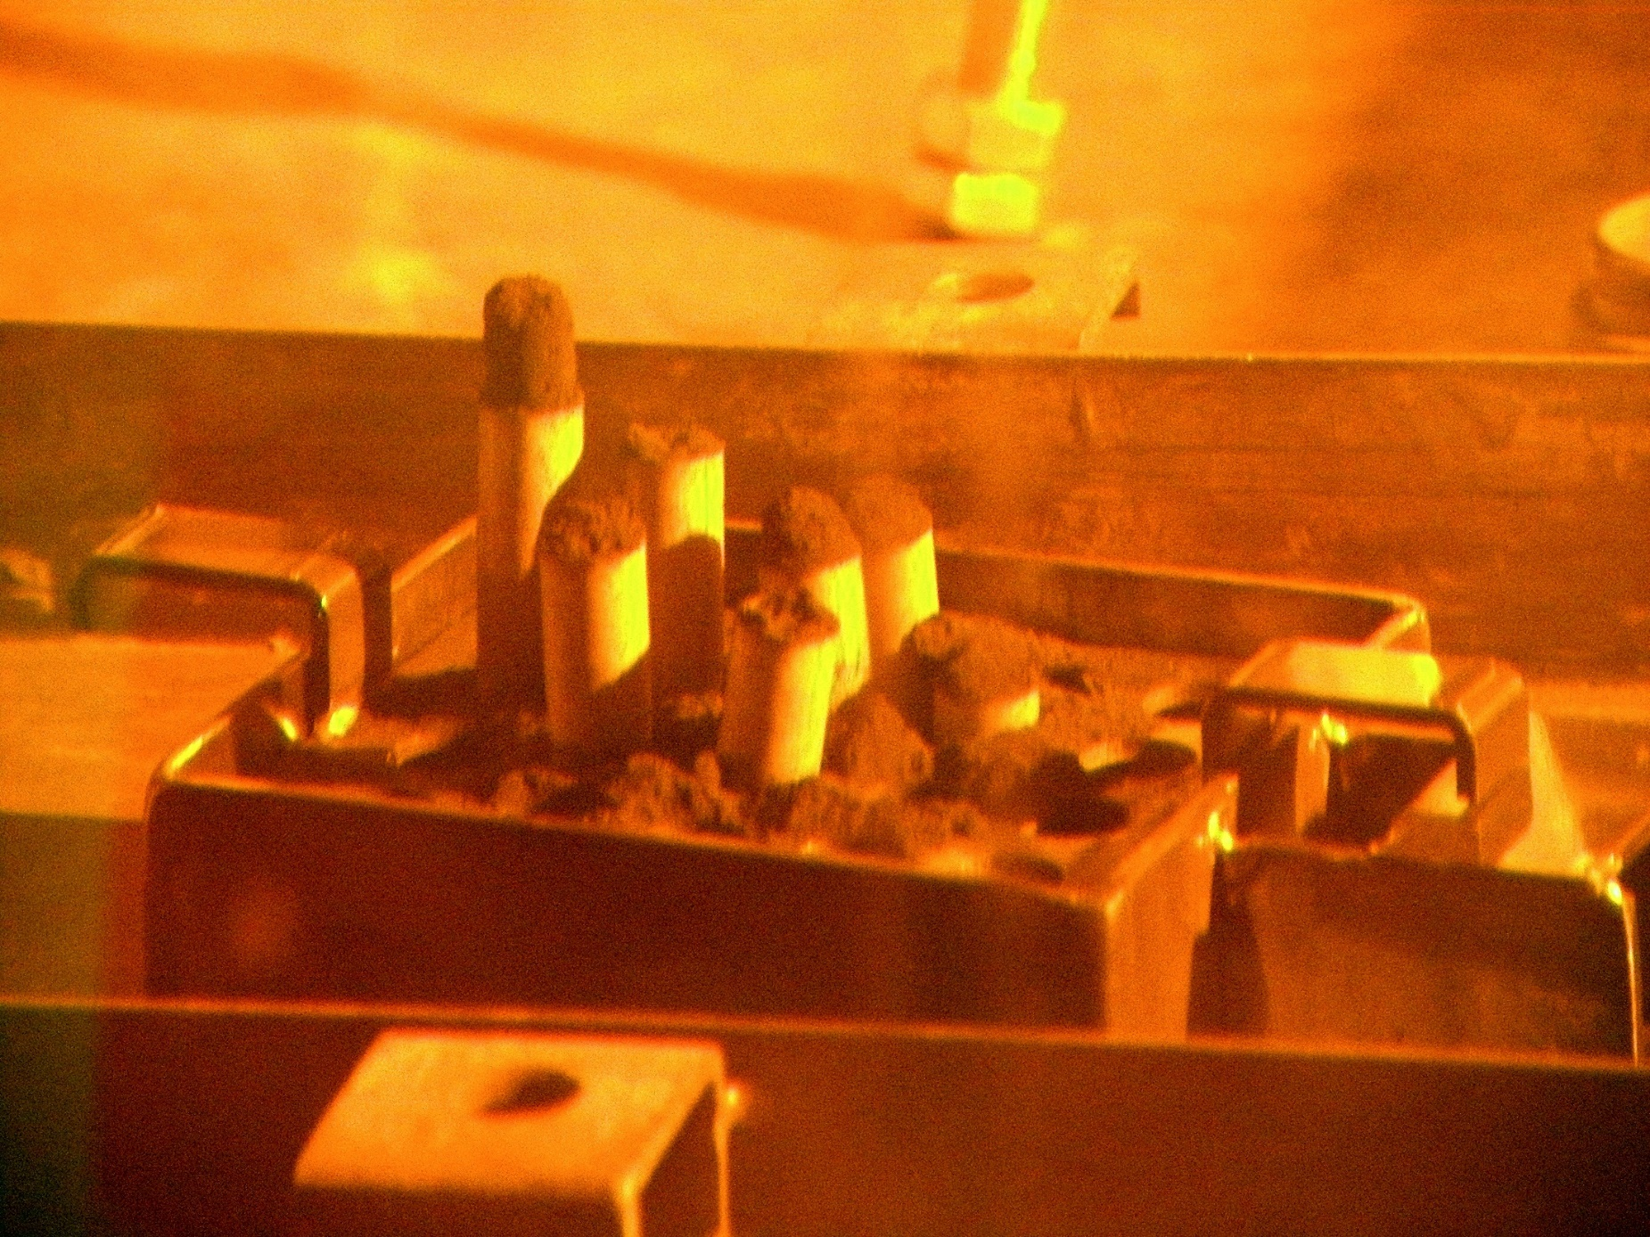
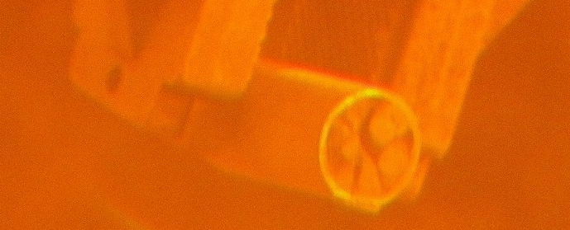
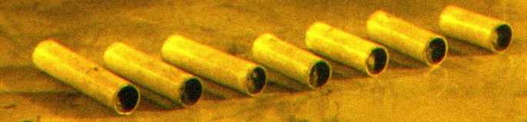
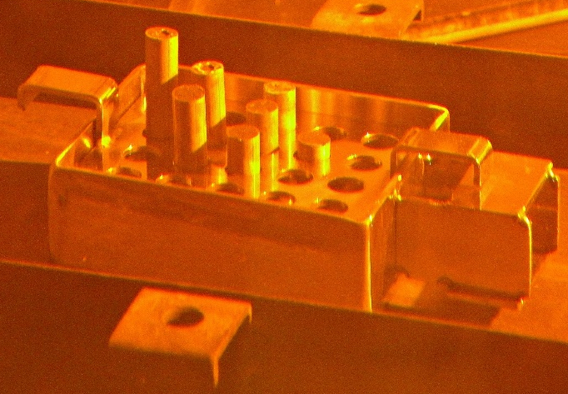
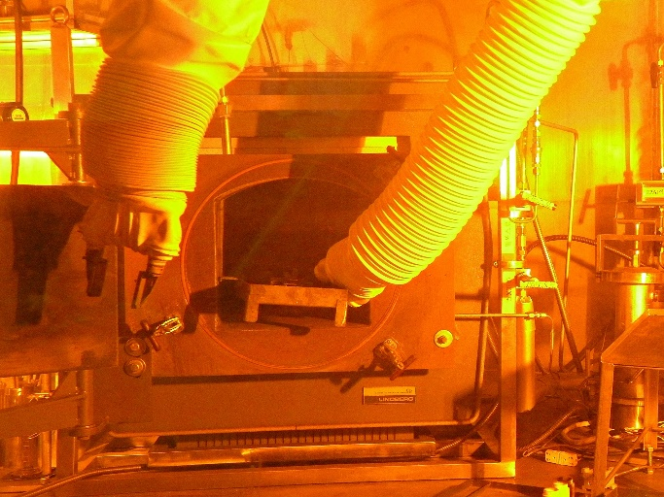
Previous study of KAERI (II)
Vertical Oxidative Decladding Experiment for SF rod-cut at 2014
Powders released from upper part of rod-cut
0.8 cm

Slide 8
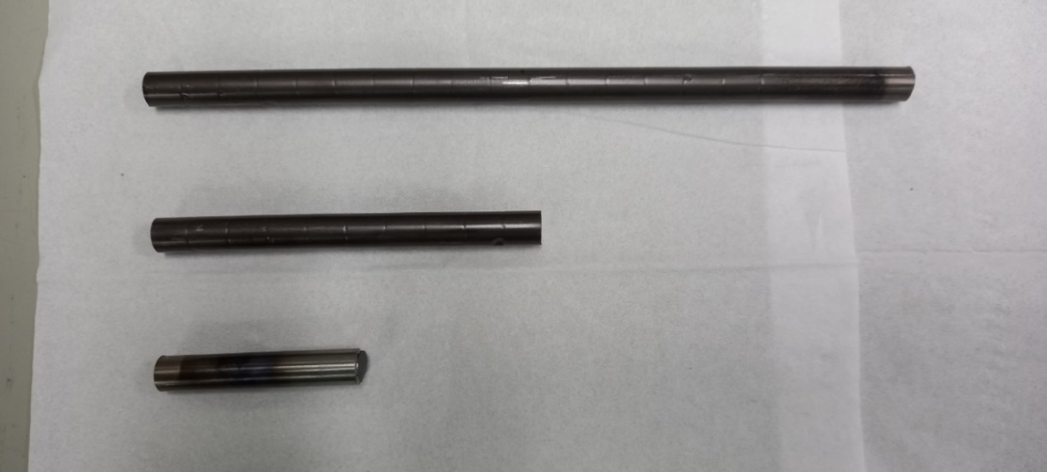
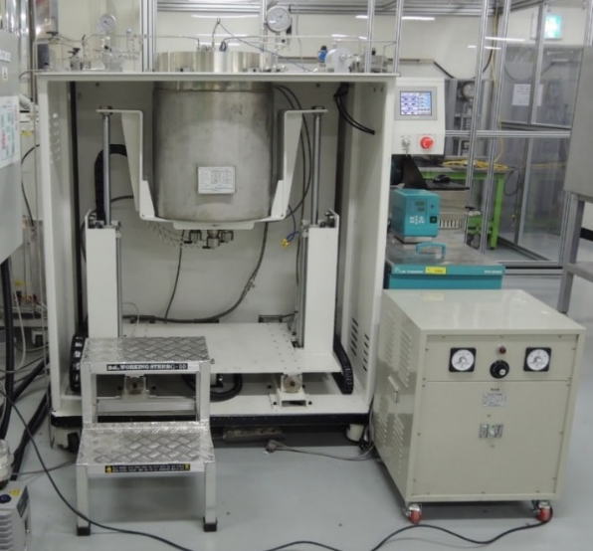
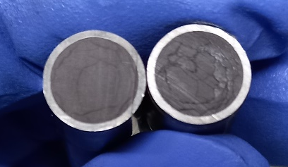
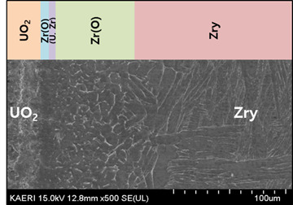
Preparation of simulated Damaged Fuel Rod
Ar
Ar
<Equipment for fabricating simulated spent-fuel rod >
<Simulated SNF of different sizes>
<Cross-section of simulated SNF>
<Chemical bonding between UO₂ and cladding>
Ar
Heat
HIP(Hot Isostatic Pressing) based equipment
Thermal treatment under argon atmosphere at 1000ºC and 70 bar during 30 min

Slide 9
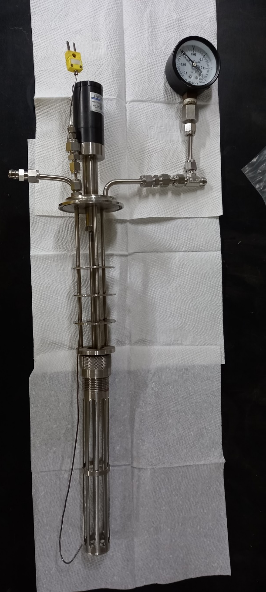
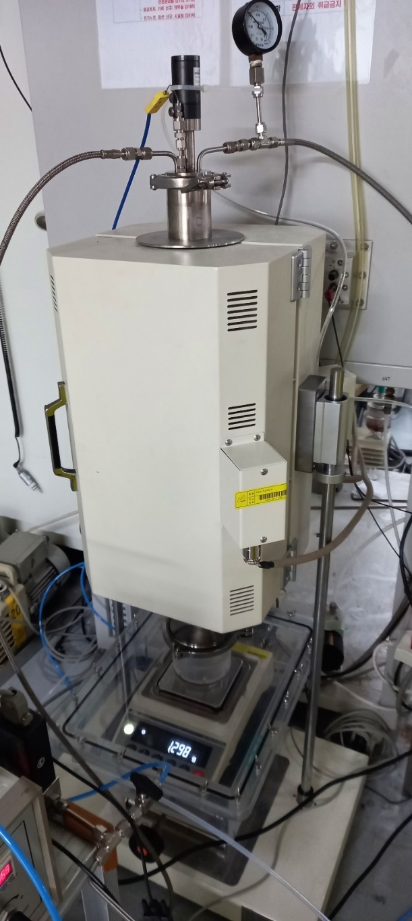
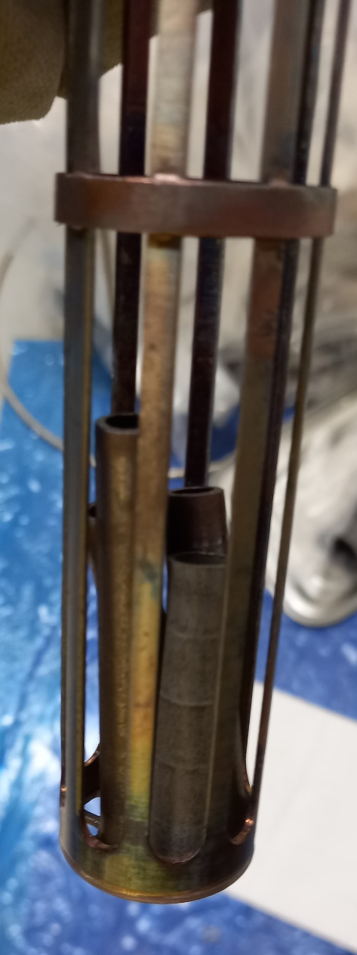
Lab-Scale Equipments for oxidative decladding
Air vibrator
Heater
저울
Balance
Weighing balance at bottom
➔ Evaluation of Real-time Oxidation behavior

Slide 10
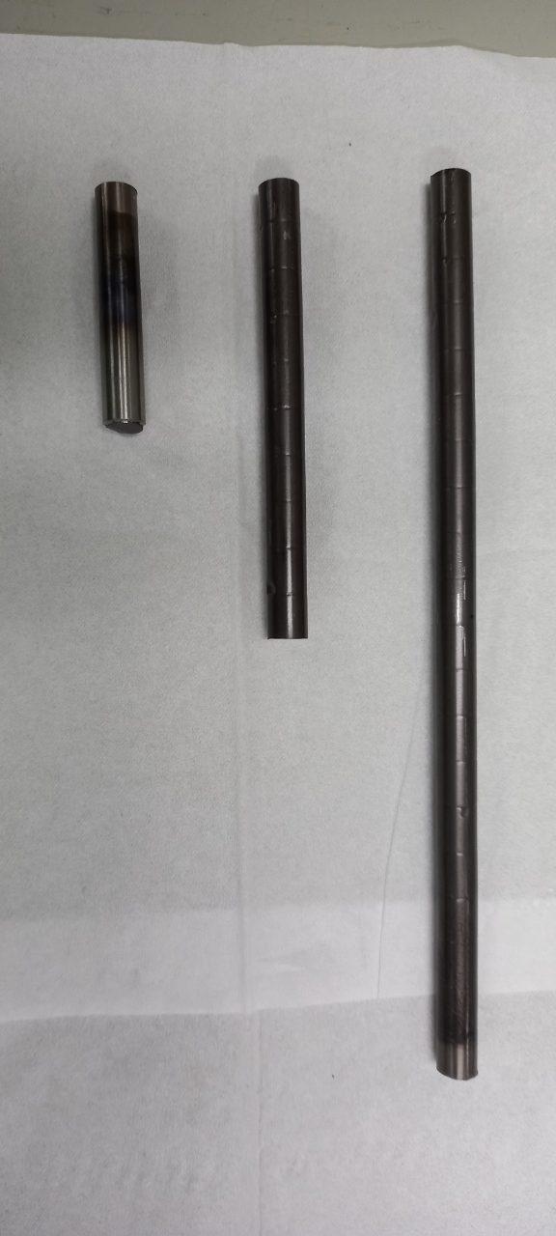
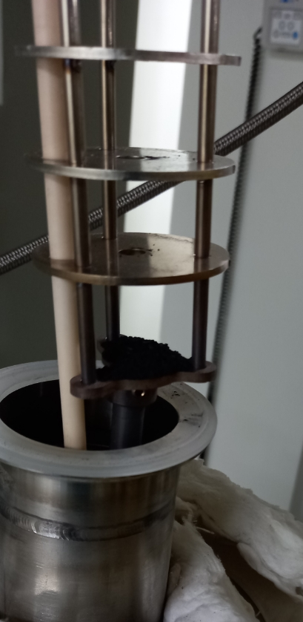
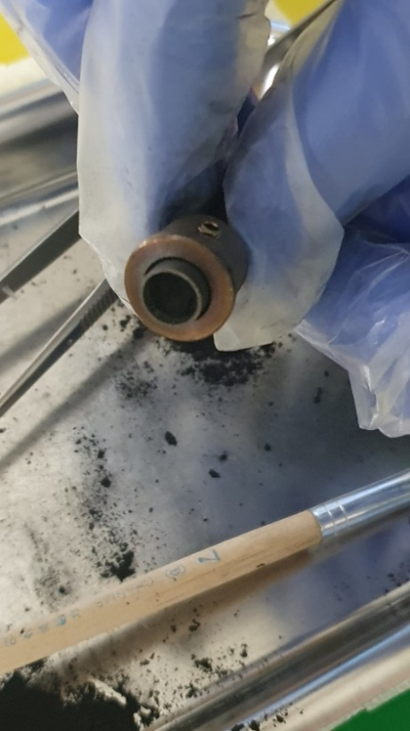
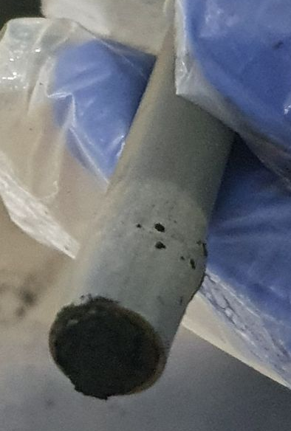
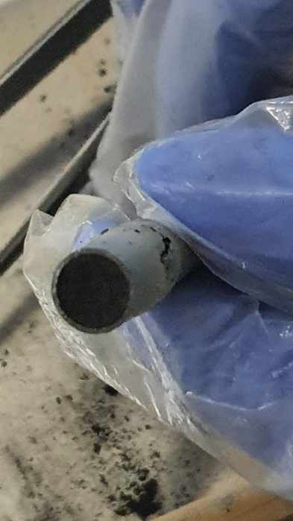
Test # 1 : Oxidation of 10 cm Rodcut (Ar → 100% O₂, 520ºC)
Evaluation of Gas Change Effect on Oxidative Decladding
Thermal treatment under argon atmosphere at 1000ºC and 70 bar during 30 min
<Upper Side of Oxidized Rod-cut>
<Bottom Side of Oxidized Rod-cut>
Upper Side : Powderization observed
Bottom Side : Rupture in cladding ➔Resulted from Rapid oxidation rate
*ASME Boiler and Pressure Vessel Code – Section III Division 5, 2021

Slide 11
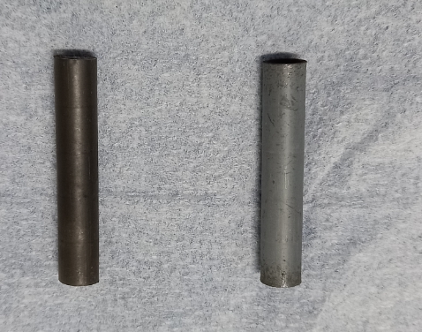
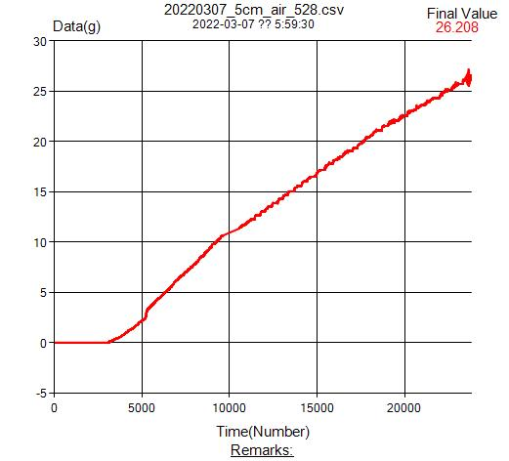
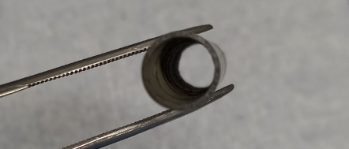
Test # 2 : Oxidation of 5 cm Rodcut (Air, 528ºC)
Before After
Oxidation Oxidation
It tooks 6 hours for completely decladding 5 cm rod-cut
Decladding rate of 0.072 g UO₂/min
*ASME Boiler and Pressure Vessel Code – Section III Division 5, 2021

Slide 12
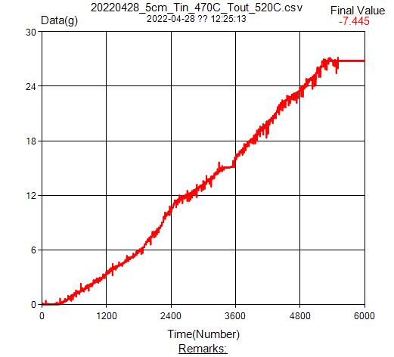
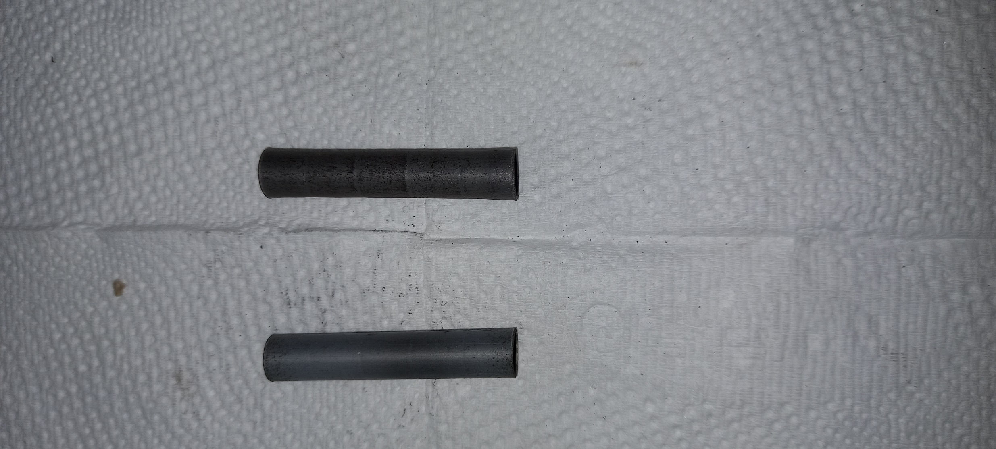
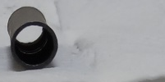
Test # 3 : Oxidation of 5 cm Rodcut (100 % O₂ , 475 ºC)
After Air After O₂
Oxidation Oxidation
100 minutes oxidation time for completely decladding 5cm rod-cut
Compared to air oxidation, 70 % in oxidation
time reduced

Slide 13
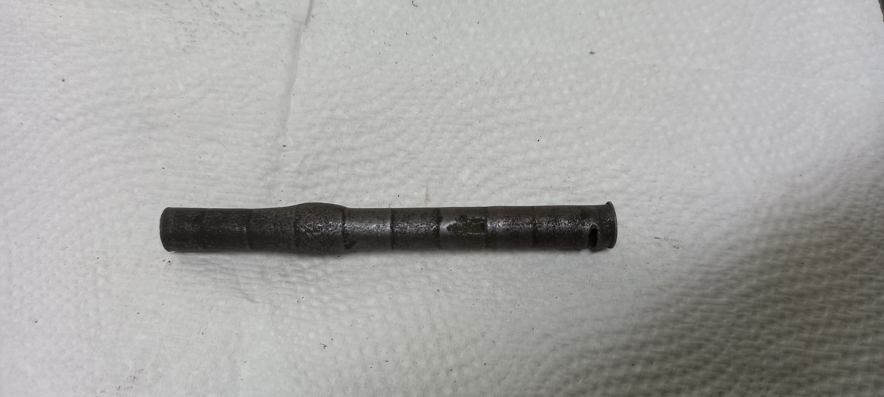
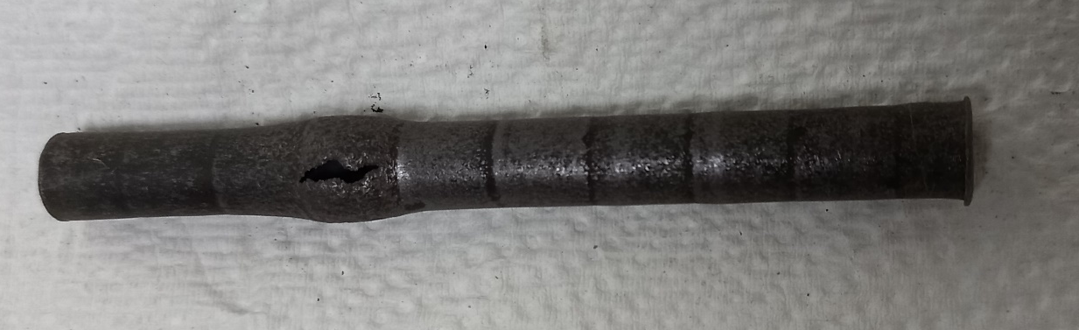

Test # 4 : Oxidation of 10 cm Rodcut (100% O₂, 475 ºC)
Incomplete Decladding (89%)
Rupture in cladding dut to volume expansion
`
`
2 cm
6 cm

Slide 14
Optimal Oxidative Decladding Condition
For complete decladding of 20-cm rodcut, Rupture in cladding should be avoided
Decladding rate (or Oxidation rate) should be adjusted
100% O₂ gas is not favored in oxidative decladding
Oxygen Content
Higher Oxidation Rate
Rupture in Cladding
Intermediate Oxidation Rate
leading to no Rupture
Temperature(ºC)

Slide 15
Concept for oxidative decladding equipment for HFEF
Oxidative Decladding mode
Reduction-Oxidation mode
Air vibrator # 1
Air vibrator # 1
Air vibrator # 1
Air or O₂
4% H₂/Ar
Heater
U₃O₈ powder
UO₂ powder
Air vibrator # 2
Air vibrator # 2
Air vibrator # 2

Slide 16
Conclusion
Higher Oxygen content and high temperature results in increased decladding rate, however, volume expansion in cladding was also observed due to either rapid oxygen penetration or increased local temperature associated with exothermic reaction of UO₂ with oxygen
For complete decladding, rapid volume expansion in cladding should be avoided and thus oxygen content less than 100% is recommended for optimal decladding condition (Temp around 500ºC and Oxygen content ranging from 20% to 80%)
Vibration effect was found to induce powder release from cladding : Vertical vibration more effective in powder release than Horizontal vibration

