Slide 1
Effective and Mean Temperatures of a Cylindrical CSBA Loaded Fuel Pellet
Reactor Physics & Transmutation Lab.
20th May 2022
Sunjoo Yoon and Yonghee Kim
Department of Nuclear and Quantum Engineering
Korea Advanced Institute of Science and Technology (KAIST)

Slide 2
Table of Contents
1. Introduction
2. Procedure
2.1 Fuel Pellet Design
2.2 Depletion Analyses
2.3 Multiphysics Analyses
2.4 Flat Temperature Analyses
3. Results and Analysis
3.1 Neutron Multiplication Factors
3.2 Temperature Distribution in Pellet
3.3 Processed Results
4. Conclusion

Slide 3
Introduction
Effective Temperature?
The effective temperature of a fuel cell is the temperature such that the fuel cell with its actual operating temperature distribution will have the same neutron multiplication factor (k-factor) as the same fuel cell with a flat temperature distribution in which the temperature is equal to the effective temperature at all points.
Research on methods to estimate the effective temperature of fuel cells have been ongoing for decades, since at least the early 1960s.
Centrally-Shielded Burnable Absorbers?
The Centrally Shielded Burnable Absorber, or CSBA, is a nuclear fuel design concept in which burnable absorbers, such as gadolinia, are placed within the fuel region of a conventional cylindrical fuel pellet in order to compensate for the decrease in reactivity with burnup and thereby reduce the need for soluble boron in the coolant.
Conventional methods of estimating the effective temperature, designed for conventional cylindrical fuel cells, may not be applicable to CSBA-loaded fuel cells!
Rahman et al., 2017

Slide 4
Procedure
The procedure of the investigation was as follows.
For the CSBA-loaded fuel pellet design being considered:
1. Burnup analysis → material composition of the pellet at MOC and BOC conditions
2. Multiphysics-coupled neutronics analyses → actual k-factor and temperature distribution
3. Flat temperature analyses → flat-temperature k-factor over a range of temperatures

Slide 5

Procedure – Fuel Pellet Design
Cylindrical CSBAs in a cylindrical fuel cell
CSBA pellets count 2
Radius, fuel region 0.40958 cm
Radius, cladding inner 0.41873 cm
Radius, cladding outer 0.47600 cm
Height, total 1.00000 cm
Radius, CSBA pellet 0.14000 cm
Height, CSBA pellet 0.12600 cm
Pin pitch 1.26230 cm
Thermal power 190.96 W

Slide 6
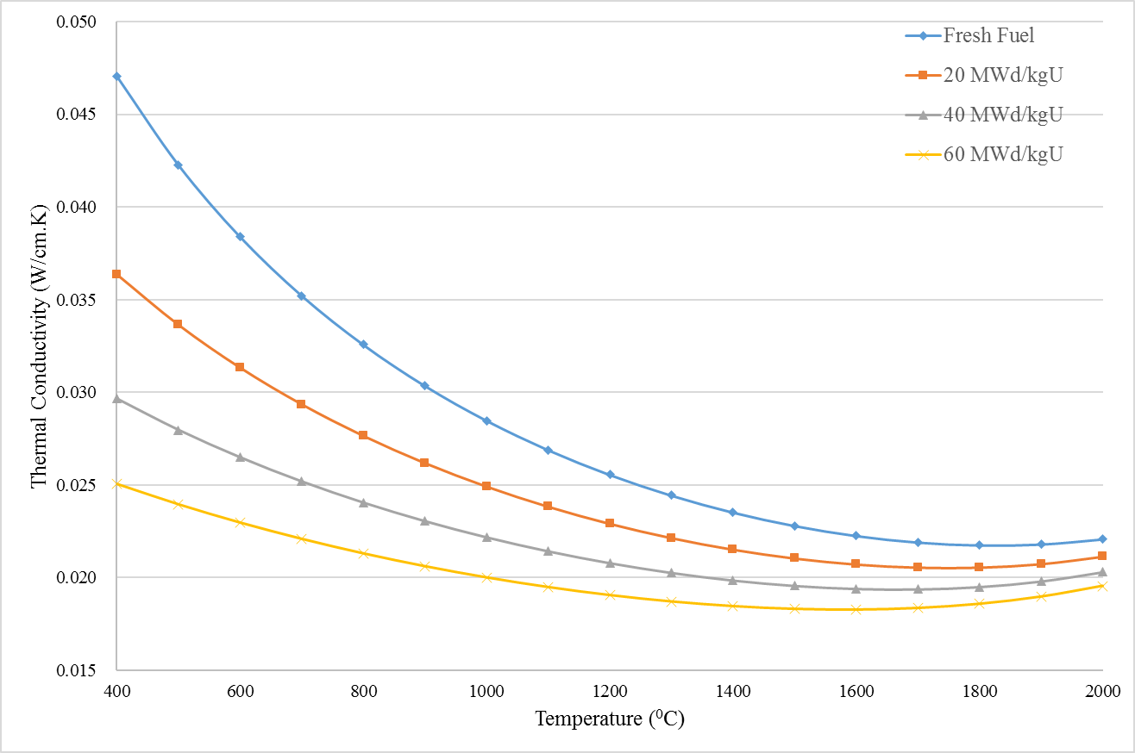

Procedure – Fuel Pellet Design
Some assumptions were made in modelling the properties of the pellet.
Neutronics cross-sections were evaluated from values tabulated 300K
The doppler resonance cross-section extrapolation module in the iMC code was used
Thermal conductivities of the fuel and cladding were adopted from Rahman et al.
$k_{fuel}=\frac{1}{0.1148+0.0035B+2.475×{10}^{−4}\left(1−0.00333B\right)T}0.0132exp\left(0.00188T\right)$
$k_{clad}=12.767−5.4348×{10}^{−4}T+8.9818×{10}^{−6}T^{2}$
(burnup in megawatt-days per kilogram uranium)
(temperature in degrees Celsius in the first equation and in Kelvin in the second)

Slide 7
Procedure – Depletion Analysis
Objective: determine the material composition of the fuel and CSBA regions at MOC and BOC conditions.
10 burnup steps, up to 50 MWd/kgU
6 burnup regions:
3 in the fuel region (radially divided)
3 in the CSBA region (inside outwards)
iMC Code
3D, mesh-based, stochastic analysis code
For each burnup step:
100 inactive and 300 active cycles
20,000 neutron histories

Slide 8
Procedure – Multiphysics Analyses
Objective: determine the actual k-value and temperature distribution of the fuel cell
Gmsh: Creating the tetrahedral mesh for the iMC analyses
3D mesh containing 39,090 tetrahedra
iMC Code
For each burnup condition (BOC, MOC, EOC),
3 iterations were conducted between the neutronics analysis and the thermal analysis
100 + 300 cycles with 50,000 neutron histories for the first two iterations
100 + 1,200 cycles with 100,000 neutron histories for the final iteration

Slide 9
Procedure – Flat Temperature Analyses
Objective: flat-temperature k-value of the fuel cell, at a range of different temperatures
Same mesh used in the multiphysics-coupled analyses
iMC Code
For each burnup condition:
Neutronics analyses were conducted, assuming a flat temperature distribution.
Since the temperature distribution is fixed, iteration is unnecessary.
Seven temperatures were tested, from 600 K to 1,200 K in 100 degree intervals.
100 + 1,200 cycles, 100,000 neutron histories
Second-degree polynomial interpolation was used to estimate the flat-temperature k-value at the volume-average temperature.

Slide 10
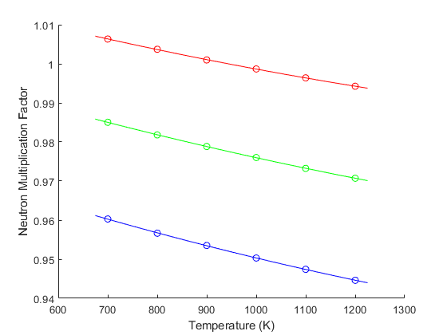
Results – Neutron Multiplication Factors
BOC Conditions
Reference 1.002844 ±7.4
700K 1.006344 ±7.3
800K 1.003718 ±7.0
900K 1.000984 ±7.5
1000K 0.998688 ±7.2
1100K 0.996399 ±7.3
1200K 0.994263 ±6.9
MOC Conditions
Reference 0.979310 ±6.9
700K 0.985037 ±6.8
800K 0.981812 ±6.8
900K 0.978845 ±6.9
1000K 0.976020 ±6.9
1100K 0.973235 ±6.8
1200K 0.970729 ±6.5
EOC Conditions
Reference 0.952446 ±6.8
700K 0.960295 ±6.9
800K 0.956662 ±7.0
900K 0.953518 ±6.9
1000K 0.950306 ±7.1
1100K 0.947420 ±7.0
1200K 0.944610 ±6.8

Slide 11
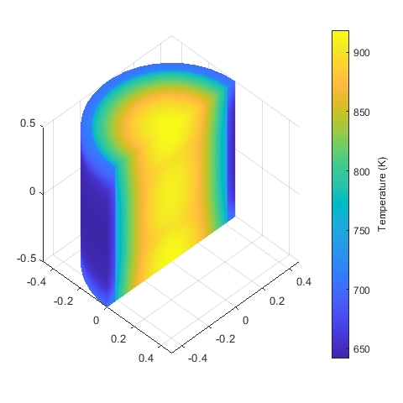
Results – Internal Temperature Distribution
Temperature at BOC Conditions
Note: the temperature distributions at MOC, EOC were not visually distinct

Slide 12
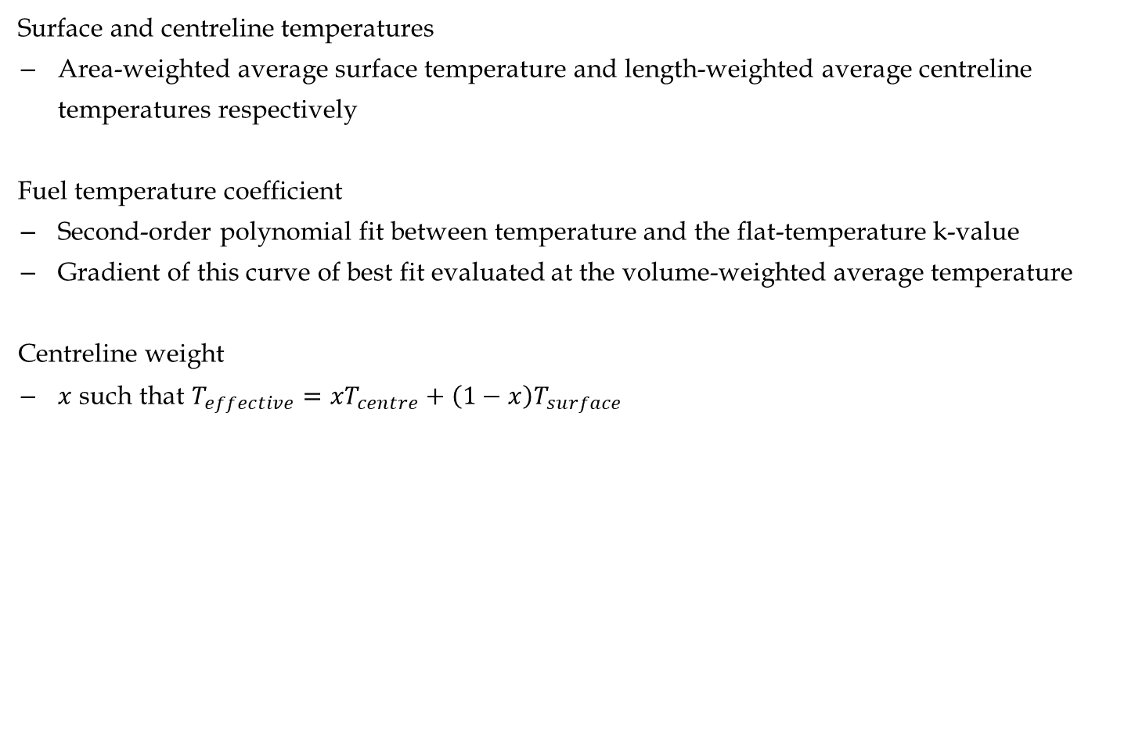
Results – Processed Results
Surface and centreline temperatures
Area-weighted average surface temperature and length-weighted average centreline temperatures respectively
Fuel temperature coefficient
Second-order polynomial fit between temperature and the flat-temperature k-value
Gradient of this curve of best fit evaluated at the volume-weighted average temperature
Centreline weight
$x$ such that $T_{effective}=xT_{centre}+\left(1−x\right)T_{surface}$

Slide 13
Results – Processed Results
 | BOC Conditions | MOC Conditions | EOC Conditions
FTC [pcm K^-1] | -3.22 | -3.64 | -4.00
Temp., vol. avg. [K] | 834.55 | 892.73 | 951.01
Temp., effective [K] | 830.50 | 883.97 | 931.57
Centreline weight | 0.4605 | 0.4574 | 0.4415
k-factor, flat temp. | 1.002739 | 0.979051 | 0.951835
k-factor, real temp. | 1.002844 | 0.979310 | 0.952446
k-factor disc. | 10.5 | 25.9 | 61.1

Slide 14
Conclusion
Validity of Flat-Temperature Approximation
The k-factor discrepancy between the actual temperature and flat-temperature models sharing the same volume-average temperature was modest, on the order of several tens of pcm, but grew with higher burnup.
This conclusion agrees with the observation made by Rahman et al.
Centreline/Surface Weighted Average as an Effective Temperature Model
The calculated centreline weights ranged from 0.4605 to 0.4415, decreasing slightly with burnup. This is very similar to the 4/9 (~0.4444) proposed by Rowlands, 1962.
No prior literature on this subject exists; further research may be needed to assess the generalisability of this finding.

Slide 15
Thank you for listening.
Are there any questions?

Slide 16
References
H. Finnemann and A. Galati, “NEACRP 3-D LWR Core Transient Benchmark Final Specifications”, OECD Nuclear Energy Agency, 1992.
C. Geuzaine and J.-F. Remacle, “Gmsh: a three-dimensional finite element mesh generator with built-in pre and post-processing facilities”, International Journal for Numerical Methods in Engineering, Vol. 79, No. 11, pp. 1309-1331, 2009.
H. Kim and Y. Kim, “Unstructured Mesh-Based Neutronics and Thermomechanics Coupled Steady-State Analysis on Advanced Three-Dimensional Fuel Elements with Monte Carlo Code iMC”, Nuclear Science and Engineering, Vol. 195, No. 5, pp. 464-477, 2020.
H. Kim and Y. Kim, “Unstructured Mesh-Grid Multi-Physics Analysis with Monte Carlo iMC Code for Advanced Fuel Elements”, Transactions of the American Nuclear Society, Vol. 122, No. 1, pp. 738-741, 2020.
W. de Kruijf and A. Janssen, “The Effective Fuel Temperature to Be Used for Calculating Resonance Absorption in a 238UO2 Lump with a Nonuniform Temperature Profile”, Nuclear Science and Engineering, Vol. 123, No. 1, pp. 121-135, 1996.
A. Rahman, X. Nguyen, and Y. Kim, “A Study on Effective Temperature of CSBA-loaded UO2 Fuel Pellet”, Transactions of the Korean Nuclear Society Autumn Meeting, 2017.
G. Rowlands, “Resonance absorption and non-uniform temperature distributions”, Journal of Nuclear Energy Parts A and B, Vol. 16, pp. 235, 1962.

