Slide 1
Modified Hydrodynamic Instability Model in consideration of Heater Configuration during Pool Boiling
KNS Spring Meeting
2022. May 18-20. ICC Jeju
Author: SeockYong Leeª, Sehyeon Park^{b}, and HangJin Jo^{a,b}
Presentor: SeockYong Lee
Pohang University of Science and Technology
ªDepartment of Mechanical Engineering
^{b}Division of Advanced Nuclear Engineering
Notes:
1p - ref 추가 (왼쪽 figure), 오른쪽 video 고민

Slide 2
Contents
I. Introduction
II. Research objectives
III. Experiments
IV. Results
V. Summary and conclusion

Slide 3
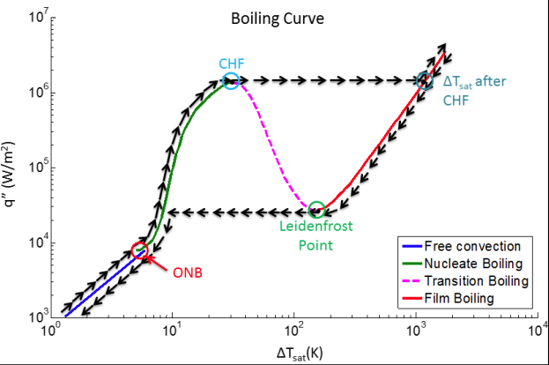
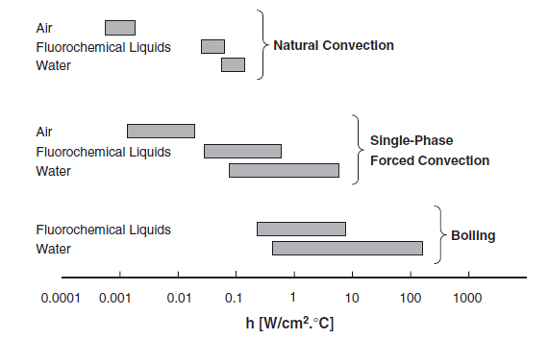
01. Introduction
Boiling: Large amount heat transfer → power plants, electric circuits, nuclear fusion, etc.
Critical Heat Flux: act as safety margin of the system
Various CHF models and corresponding factors exist to explain CHF triggering mechanism Ex. Thermal properties, heater configuration (size, aspect ratio), wettability, roughness ratio, K-H instability, etc.
[Table of cooling efficiency¹]
[Visualization of film boiling²]
1/10
Notes:
[1] Bejan, A. (2016). Advanced engineering thermodynamics. John Wiley & Sons.
[2] Pool Boiling Heat T ool Boiling Heat Transfer Surface Enhancement using face Enhancement using Electrodeposition with Non-Electrolyte Bath

Slide 4
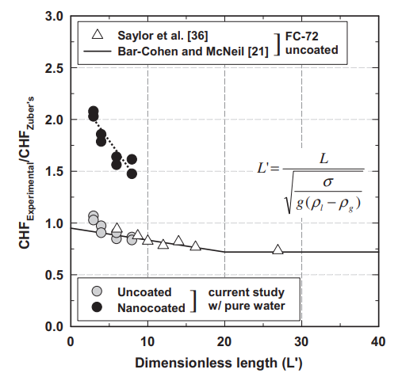
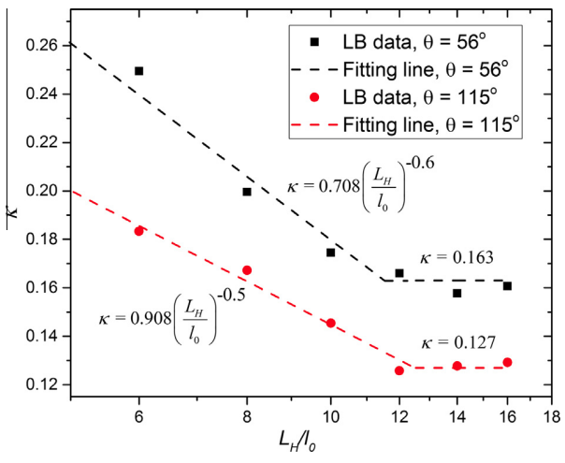
02. Research objectives
Size of cooling channels (chips) differs at the application and type GP108-74 mm², GV100-815 mm², divertor cooling channel-diameter~10 mm, length~1 m
Usually correlate normalized CHF (q’’_{exp}/q’’_{zuber}) with characteristic length scale (L_{characteristic}/L_{capillary})
Conducted on circular (diameter), square heaters (one side length) unlike actual chips
k
q''_{CHF-Zuber}
[Effect of heater size on CHF³]
[LBM results about effect of heater size on CHF⁴]
Research objective - Investigate the heater configuration effect on the CHF with rectangular heaters
2/10
Notes:
[3] Kwark, S. M., Amaya, M., Kumar, R., Moreno, G., & You, S. M. (2010). Effects of pressure, orientation, and heater size on pool boiling of water with nanocoated heaters. International Journal of Heat and Mass Transfer, 53(23-24), 5199-5208.
[4] Zhang, C., Cheng, P., & Hong, F. (2016). Mesoscale simulation of heater size and subcooling effects on pool boiling under controlled wall heat flux conditions. International Journal of Heat and Mass Transfer, 101, 1331-1342.

Slide 5
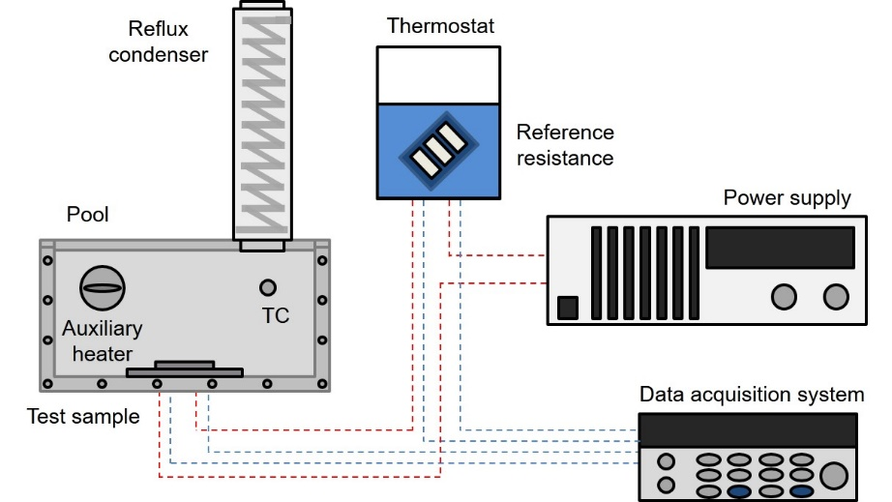
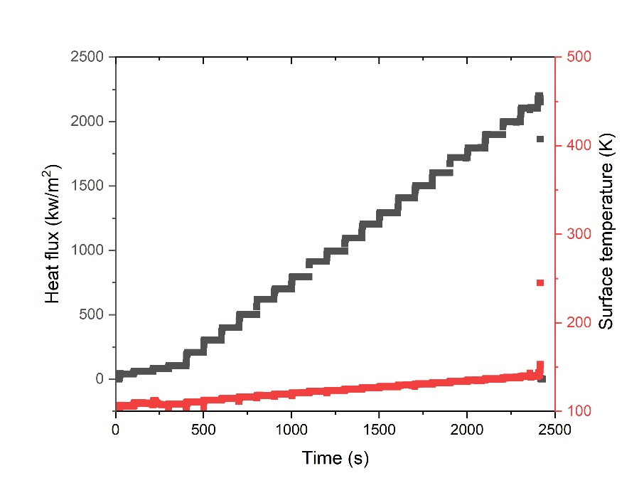
03. Experiments (Set-up)
Pool Boiling facility
Heating method: electrical joule heating
Working fluid: water, novecTM7100 → to cover wide L‘ range (L_{capillary}:2.51, 0.96 mm)
Pressure: atmospheric pressure
Sub-cooling: saturated boiling
[Experimental setup for pool boiling]
Test procedure
Measurement of voltage (test sample, reference resistance) → q’’, T_{surface}
Stepwise increase in heat flux
Sudden increase in surface temperature → CHF
[CHF determination]
3/10

Slide 6
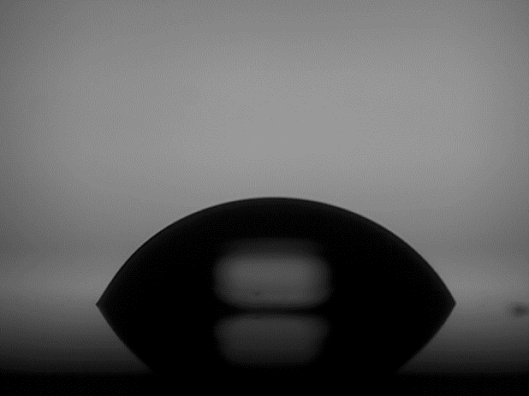
03. Experiments (Sample fabrication)
Heating width and length were both controlled to investigate the effect of heater configuration width: the shorter one of two side lengths, length: the longer one
Heating surfaces were fixed as SiO₂ to exclude surface characteristics effects on the CHF Average roughness ~ 10 nm, CA ~ 63 °C (Water), 10 °C (NOVECTM7100)
Water
Contact Angle ~ 63°
(a)
Heating surface
(b)
500 nm
Heating length
475 um
1200 nm
Heater
Heating width
Si
NOVECTM 7100
Contact Angle ~ 10°
SiO₂
Pt
[(a) side view (b) bottom view of heater]
4/10

Slide 7
03. Experiments (Cases)
Heater dimension were selected in consideration of the capillary length of each fluid and infinite heater size (L‘: 12 ~ 20) suggested in previous study L_{c,Water}: 2.51 mm, L_{c,NOVEC}TM₇₁₀₀: 0.96 mm
Sample # | Working Fluid | Width [mm] (L’) [-] | Length [mm] (L’) [-] | Area [mm²] | Aspect ratio [-]
1 | Water | 3 (1.19) | 15 (5.97) | 45 | 5
2 |  | 4 (1.59) |  | 60 | 3.75
3 |  | 5 (1.99) |  | 75 | 3
4 |  | 8 (3.18) |  | 120 | 1.875
5 |  | 10 (3.98) |  | 150 | 1.5
6 |  | 4 (1.59) | 40 (15.93) | 160 | 10
7 |  | 8 (3.18) |  | 320 | 5
8 |  | 16 (6.37) |  | 640 | 2.5
9 | NOVECTM 7100 | 4 (4.16) | 15 (15.62) | 60 | 3.75
10 |  | 8 (8.33) |  | 120 | 1.875
11 |  | 4 (4.16) | 40 (41.66) | 160 | 10
12 |  | 8 (8.33) |  | 320 | 5
13 |  | 16 (16.66) |  | 640 | 2.5
[Geometric information of experimental cases]
5/10

Slide 8
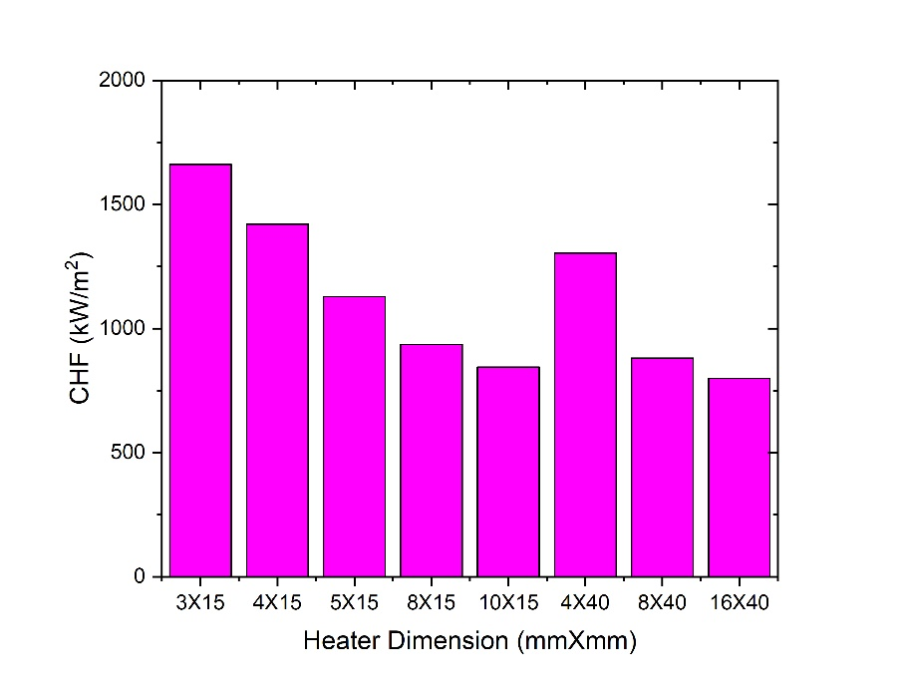
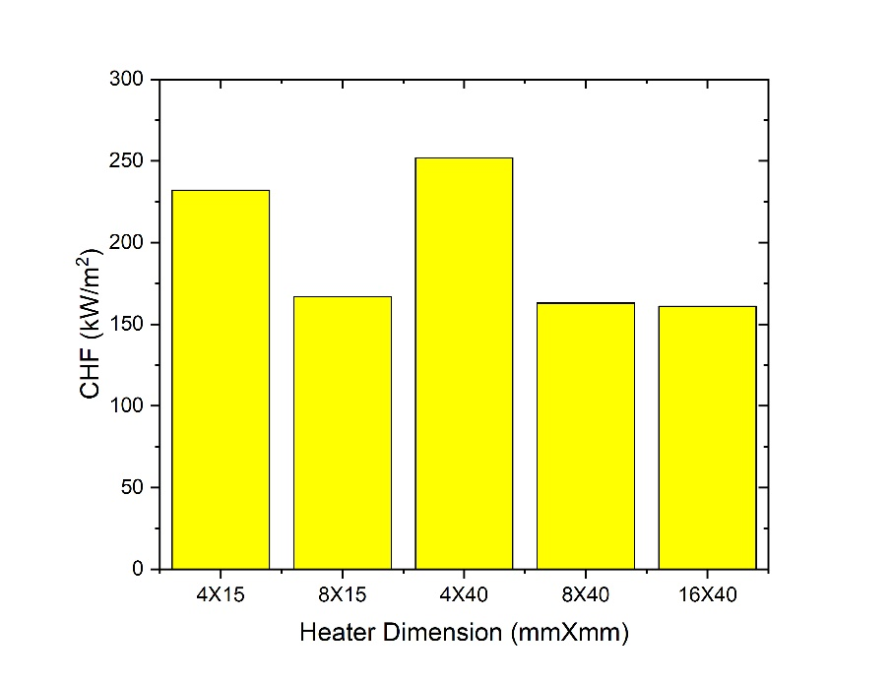
04. Results – CHF difference depending on heater dimension
Significant CHF change was confirmed depending on heater dimension at each working fluid Water- max 107% difference in CHF (S01-1662 kW/m², S09-800 kW/m²) NOVECTM7100- max 56% difference in CHF (S11-252 kW/m², S13-161 kW/m²)
In general, CHF decreases as the heating size increases, but singularity exists
(a)
(b)
Larger heating size
[CHF results depending on the heater dimension (a) Water, (b) NOVECTM7100]
6/10

Slide 9
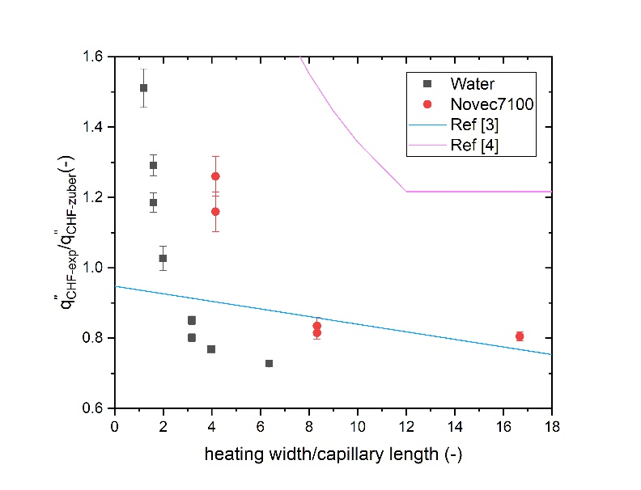
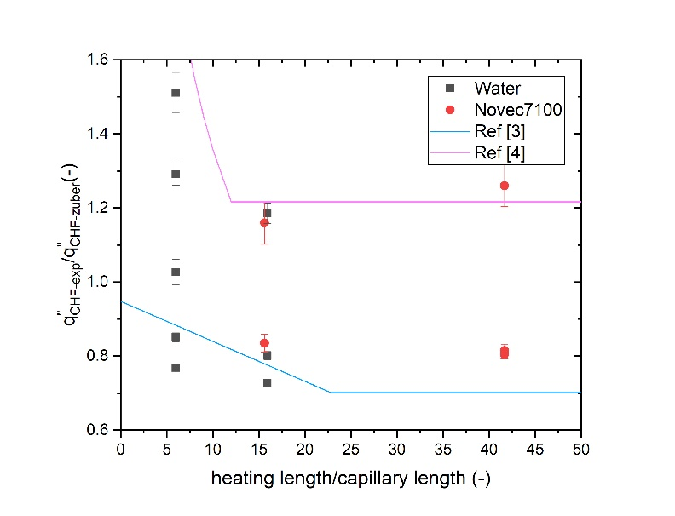
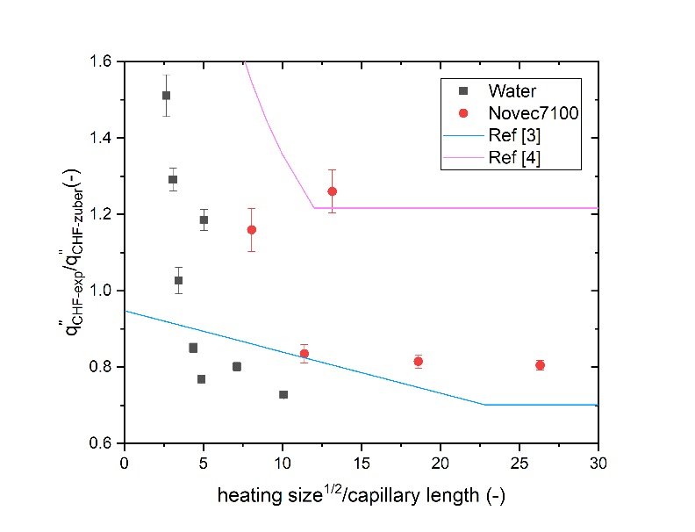
04. Results – comparison with previous study
Various candidates were selected as characteristic length at given heater dimension Candidates: width, length, heating size^{1/2}
(a)
(b)
(c)
Large
deviation
Large
deviation
[Normalized CHF versus characteristic length (a) width, (b) length, (c) heating size^{1/2}]
Width shows the greatest relevance with CHF among various candidates
Although the trend is similar, but the exact value is different depending on the working fluid → induced by difference in CA
7/10

Slide 10
04. Results – modified instability model development
Similar with original model, we derived CHF using Energy conservation in unit cell
Width (the shortest distance between two liquid paths) → modulated wavelength
Liquid inflow
$\frac{q_{CHF}^{′′}}{q_{CHF,Zuber}^{′′}}{\sim \left(\frac{λ_{b}}{λ_{m}}\right)}^{1/2}$
$λ_{m}=\left\{\begin{aligned}width, if width<λ_{b} \\ λ_{b}, if width>λ_{b}\end{aligned}\right.$
→ $\frac{q_{CHF}^{′′}}{q_{CHF, infinite}^{′′}}={\left(\frac{λ_{b}}{λ_{m}}\right)}^{1/2}$
(a)
λ_{b} or λ_{m}
(b)
Vapor
column
Vapor
column
Liquid inflow
λ_{m}
q’’
q’’
[Schematic of hydrodynamic instability model considering (a) artificial liquid paths, (b) heater configuration]
Difference in heating method, circumstance induce difference in CHF at infinite heating size
→ CHF with infinite heating size was calculated using CHF at the largest heating size (Water-S08, NOVECTM7100-S13)
8/10

Slide 11
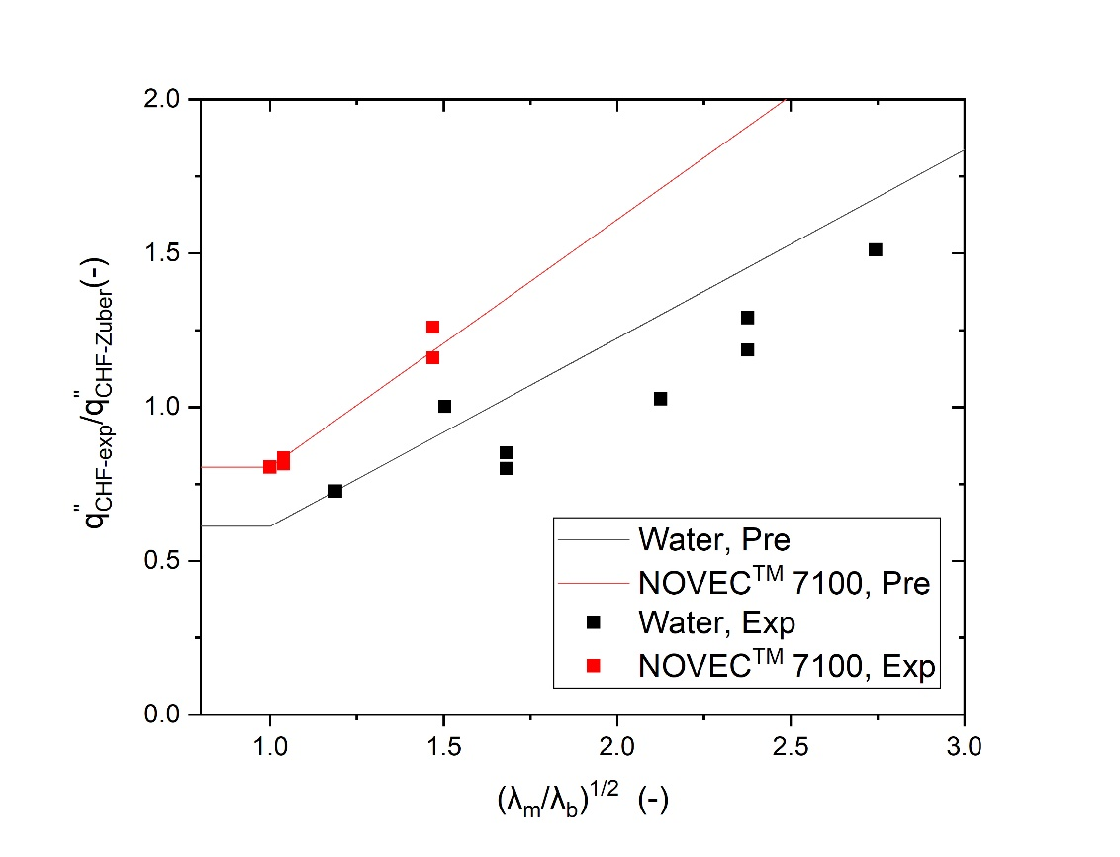
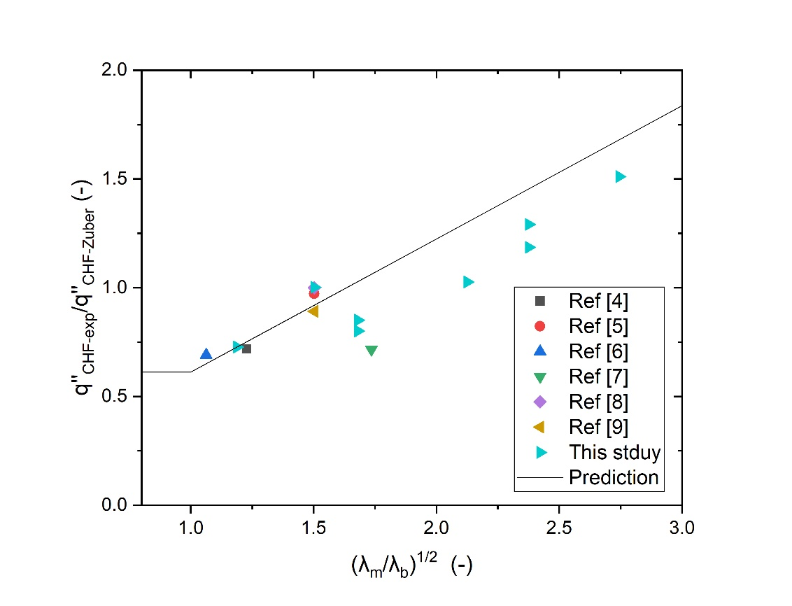
04. Results – Predictability of model
[CHF vs modulated wavelength-This study]
[CHF vs modulated wavelength-literature]
The equation relatively predicts the experimental results well (Water 15.6 %, NOVECTM7100: 2.7 %)
Slope of each working fluid differs [Water-0.612 (0.531,R²~0.84), NOVECTM7100-0.805 (0.812,R²~0.96)]
Experimental results in previous study using water matches relatively well with the prediction → CHF with various heater dimension could be estimated using literatures about same condition
9/10
Notes:
[4] Kim, H., Ahn, H. S., Kwak, H. J., Kim, M. H., & Kim, D. E. (2016). Boiling crisis controlled by capillary pumping and viscous friction: Liquid penetration length and dry spot diameter. Applied Physics Letters, 109(24), 243901.
[5] Chen, R., Lu, M. C., Srinivasan, V., Wang, Z., Cho, H. H., & Majumdar, A. (2009). Nanowires for enhanced boiling heat transfer. Nano letters, 9(2), 548-553.
[6] Chu, K. H., Enright, R., & Wang, E. N. (2012). Structured surfaces for enhanced pool boiling heat transfer. Applied Physics Letters, 100(24), 241603.
[7] Zou, A., & Maroo, S. C. (2013). Critical height of micro/nano structures for pool boiling heat transfer enhancement. Applied Physics Letters, 103(22), 221602.
[8] Kim, D. E., Yu, D. I., Park, S. C., Kwak, H. J., & Ahn, H. S. (2015). Critical heat flux triggering mechanism on micro-structured surfaces: Coalesced bubble departure frequency and liquid furnishing capability. International Journal of Heat and Mass Transfer, 91, 1237-1247.
[9] Kim, J. M., Kim, J. H., Park, S. C., Kim, M. H., & Ahn, H. S. (2016). Nucleate boiling in graphene oxide colloids: morphological change and critical heat flux enhancement. International Journal of Multiphase Flow, 85, 209-222.

Slide 12
05. Summary and conclusion
Effect of heater dimension on CHF was experimentally confirmed in the rectangular type heaters at two working fluids (Water, NOVECTM7100)
Maximum CHF difference of 107% for water, 56% for NOVECTM7100 was confirmed within heater dimension used in this study
Width, the shorter one of two side lengths, dominantly determines the CHF at fixed working fluid
The hydrodynamic instability model was modified to consider the width as modulated wavelength in consideration of heater dimension and showed relatively good predictability
10/10

Slide 13
Thank you
KNS Spring Meeting
2022. May 18-20. ICC Jeju
Author: SeockYong Leeª, Sehyeon Park^{b}, and HangJin Jo^{a,b}
Presentor: SeockYong Lee
Pohang University of Science and Technology
ªDepartment of Mechanical Engineering
^{b}Division of Advanced Nuclear Engineering

