Slide 1
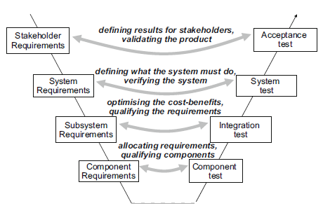
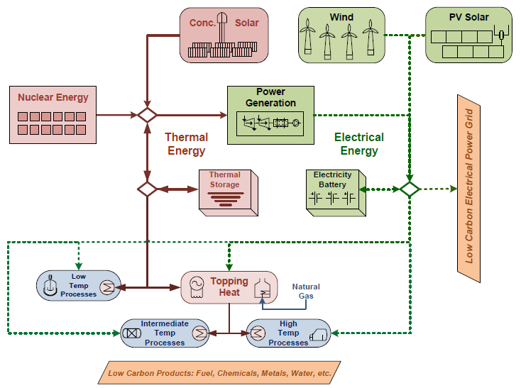
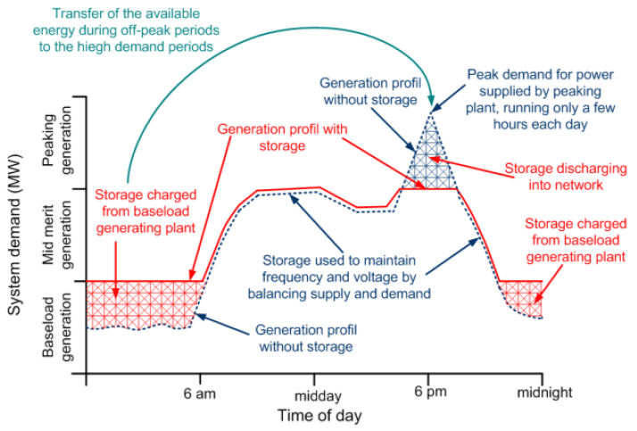
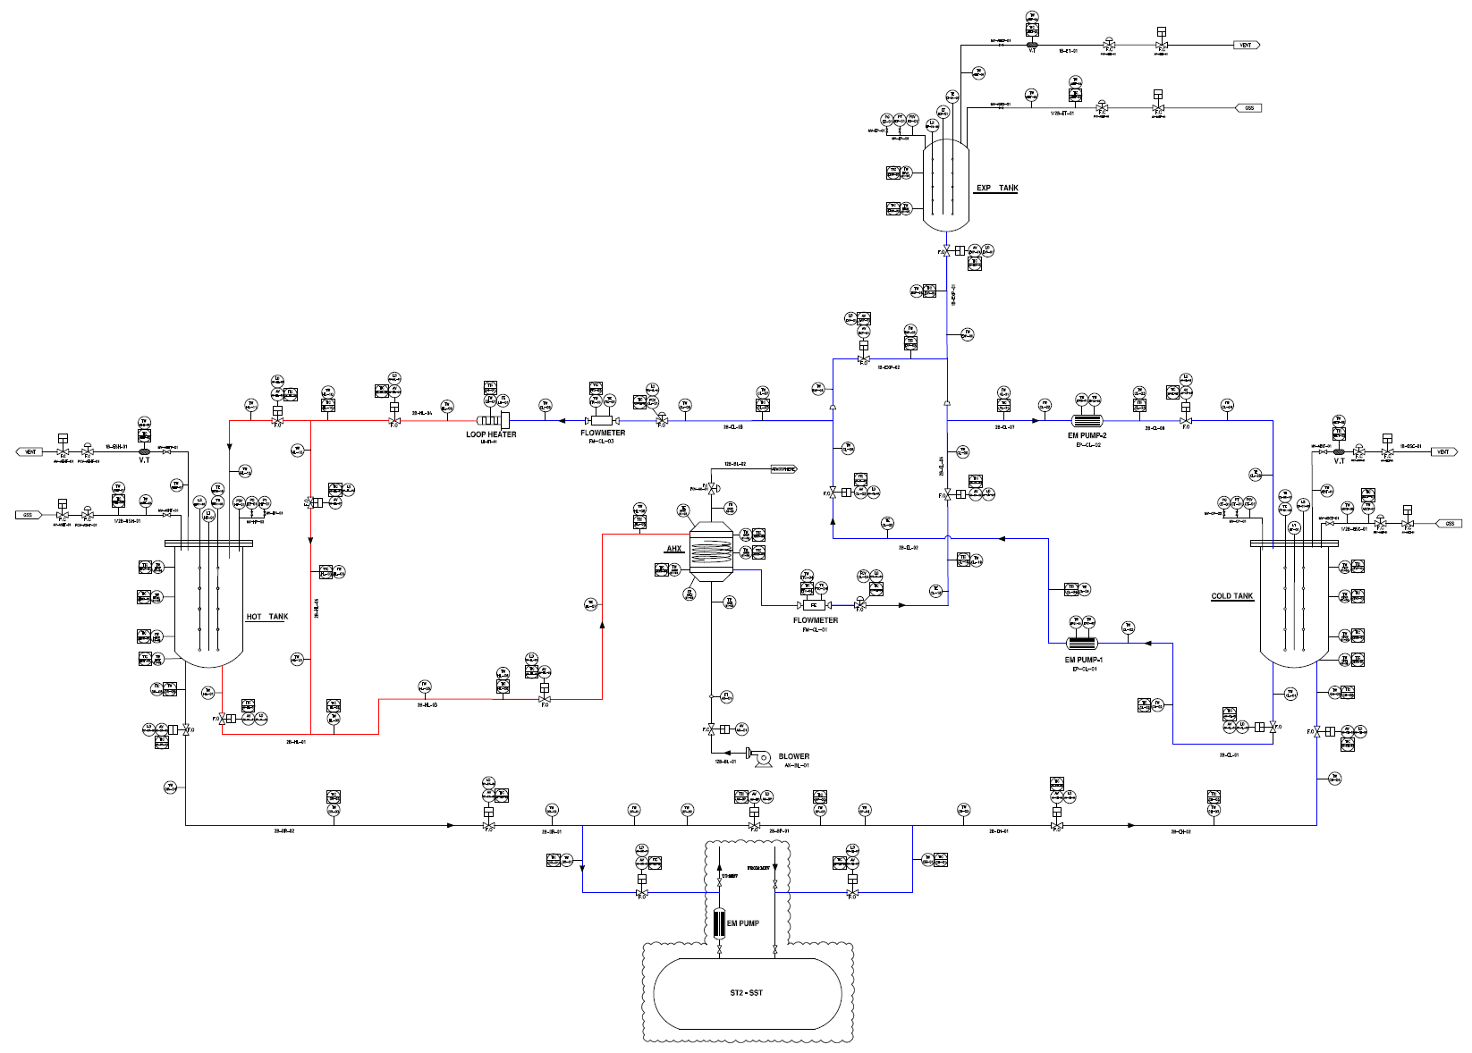
Proposal on Operating Modes of TES test facility using Sodium Hyeonil Kim^{a*}, Jung Yoonª, Yong-Hoon Shinª, Jewhan Leeª ªVersatile Reactor Technology Development Division, KAERI, 111 Daedeok-daero 989beon-gil Yuseong-gu, Daejeon, 34057, Rep. of Korea * Corresponding author: hyeonilkim@kaeri.re.kr
I. Introduction
Energy storage systems (ESS) have been being in the spotlight as a practical option for bridging technical gaps that we meet when utilizing renewable energy even under Nuclear-Renewable Hybrid Energy Systems (N-R HES or NRHES) in a power grid because of intermittency intrinsic to renewable energy in terms of 1) uncertainty and 2) variability: uncertainty refers to difficulty and error to predict generation power and variability does to rapid and large fluctuations in output power.
One of the promising options for ESS is thermal energy storage (TES) using liquid metals such as sodium, which is chemically stable, well-controllable, and marginal to possibly off-normal operating conditions.
We, Korea Atomic Energy Research Institute (KAERI) are developing a TES test facility using sodium to verify its technical feasibility focused on high temperature operation up to 700℃ and long-term mechanical structures integrity [1-3].
A TES is a subsystem of a NRHES that is under development in technical readiness level (TRL) around 2-3, which means that the TES is not specific to a single goal and it still remains open to various applications.
Thus this paper deals with a process to build a preliminary set of requirements of a TES as a ESS, a subsystem/component of an NRHES and specific requirements of the test facility considering various applications. Tentative operating modes were drawn to evaluate the TES and this will be a basis for preparing a test matrix of the TES test facility.
II. Methods and Results
The TES test facility using sodium should be verified such that two distinct requirements such as interface requirements (IR) and performance requirement (PR) be technically feasible to realize: the IR as a subsystem and/or a component of an NRHES and the PR as an ESS [4]. Sometimes it is not quite clear to classify IR and PR but the classification here is only focused on a comprehensive and systematic approach to handle design attributes having impact of significance on technical feasibility of TES as a whole. Both requirements were identified by using Requirements engineering [5], as shown in Fig. 1.
In addition, the principle of being design agnostic is applied, which “is purposely choosing not to delve into the details of the solution too early” [5]. A guide to this principle is to think in terms of “black boxes.” Then we are allowed to talk about: External interfaces, including inputs and output;
Externally observable behavior of the system expressed in terms of inputs and outputs.
2.1 Interface Requirements
General architectures including a case as shown in Fig. 2 [6] were considered as candidates for a NRHES for analyzing the interface requirements of a TES. And the case, Fig. 2 was selected as a model case because of both reasons: a single financial entity considering electricity market in Korea and an ideally simplified input/output.
Then the interface requirements can be assumed from the general architecture considering general design of conventional nuclear power plants (NPP) and concentrated solar power (CSP) as follows:
Thermal input/output as water or steam with flow rate and thermodynamic properties such as pressure, temperature, and quality; or Power input/output with respect to time.
Other IRs are related to the intermittency of renewable energy characterized by Fig. 3 [7] representing principle of the energy storage. Uncertainty (error to predict generation power) can be covered by undercharge and overcharge to a TES and variability (rapid and large fluctuations in output power) can be handled by controlled charging/discharging of stored heat.
2.2 Performance Requirements
Conventional principal characteristics of ESS for selecting candidates are as follows [7]:
Storage capacity
Available power
Efficiency
Discharge time (the maximum-power discharge duration)
Durability (cycling capacity)
Self-discharge.
2.3 Operating modes
A preliminary set of operating modes were developed as shown in Table I by engineering judgement considering the IR and PR and the test facility design itself using sodium [1][2][3].
Thermal input and output will be simulated by electric heater and sodium-to-air heat exchanger, respectively. All of the PR will be tested on a budget to verify the feasibility of this technology except for durability, of which assessment will be supported by numerical computation.
Fig. 1. Requirements engineering in layers in the V-model.
Fig. 2. General architecture for a tightly coupled NRHES
Fig. 3. Principle of the energy storage considering renewable energy.
Table I: Operating modes of the test facility
Operating modes (experimental variables of importance) | Expectations
 | NRHES | TES /Test facility
Startup (time and manning) | Scheduling | Behaviors
Shutdown (time and manning) | Scheduling | Behaviors
Charging (rate and RTE) | I/F* | Performance
Discharging (rate and RTE) | I/F | Performance
Charging/ Discharging (each rate and RTE) | I/F | Performance
Still (Self-discharge and RTE) | I/F | Performance
III. Conclusions
A process in a comprehensive and systematic manner was applied based on requirements engineering to identify interface and performance requirements of a TES test facility using sodium. From this process a preliminary set of operating modes of the test facility was proposed with supported by engineering judgements considering the facility design. This preliminary work will be updated and a test matrix in detail will be realized by considering the design characteristics and budgets as the project goes.
References
[1] J. Yoon et al., Design Requirements of Thermal Energy Storage Verification Test Facility, Internal Report, Korea Atomic Energy Research Institute, CAP-TS130-DR-01, 2020.
[2] J. Yoon et al., “Design Report of Thermal Energy Storage Tank for Thermal Energy Storage Verification Test Facility,” Internal Report, Korea Atomic Energy Research Institute, CAP-TS130-ER-01,
2021.
[3] J.M. Kim et al., Piping and Instrument Diagram of Thermal Energy Storage Verification Test Facility, Internal Report, Korea Atomic Energy Research Institute, CAP-TS130-DW-01, 2021.
[4] H. Kim et al., TES test facility Operating Scenario and Conditions, Internal Report, Korea Atomic Energy Research Institute, NEF/TS130-GE-02, 2021.
[5] Jeremy Dick et al. (2017). Requirements Engineering. Springer.
[6] INL/EXT-16-38165. Nuclear-Renewable Hybrid Energy Systems: 2016 Technology Development Program Plan. 2016.
[7] H. Ibrahim et al. Performance Index: A Simple Selection Method of Appropriate Energy Storage for Specific Application. MATEC Web of Conferences 171, 01002 (2018).
https://doi.org/10.1051/matecconf/201817101002.
Acknowledgement
This work was supported by the National Research Foundation of Korea (NRF) (2021M2D1A1084836) and the National Research Council of Science & Technology (NST) (No. CAP-20-03-KAERI) grant funded by the Korea government (Ministry of Science and ICT).

