Slide 1
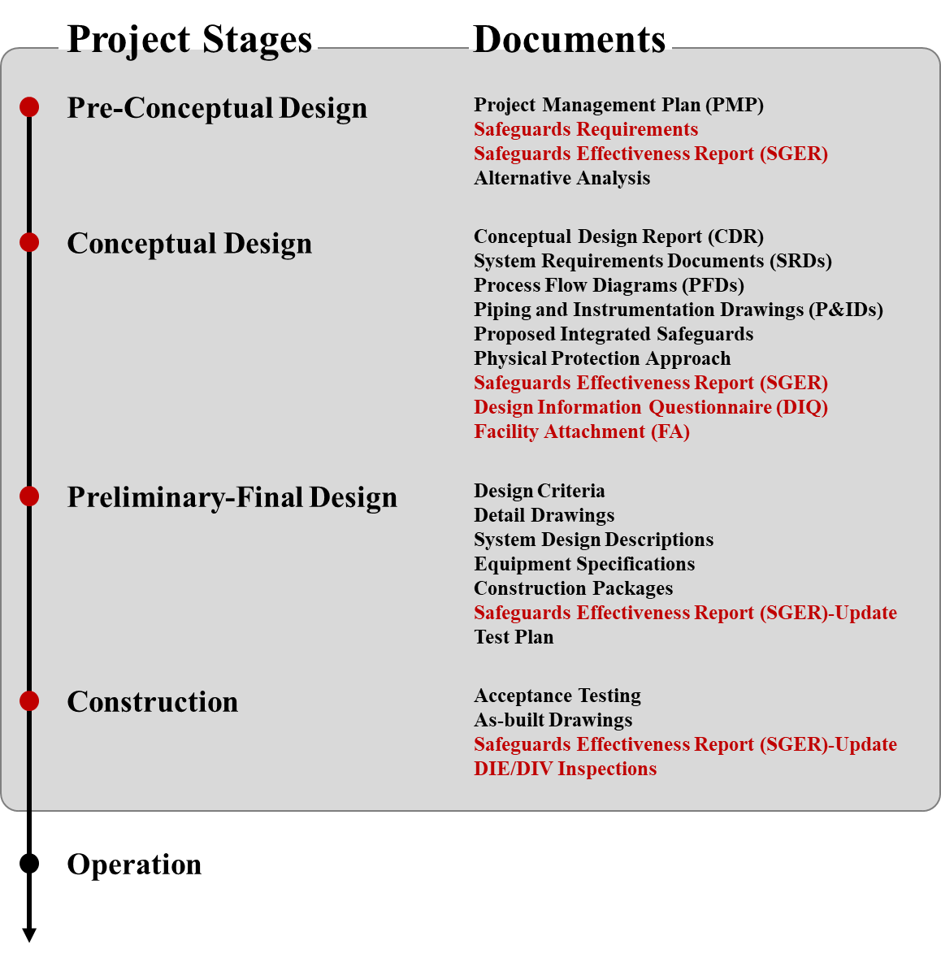
A Study on the Regulatory Policy for the Application of Safeguards by Design Yujeong Hwang, Seungmin Lee KINAC, Nuclear Security Division, 1418 Yuseong-daero, Daejeon, Korea
Introduction
The Idaho National Laboratory (INL) put forward a project flow shown in Fig. 1. for the successful implementation of SBD [2] from pre-conceptual design to construction of a nuclear facility.
The project flow diagram above shows that application of SBD should be considered during all phases from pre-conceptual design to the construction of a nuclear facility.
Research is currently under way in 2022 to introduce new nuclear facilities such as small modular reactors (SMR) and dry storage facilities for light-water reactor (LWR) spent fuel.
It is necessary to solidify the legal basis for safeguards by design (SBD) stipulated in the Nuclear Safety Act (NSA) as a mandatory requirement rather than a recommendation, so IAEA obligations can be smoothly executed at the design phase
According to the Comprehensive Safeguards Agreement (CSA), the State is to provide preliminary information on any new nuclear facility as soon as the decision is taken to construct, or to authorize the construction of the facility [1]
There are many cases where application of safeguards is considered after the construction phase [2]
If discussions with the IAEA on application of safeguards at the design phase precede construction, design changes caused by safeguards after completion would not need to be considered.
In this study, we analyze case studies of other countries and the safeguard regulations system in Republic of Korea (ROK) to apply SBD to new nuclear facilities so as to suggest directions for complementary policies.
Methods to Apply SBD Regulations in ROK
The ways to apply SBD regulations in ROK can be stated as follows;
Major SBD items that should be applied to a new nuclear facility should be stipulated so that the safeguards are considered during the design phase
Time limits for providing the design information of a new facility should be imposed. A legal basis of public notice should be created and discussions on SBD should be conducted at the application phase before approval of sites and application for construction permit (Fig. 2.)
Discussions on SBD should be held among parties of the IAEA, business owners, and the government
Current Status on Safeguards
The time limits set to provide design information for the IAEA in accordance with the INFCIRC/153(Corr.) should be imposed based on subsidiary agreements between the State and the IAEA.
“Provision of completed DIQ for new facilities based on “as-built” designs as early as possible, and in any event not later than 180 days before the initial reception of nuclear materials at the facility”
It has become standard practice to simply apply at the design phase and consider specific design for safeguards at the construction phase [3]. This approach satisfies the INFCIRC/153, but shows that the application of SBD from conceptual design phase is limited.
Fig. 2. Approval steps in ROK
Conclusions
We analyzed the CSA and AP, and compiled the safeguards relevant regulations during design and construction phases of nuclear facilities. We checked cases of other countries regarding the provision of design information for safeguards and the list of documentation per phase for application of SBD.
We are supplementing the SBD regulations system in ROK, where the installation and implementation procedures of safeguards can be applied from the design phases of new nuclear facilities. A legal basis should be laid for fulfilling the IAEA requirements at the design and construction phases. We analyzed issues on the provision of design information in association with SBD application regulations and suggested a direction of statute revision by stating a proper time limits for provision.
REFERENCES
[1] IAEA, The Structure and Content of Agreements Between the Agency and States Required in Connection with the Treaty on the Non-Proliferation of Nuclear Weapons, INFCIRC/153, 1972.
[2] T. Bjornard, R. Bean, P. Durst, J. Hockert, J. Mergan, Implementing Safeguards-by-Design, Project Management and Coordination, INL Report, INL/EXT-09-17085, pp. 7-16, 2010.
[3] T. Wood, A. Seward, V. Lewis, E. Gitau, M. Zentner, Evaluation of a Business Case for Safeguards by Design in Nuclear Power Reactors, SbD Business Case Assessment for Existing Reactor Designs, PNNL Report, PNNL-22102, pp. 2-5, 2012.
Fig. 1. Project flow diagram nuclear facility [2]

