Slide 1
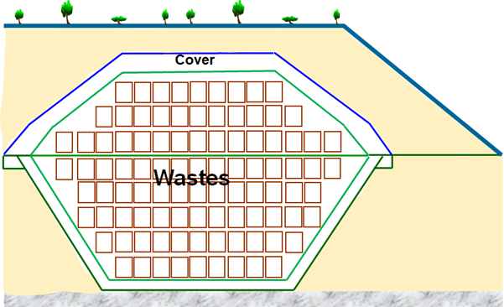
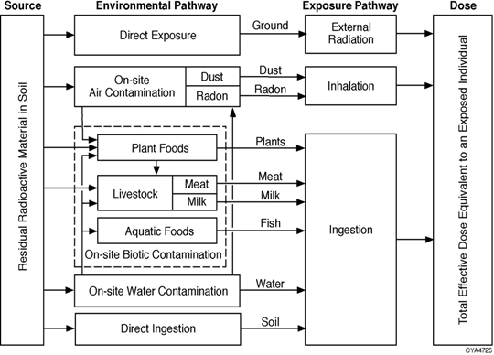
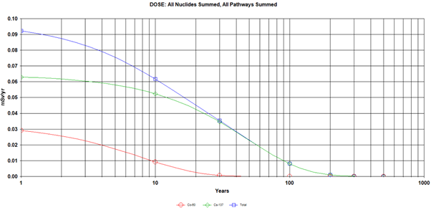
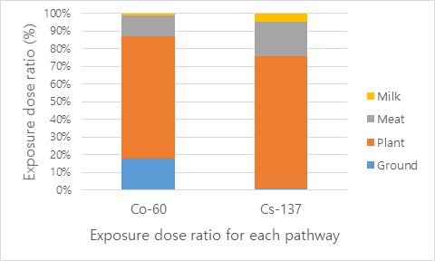
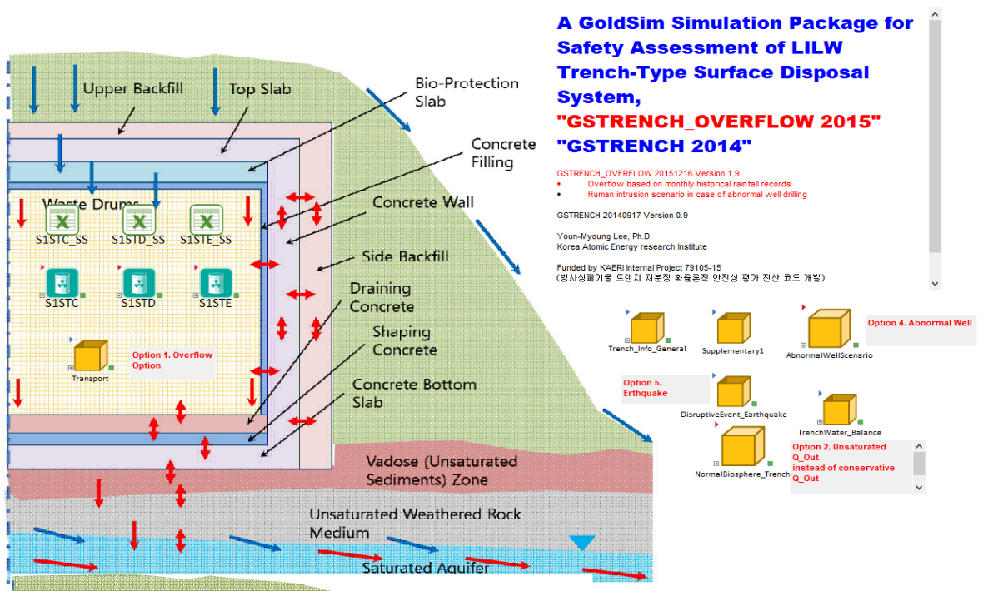
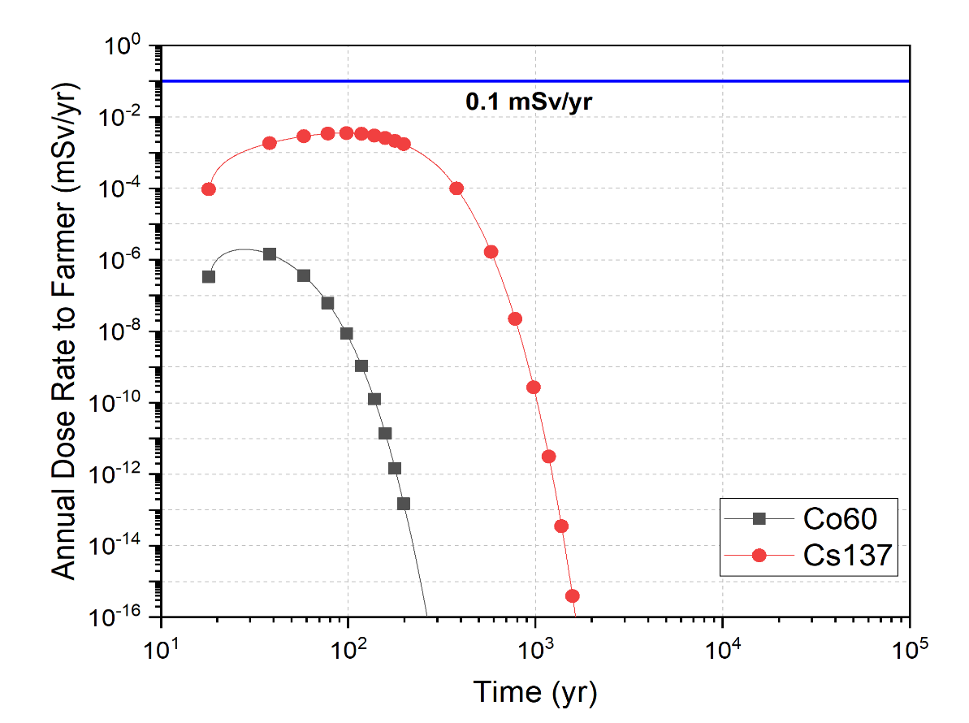
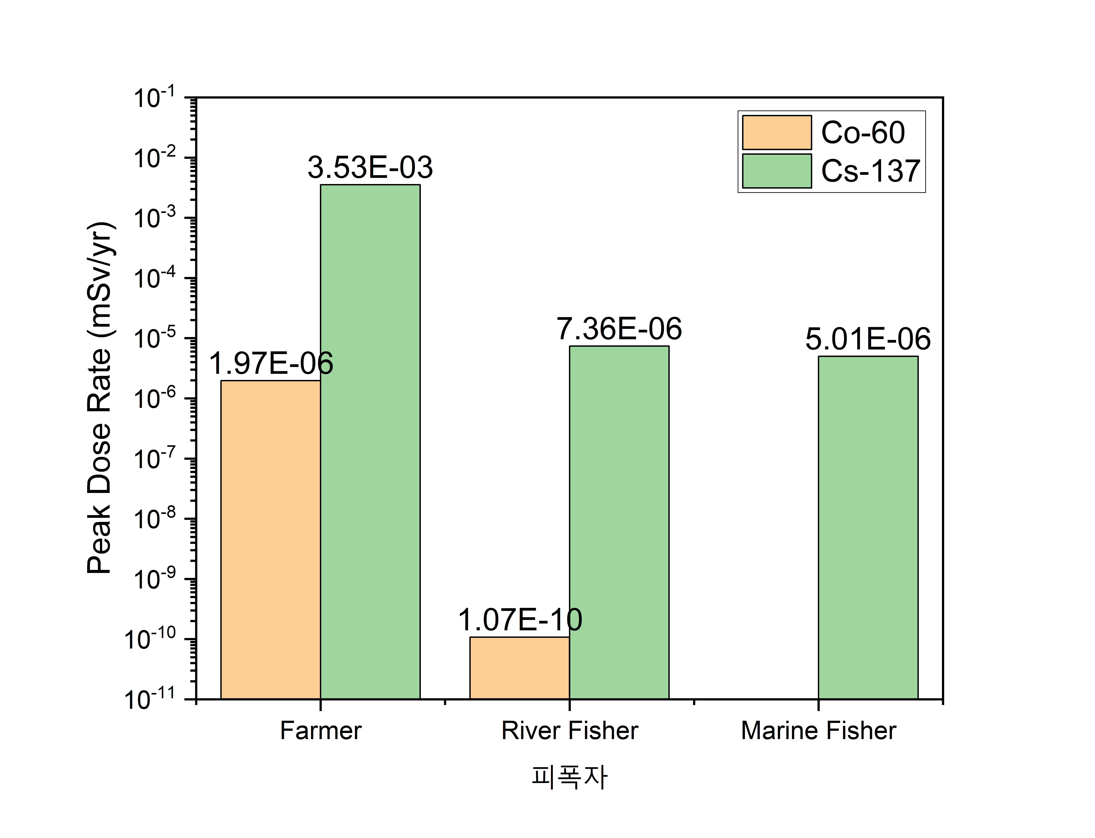
P03C09
The Korean Nuclear Society 2022 Spring Meeting, May 18-19, 2022, Jeju ICC
Preliminary Evaluation of the Suitability for Geological Disposal of
a Solidified Decommissioning Waste
Min-Hoon Baik(mhbaik@kaeri.re.kr), Jongtae Jeong, Heejae Ju, Jae-Kwang Lee
Disposal Safety Evaluation Research Division, KAERI
Introduction
Disposal Safety Assessment
The generation of large amounts of radioactive wastes is now of important issue in the decommissioning of nuclear power plants (NPPs). Various types of radioactive wastes are generated from decommissioning of NPPs [1].
Solidification technologies need to be developed to improve the acceptability for safe disposal of the wastes generated during treatment processes for the volume reduction of decommissioning wastes [2].
In addition, it is necessary to assure disposal safety through safety and suitability assessments for a suggested disposal method according to the classification of radioactive wastes.
In this study, a preliminary suitability for a solidified concrete waste from decommissioning of NPPs using MKPC (Magnesium Potassium Phosphate Cement) was evaluated for both landfill and near-surface disposal sites based on safety assessment and acceptance criteria.
Landfill Disposal
In the case of landfill disposal, the RESRAD-Onsite code developed by ANL (Argonne National Laboratory, USA) was used for the safety assessment [4].
Near Surface Disposal
GS-TRENCH code developed by KAERI was used for the safety assessment of near surface disposal [6].
Table 1. Typical Radioactive Wastes from the Decommissioning of a PWR [1]
Table 5. Major Input Data for the Safety Assessment of Landfill Disposal
Radioactive wastes | Amount (ton) | %
Activated steel | 650 | 10.5
Activated concrete | 300 | 4.9
Contaminated ferritic steel | 2,400 | 38.7
Steel likely to be contaminated | 1,100 | 17.1
Contaminated concrete | 600 | 9.7
Contaminated lagging | 150 | 2.4
Contaminated technological wastes | 1,000 | 16.1
Total | 6,200 | 100
Parameter | Unit | Value
Area of contaminated zone | m² | 14,250
Thickness of contaminated zone | m | 16
Length parallel to aquifer flow | m | 600
Depth of cover | m | 0.5
Density of cover | g/cm³ | 1.6
Erosion of contaminated zone | m/yr | 0.001
Total porosity of contaminated zone | - | 0.15
Effective porosity of saturated and unsaturated zones | - | 0.2
Hydraulic conductivity of contaminated zone and unsaturated zone | m/yr | 10
Hydraulic conductivity of saturated zone | m/yr | 100
Thickness of unsaturated zone | m | 4
Hydraulic gradient of saturated zone | - | 0.02
Evaporation coefficient | - | 0.68
Water table drop rate | m/yr | 0.001
Well pumping rate | m³/yr | 250
Wind speed | m/sec | 2.1
Precipitation | m/yr | 1.7
Runoff coefficient | - | 0.2
Watershed are for nearby stream or pond | m² | 1,000,000
Humidity in air | g/cm³ | 8.0
Inhalation rate | m³/yr | 8,400
Exposure duration | yr | 30
Indoor time fraction | - | 0.5
Outdoor time fraction | - | 0.25
Fig. 1. A schematic view of a typical trench for a landfill site.
Fig. 2. Exposure pathways considered in the RESRAD-ONSITE code
Fig. 2. Exposure dose with time in the landfill disposal.
We found that total exposure doses are below 0.1 mSv/yr, which is the safety goal for low-and intermediate-level radioactive waste repositories.
We also estimated exposure doses for resident farmer and industrial worker scenarios and found that they were also below 0.1 mSv/yr.
Solidified Decommissioning Wastes
Fig. 3. Exposure dose ratio of Co-60 and Cs-137 for each pathway.
A recent research suggested the use of magnesium potassium phosphate cement (MKPC) to solidify concrete powder waste generated from decommissioning of nuclear power plants [3].
It has been also demonstrated that the concrete powder waste solidified with MKPC can be used to immobilize radioactive concrete waste [3].
Table 6. Distribution coefficients of Co and Cs [m³/kg]
Nuclide | Concrete | Granite | Soil | River Sediment | Marine Sediment | Aquifer
Co | 0.172 | 0.113 | 0.219 | 0.219 | 0.219 | 0.219
Cs | 0.0189 | 0.0162 | 0.00813 | 0.00813 | 0.00813 | 0.00813
Table 6. Properties of components in the repository
Table 2. Composition of the Solidified Waste [1]
K_{d}* are representative K_{d} values
Fig. 4. Safety assessment model of the GS-TRENCH code for the near-surface disposal.
Properties | Concrete | Granite | Soil | River Sediment | Marine Sediment | Aquifer
Density [kg/m³] | 1,890 | 2,690 | 2,690 | 2,690 | 2,690 | 2,300
porosity [-] | 0.3 | 0.001 | 0.5 | 0.5 | 0.5 | 0.1
Component | Wt. %
SCPW¹⁾ | 50
MgO | 10.07
KH₂PO₄ | 22.66
H₂O | 14.68
H₃BO₃ | 0.5
CsNO₃²⁾ | 0.58
Co(NO₃)₂²⁾ | 0.87
Sr(NO₃)₂²⁾ | 0.63
Total | 100
Table 3. Leachability Index of the Solidified Waste
Leachability Index (LI) by ANS16.1 method
Cs | Co | Sr
11.45 | 17.63 | 15.66
The LIs of Cs, Co, and Sr are satisfying the WAC (waste acceptance criteria) of > 6.
simulated concrete powder waste,
²⁾ nuclides contained in the wastes
Fig. 5. Exposure dose for farmers with time in the near-surface disposal.
Fig. 6. Peak dose ratios of Co-60 and Cs-137 for exposure groups in the near-surface disposal.
Table 4. Compressive Strength of the Solidified Waste
The maximum exposure dose was 3.5310⁻³ mSv/yr after 100 yrs, which is much lower than 0.1 mSV/yr.
Estimated exposure dose for resident farmer is the highest but 10⁻³ times less than fishermen.
Sample | Compressive Strength (MPa)
 | Pristine | Thermal cycling | Water immersion
1 | 61.39 | 40.52 | 51.58
2 | 51.73 | 50.00 | 44.35
3 | 55.70 | 49.09 | 51.21
Average ± s.d. | 56.27 ± 4.86 | 46.72 ± 5.42 | 49.05 ± 4.86
The compressive strength of the specimens are well above the WAC of 3.45 MPa.
Preliminary Suitability
Based on the results of safety assessment for the landfill and near-surface disposal sites, the solidified decommissioning concrete waste using MKPC is postulated to be acceptable to both disposal sites in the of radiological aspect because their calculated exposure doses are estimated to be less than the regulatory safety goal (0.1 mSv/yr).
The characteristics of the solidified waste form using MKPC was also estimated to be acceptable to the both radioactive waste repositories due to following facts [3]:
the compressive strength of the solid waste using MKPC showed > 45 MPa, which satisfies the waste acceptance criterion (3.45 MPa), and
the leaching indices of Cs, Co, and Sr analyzed following the ANS 16.1 procedure, were 11.45, 17.63, and 15.66, respectively; these also satisfy the waste acceptance criterion (> 6).
Therefore, based on the results of safety assessments and characteristic study for the solid waste form, it can be preliminarily concluded that MKPC can be used to immobilize radioactive concrete wastes generated during the decommissioning of nuclear power plants and suitable to both landfill and near surface disposal.
References
[1] IAEA, Management low radioactivity material from the decommissioning of nuclear facilities, Technical Report Series No. 462, International Atomic Energy Agency, 2007.
[2] NSSC, The regulation on the classification of radioactive wastes and regulatory clearance, Notice 2020-06, Nuclear Safety and Security Commission, 2020.
[3] J.-Y. Pyo, W. Um, J. Heo, Magnesium potassium phosphate cements to immobilize radioactive concrete wastes generated by decommissioning of nuclear power plants, Nuclear Engineering and Technology, Vol. 53, p. 2261-2267, 2021.
[4] S. Kamboj, E. Gnanapragasam, C. Yu, User’s guide for RESRAD-Onsite Code, Version 7.2, ANL/EVS/TM-18/1, Argonne National Laboratory, 2018.
[5] J.T. Jeong M.-H. Baik, J.-K. Lee, J.-Y. Pyo, W. Um, J. Heo, Safety assessment for the Landfill disposal of decommissioning waste solidified by magnesium potassium phosphate cement. J. Nucl. Fuel Waste Technol, Vol. 20, No. 1, p. 13-22, 2022.
[6] Y. M. Lee, J. Jeong, Development of GoldSim program template for safety assessment of an LILW disposal, KAERI/TR-4105/2010, Korea Atomic Energy Research Institute, 2010.
This work was supported by National Research Foundation of Korea (NRF) grant funded by the Korea government (Ministry of Science and ICT, MSIT) (No. 2017M2B2B1072407)

