Slide 1
Preliminary Calculation on the Conceptual design of PCSG system for the i-SMART plant using MELCOR1.8.6
19/05/2022
Jong-Hwa Park*, Sang-Ho Kim
K A E R I

Slide 2
Purpose of this work
Check whether MELCOR can simulate the PCSG or not.
1. Is it possible to prepare the input deck for simulating the PCSG type ? (X)
it is difficult to prepare MELCOR input due to the embedded input structure.
There are no embedded geometry data for the PCSG type in MELCOR.
2. if it is possible, then the calculation will be performed to see whether
MELCOR can be applied to predict the thermal behaviors on PCSG or not.
3. check points
o HS (base plate) Temperature
o void fraction change in the secondary circuit ( steam production rate )
o Change in pool temperatures & Pressures in the primary/the secondary circuit
o effect of MFW & primary inlet temperature, MFW flow rate, number of circuit etc…

Slide 3
Limitations in modeling PCSG with MELCOR
No model exist for considering the printed circuit SG geometry in MELCOR
- geometry ( reverse !: impossible to prepare the input deck)
ex. Up to now, flow through pipe and its heat transfer with external/internal large volume !
but for PCSG, flow through large number of micro channels in solid structure
- no data available for the heat transfer coefficients in the micro channel vs
changing flow regimes in MELCOR
- need material properties for the possible printed circuit plate
( conductivity, enthalpy, heat capacity, density…)

Slide 4
Data under the assumption of slab [SI]
entire plate upper surface area = (0.5-0.04x2)x0.9=0.378 [m2]
number of channel/one plate=0.42/0.004= 약105 개 추정
volume for one primary channel (1/105)=[pi*(1.2eE-3)**2]*0.9/2=2.035752E-6 [m3]
volume for one secondary channel (1/105)=[pi*(0.8eE-3)**2]*0.9/2=9.047786842E-7 [m3]
entire primary volume/1 plate=0.378xhpf1=2.035752E-6x105=2.1375396E-4 [m3]
- equivalent depth of primary fluid= hpf1 =5.654866667E-4 [m]
entire secondary volume/1 plate=0.378xhsf2=9.047786842E-7x105=9.500176184E-5 [m3]
- equivalent depth of secondary fluid= hsf2 =2.513274123E-4 [m]
entire primary base plate volume /1 plate= { 0.0019x0.004x0.9}x105 - [π*(0.0012)²x0.9/2 ]x105
= 6.84E-6*105 – 0.00021375396=0.0007182-0.00021375396
= 0.00050444604 =5.0444604E-4 [m3]
entire secondary base plate volume/1 plate = { 0.0015x0.004x0.9- π*(0.0008)²x0.9/2 } x105
= (5.4E-6 – 9.047786842E-7)x105= 4.495221316E-6x105
= 4.719982382E-4 [m3]

Slide 5
entire primary base plate volume /1 plate= { 0.0019x0.004x0.9- { [π*(0.0012)²]x0.9/2 } }x105
= (6.84E-6 – 2.03575204E-6)x105=4.80424796E-6x105
= 5.044460358E-4 [m³]
entire secondary base plate volume/1 plate = { 0.0015x0.004x0.9- { [π*(0.0008)²]x0.9/2 } }x105
= (5.4E-6 – 9.047786842E-7)x105= 4.495221316E-6x105
= 4.719982382E-4 [m³]
entire primary base plate volume/1 plate=0.378xhpb1= 5.044460358E-4 [m³]
- equivalent depth of primary base plate= hpb1 = 1.334513322E-3 [m]
entire secondary base plate volume/1 plate=0.378xhsb2= 4.719982382E-4 [m³]
- equivalent depth of secondary base plate= hsb2 = 1.248672588E-3 [m]
two base plates summed hS depth=2.58318591E-3 [m]

Slide 6
Nodalization as a rectangular plate (1/264)
Simulate only one plate (one primary + one secondary)
insulated
500/264=1.893 kg/s
A2nd=1.055575132E-4 [m²]
3.399999989E-3 [m]
MSL
dh=2.513274123E-4 [m]
CV Secondary (20X)
503.15 K
57.9 bar
MFW
3.148672577E-3 [m]
dh=2.58318591E-3
Primary + secondary slab HS
594.05 k
5.654866667E-4 [m]
Hot leg
Aist=2.375044046E-4 [m²]
dh=5.654866667E-4
CV Primary (50X)
155 bar
Cold-leg
6281/264=23.794 kg/s
0.0
insulated
Horizontlly, divide the simulation domain into 3 parts

Slide 7
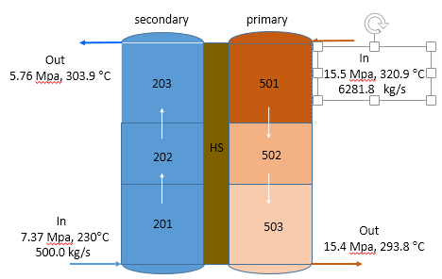
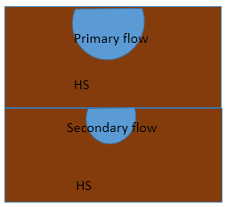
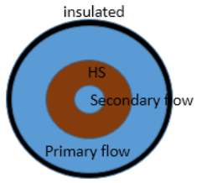
Modeling of the PCSG system with a lumed cylinder
One plate = multiply above by 105
One block = 264 x one plate

Slide 8
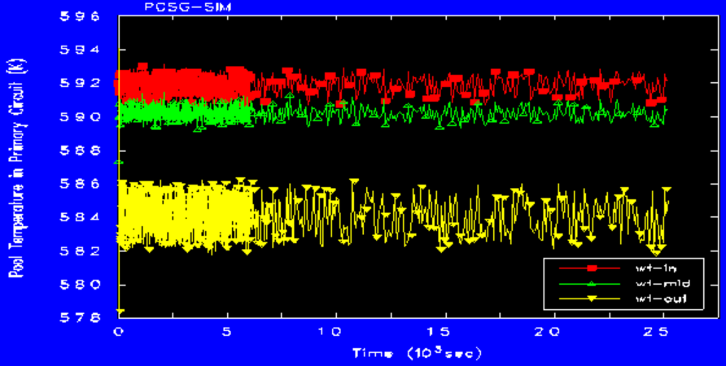
Primary fluid temperature [K]
The prediction shows that the primary fluid temperature goes down along the channel
as the heat transfers to the secondary side through the mixed wall.

Slide 9
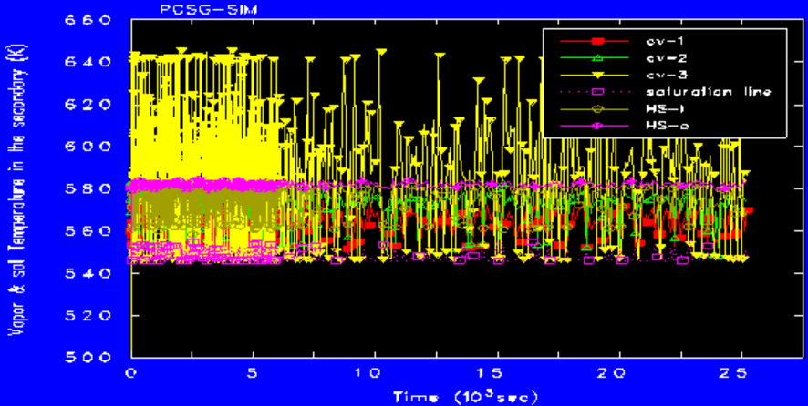
Secondary fluid temperature [K]
The secondary fluid temperature oscillates its state between the sub-cooled and the super-heated

Slide 10
Summary of the current Status
In this study, the preliminary calculations to simulate the PCSG system was performed using MELCOR code. To simulate the PCSG system, the actual plate type of PCSG was assumed to be modified into cylindrical type and also, two base plates for the primary and the secondary were mixed together. The current preliminary calculation results from these assumptions shows that the amount of steam production at the exit of the secondary channel was largely under-predicted.
It is estimated that this may caused from the under-predictions of the heat transfer through the mixed wall. These under prediction may also be caused from the assumption on the geometry for the base plates and from the assumption, whch modified the two separate base plate into the single mixed structure.
If a more recent design data on PCSG system such as the heat transfer coefficients through the micro channels, the size of pressure drop, the material properties are provided, then it will be possible to develop the method for simulating the PCSG system using MELCOR. This works can contribute to estimate the overall thermal behaviors for the i-smart plant with connecting PCSG system using MELCOR.

