Slide 1
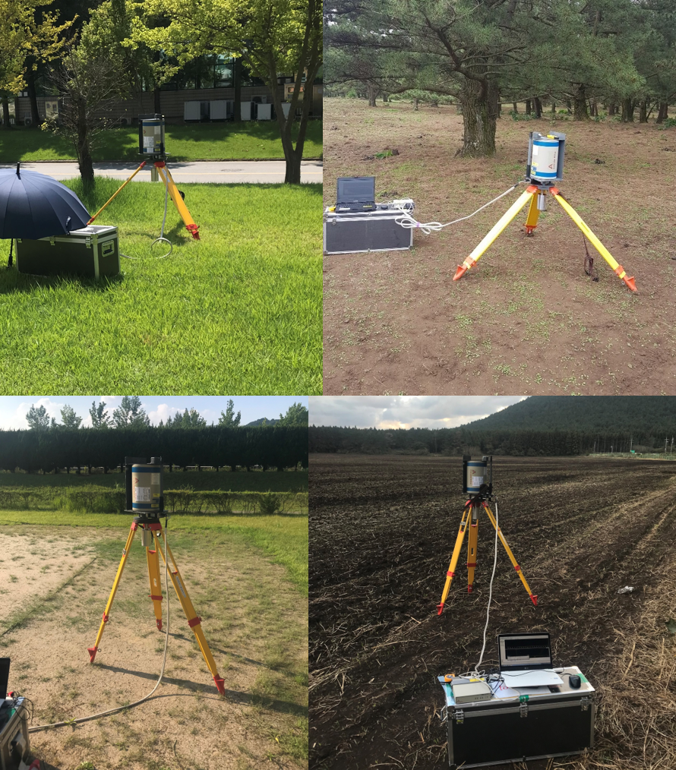
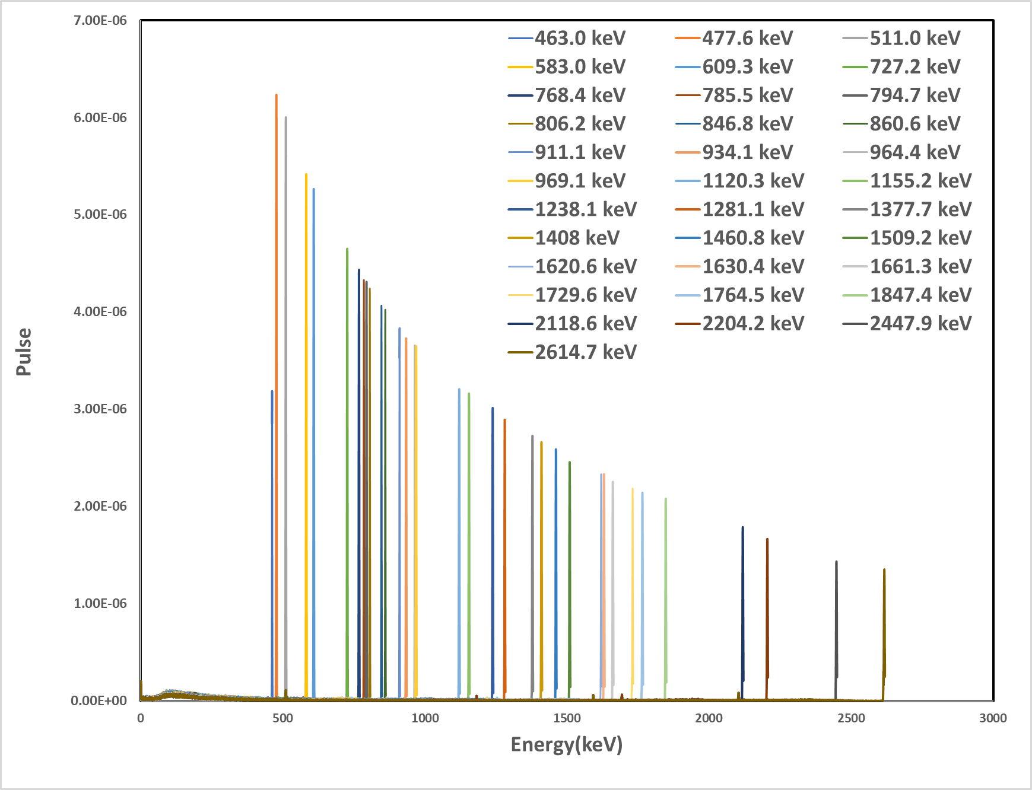
Background Spectrum Simulation for In-situ Measurement Technology
Byungchae Lee ª, Seunggi Jeong ª, Jihyun Yu ª, Jonghoa Kim ª, Jangsoo Suh ª, Sangbum Hong ^{b}
ª Sae-An Enertech Corporation, ^{b} Korea Atomic Energy Research Institute
Ⅰ. Introduction
Table 1. Gamma energy and intensity of natural nuclides.
Nuclide | Energy (keV) | Intensity (%) | Nuclide | Energy (keV) | Intensity (%)
²²⁸Ac | 463.0 | 4.4 | ²¹⁴Bi | 1155.2 | 1.6
⁷Be | 477.6 | 10.3 | ²¹⁴Bi | 1238.1 | 5.8
²⁰⁸Tl | 511.0 | 22.6 | ²¹⁴Bi | 1281.1 | 1.4
²⁰⁸Tl | 583.0 | 84.5 | ²¹⁴Bi | 1377.7 | 4.0
²¹⁴Bi | 609.3 | 46.1 | ²¹⁴Bi | 1408.0 | 2.2
²¹²Bi | 727.2 | 7.6 | ⁴⁰K | 1460.8 | 11.0
²¹⁴Bi | 768.4 | 4.9 | ²¹⁴Bi | 1509.2 | 2.1
²¹²Bi | 785.5 | 1.3 | ²¹²Bi | 1620.6 | 1.5
²²⁸Ac | 794.7 | 4.3 | ²²⁸Ac | 1630.4 | 1.5
²¹⁴Bi | 806.2 | 1.2 | ²¹⁴Bi | 1661.3 | 1.2
⁵⁶Mn | 846.8 | 98.9 | ²¹⁴Bi | 1729.6 | 2.9
²⁰⁸Tl | 860.6 | 12.0 | ²¹⁴Bi | 1764.5 | 15.4
²²⁸Ac | 911.1 | 25.8 | ²¹⁴Bi | 1847.4 | 2.1
²¹⁴Bi | 934.1 | 3.0 | ²¹⁴Bi | 2118.6 | 1.1
²²⁸Ac | 964.4 | 5.0 | ²¹⁴Bi | 2204.2 | 5.1
²²⁸Ac | 969.1 | 15.8 | ²¹⁴Bi | 2447.9 | 1.6
²¹⁴Bi | 1120.3 | 15.1 | ²⁰⁸Tl | 2614.7 | 99.0
■ Background
- It is necessary to develop In-situ measurement technology
that minimizes environmental impact and improves mobility.
■ Purpose
- In this research, the background spectrum was simulated
to reduce measurement uncertainty of the Peak to Compton
(PTC) method, which is an In-situ measurement technology
developed in previous research.
Ⅱ. Methods
Fig. 1. In-situ gamma-ray spectroscopy for
measurement of natural nuclides at sites.
Fig. 2. Gamma spectra of natural nuclides calculated by MCNP simulation
■ Background Spectrum MCNP Simulation
- The background spectrum of the Compton continuum area
(381.38 to 410.29 keV) of 137Cs, a nuclide mainly emitted
from the contaminated site, was simulated by MCNP.
- Among the gamma rays emitted from natural nuclides, the
intensity was 1 % or more, and the energy spectra of 34
gamma rays affecting the ¹³⁷Cs Compton continuum area
were simulated(Table 1).
- The Compton continuum area was calculated using the
ratio of the Full energy peak of the spectrum simulating
each gamma ray energy to the measured Full energy peak.
- The simulated background spectrum was compared with
39 spectra (28 in Daejeon and 11 in Jeju) measured in
an uncontaminated environment as shown in Fig. 1 to
evaluate the accuracy.
■ MCNP Geometry
- Detector : Potable High Purity Germanium detector
- Distance : 50cm
- Effective area : 1000cm ⅹ 1000cm
- Natural nuclides : Homogeneous at all depths
- Tally : F8
Table 2. Comparison of In-situ measurement results and MCNP simulation results in ¹³⁷Cs Compton
continuum area
No | Measurement (CPS) | MCNP (Pulse) | Relative error (%) | No | Measurement (CPS) | MCNP (Pulse) | Relative error (%)
1 | 4.62 | 4.55 | 1.49 | 21 | 4.07 | 4.07 | 0.01
2 | 4.60 | 4.55 | 4.08 | 22 | 4.25 | 4.24 | 0.09
3 | 4.01 | 3.89 | 3.05 | 23 | 4.17 | 4.17 | 0.01
4 | 4.02 | 3.95 | 1.84 | 24 | 4.22 | 4.16 | 1.39
5 | 3.99 | 3.83 | 3.86 | 25 | 4.33 | 4.33 | 0.01
6 | 4.18 | 4.26 | 1.92 | 26 | 4.35 | 4.35 | 0.10
7 | 4.11 | 4.18 | 1.95 | 27 | 4.35 | 4.35 | 0.01
8 | 4.19 | 4.33 | 3.18 | 28 | 4.43 | 4.31 | 2.62
9 | 4.23 | 4.19 | 0.94 | 29 | 1.27 | 1.25 | 1.78
10 | 4.13 | 4.23 | 2.43 | 30 | 1.26 | 1.28 | 1.69
11 | 4.02 | 4.13 | 2.74 | 31 | 1.31 | 1.31 | 0.01
12 | 4.13 | 4.24 | 2.61 | 32 | 1.12 | 1.14 | 1.57
13 | 4.16 | 4.30 | 3.27 | 33 | 1.16 | 1.16 | 0.01
14 | 4.45 | 4.45 | 0.04 | 34 | 1.15 | 1.15 | 0.01
15 | 4.55 | 4.54 | 0.16 | 35 | 1.30 | 1.32 | 1.79
16 | 4.41 | 4.59 | 3.90 | 36 | 1.35 | 1.29 | 4.04
17 | 4.59 | 4.81 | 4.77 | 37 | 1.31 | 1.34 | 2.62
18 | 4.41 | 4.61 | 4.46 | 38 | 1.33 | 1.32 | 1.28
19 | 4.54 | 4.54 | 0.01 | 39 | 1.32 | 1.32 | 0.01
20 | 4.22 | 4.22 | 0.01
Ⅲ. Results
■ Comparison by Region
- As a result of comparing the spectra measured in Daejeon
(No. 1 to 28) and Jeju (No. 29 to 39), it was found that
Jeju showed lower radioactivity.
- In the case of Jeju, it is judged that the radioactivity is
low because the proportion of natural nuclides contained
in the soil is lower than that of other regions.
■ Comparison of Measurement and MCNP
- Relative error : 0.01 ~ 4.81 %, High accuracy
- The reason for the high accuracy is considered to be
because the Full energy peak ratio of the measured and
simulated spectrum for each gamma ray energy was
calculated.
Ⅳ. Conclusions
■ In order to reduce the measurement uncertainty of the Peak
to Compton method, an In-situ measurement technology, the
background spectrum of the ¹³⁷Cs Compton continuum area
was simulated with MCNP.
■ As a result of comparing the simulated background spectrum
with the spectrum measured in an uncontaminated
environment, the average relative error was within 5 %.
■ It is expected that this evaluation method will be able to
quickly and accurately evaluate radioactivity if it is applied to
the decommissioning site of a nuclear power plant or a site
contaminated by an accident in the future.

