Slide 1
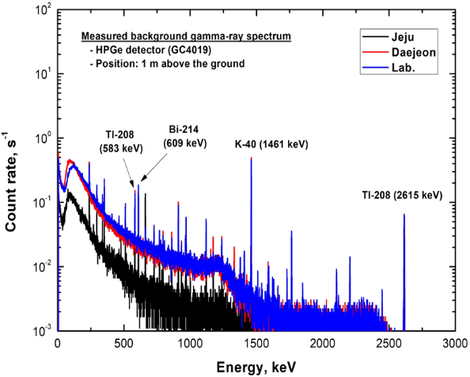
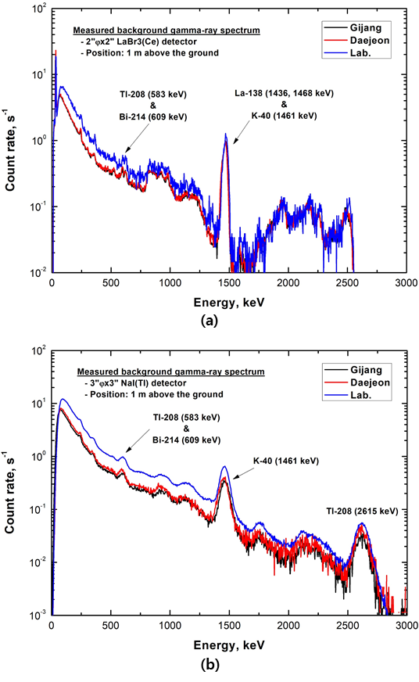
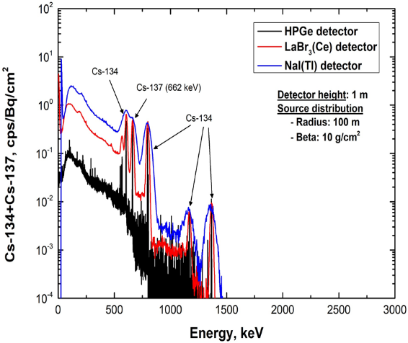
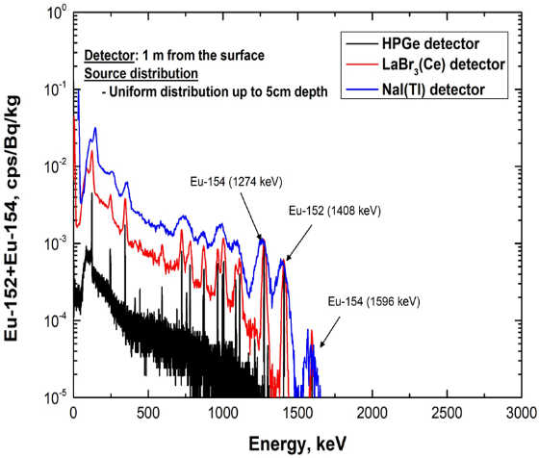
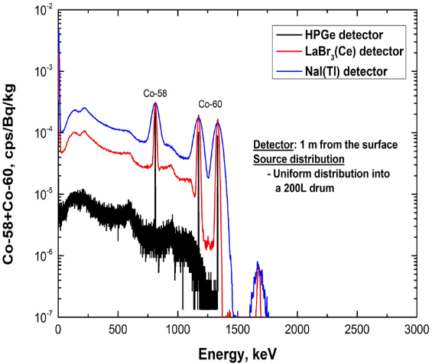
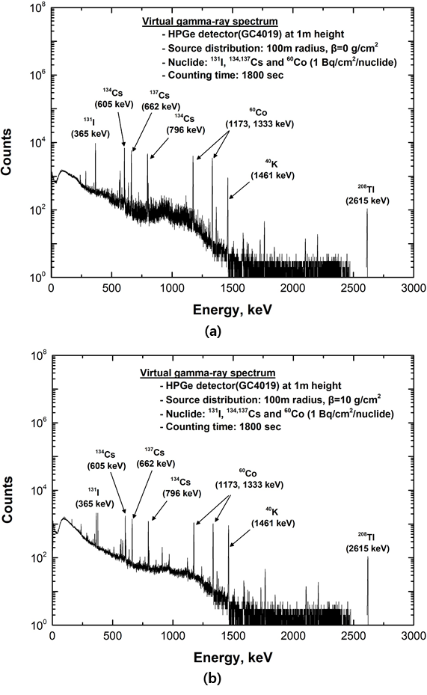
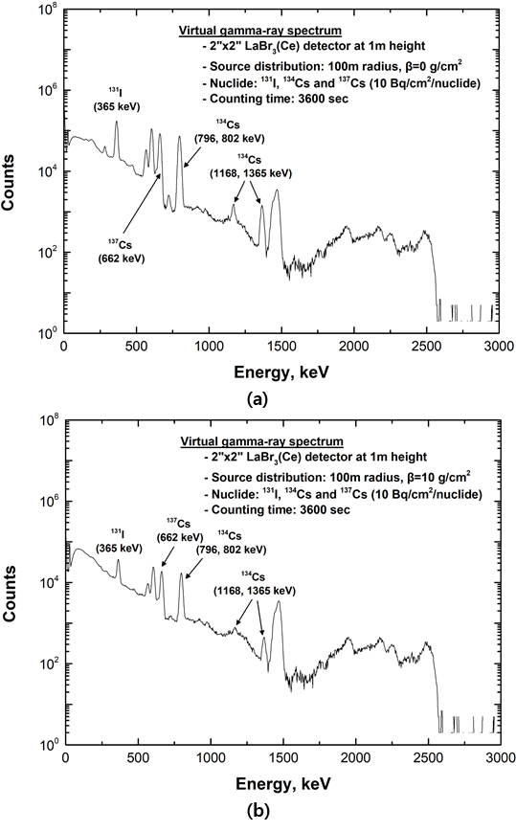
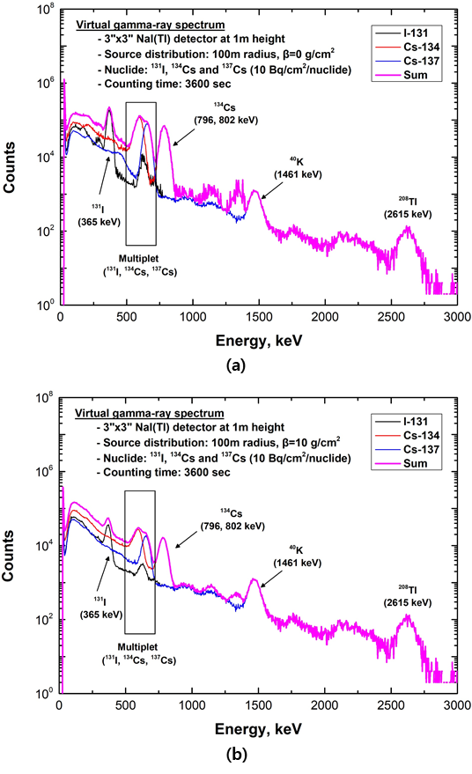
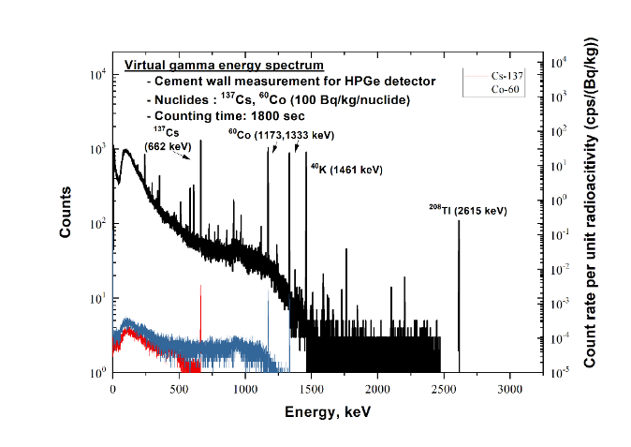
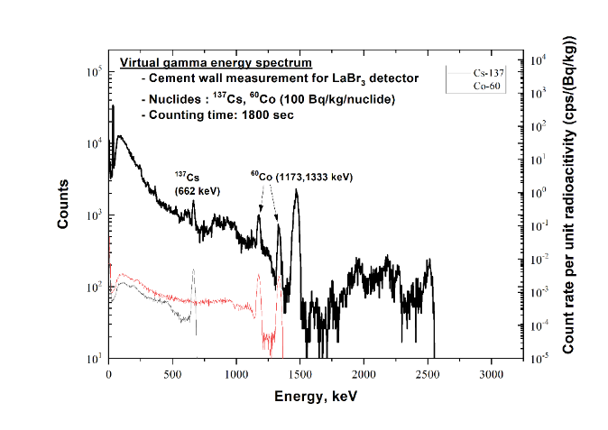
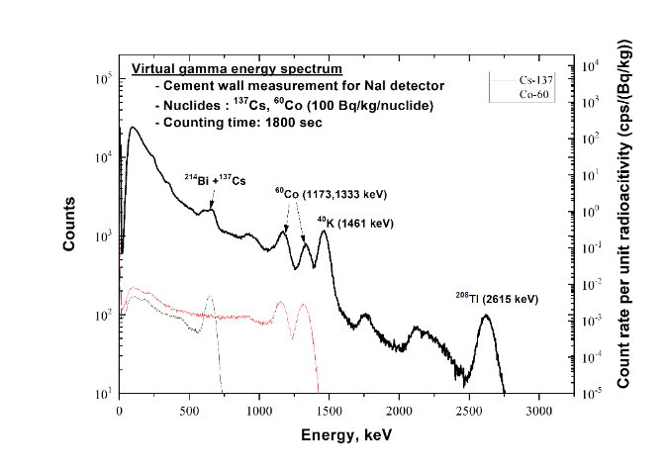
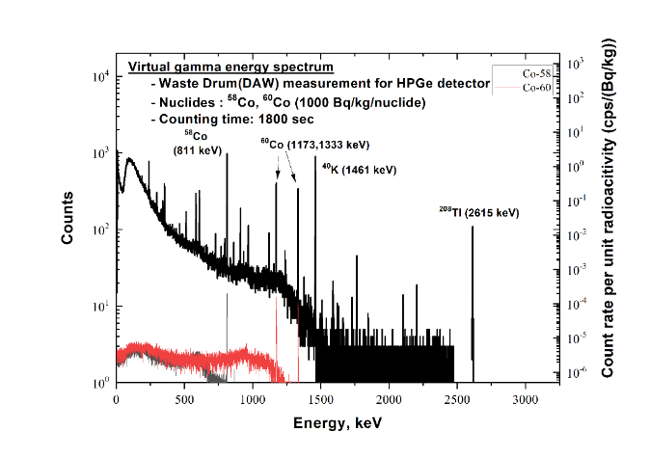
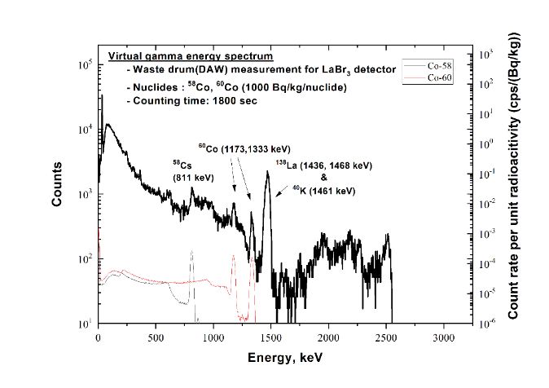
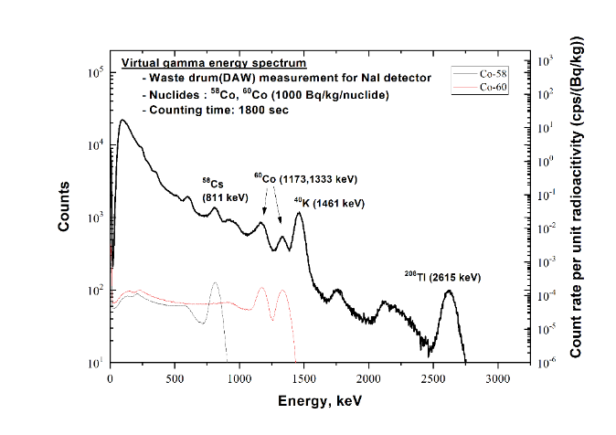
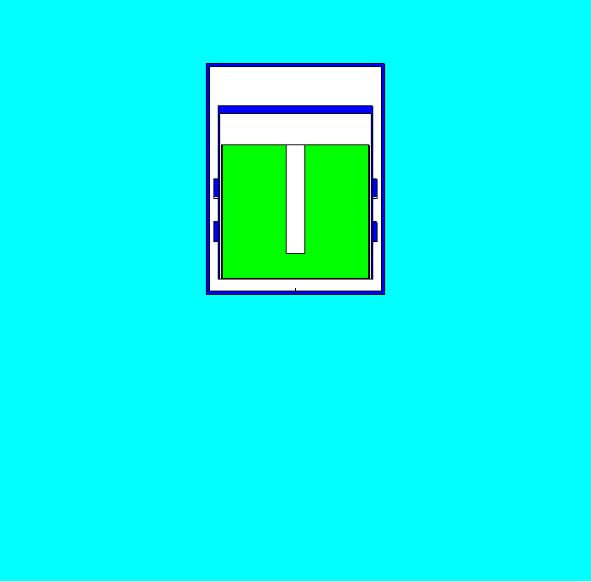
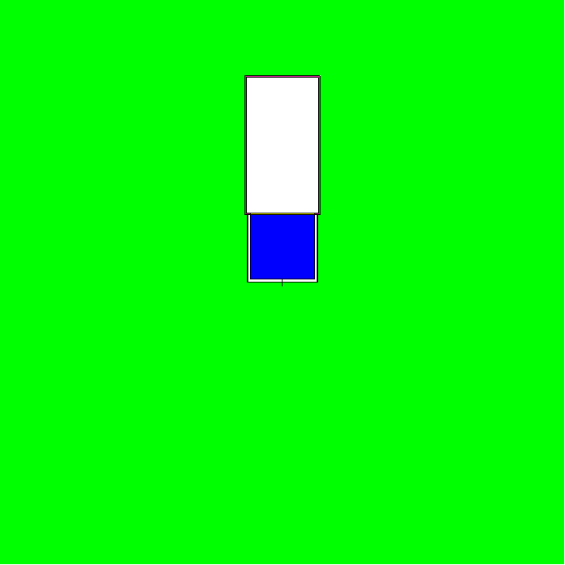
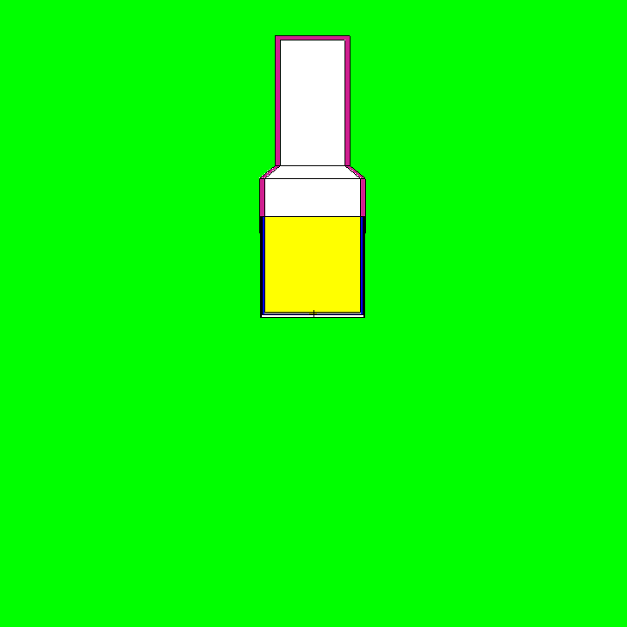
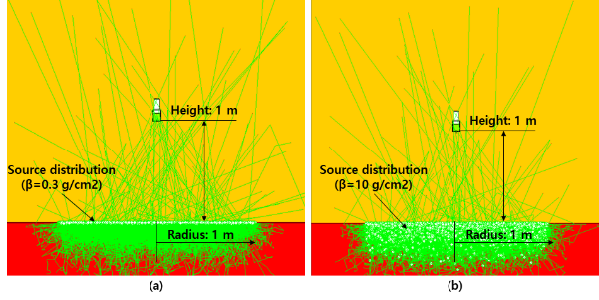
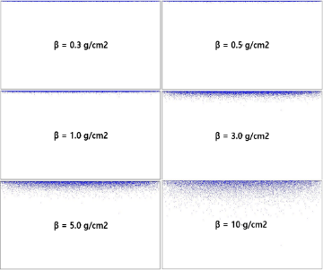
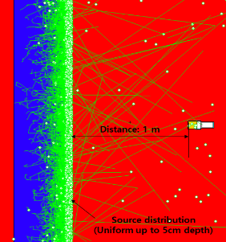
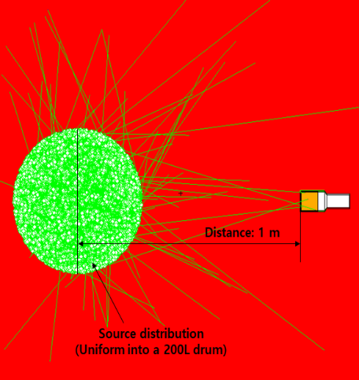
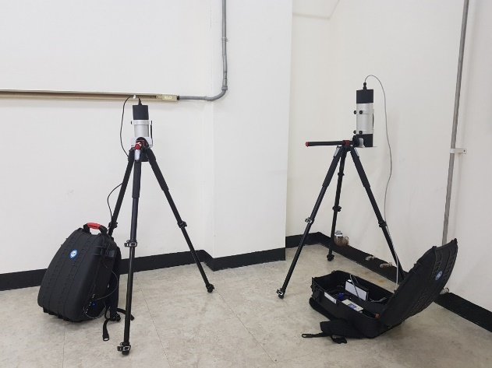
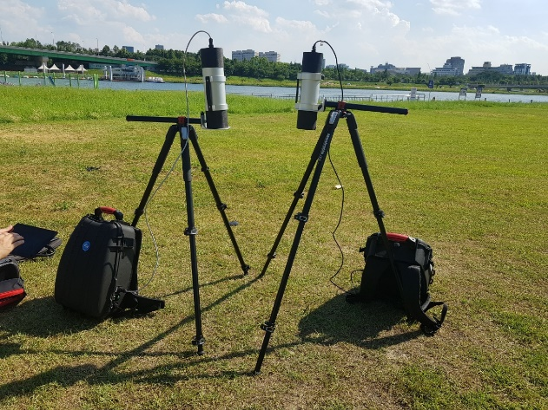
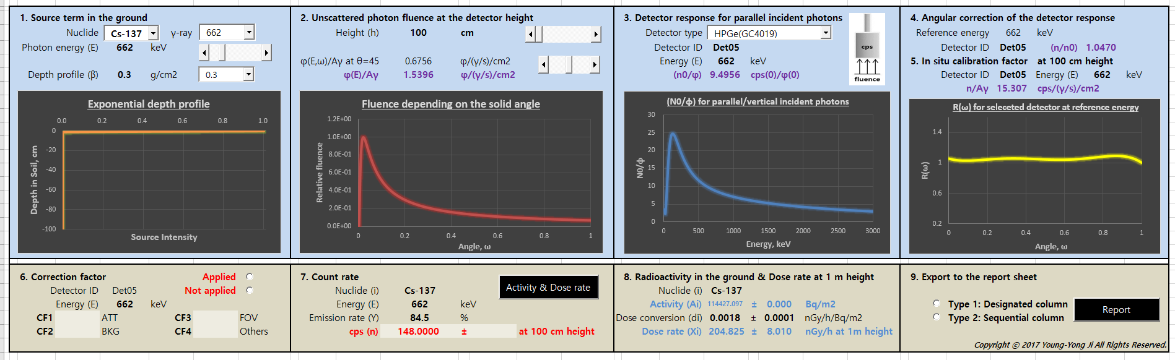
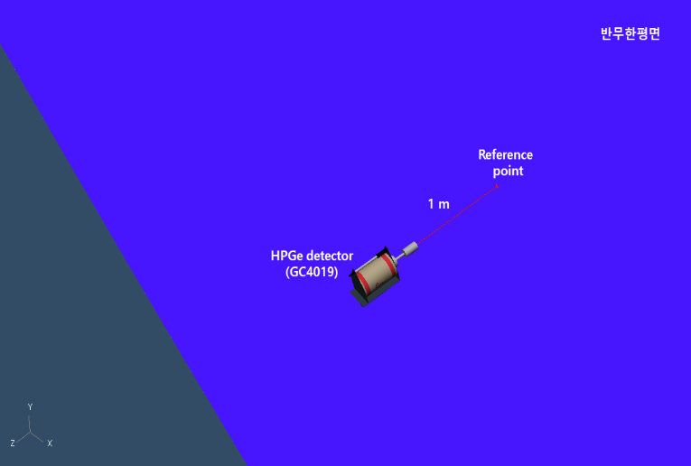
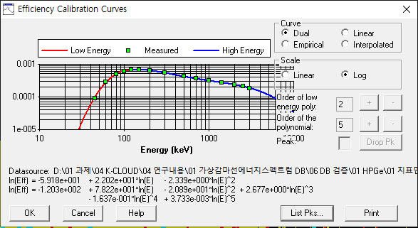
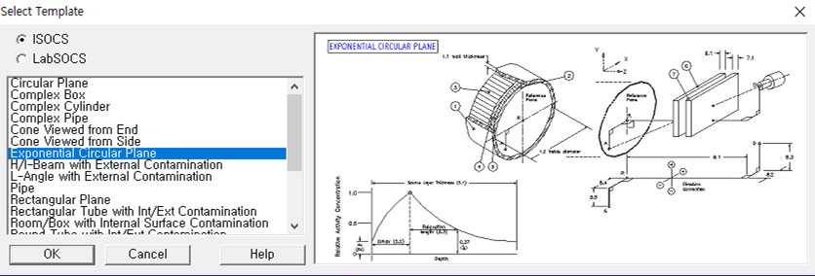
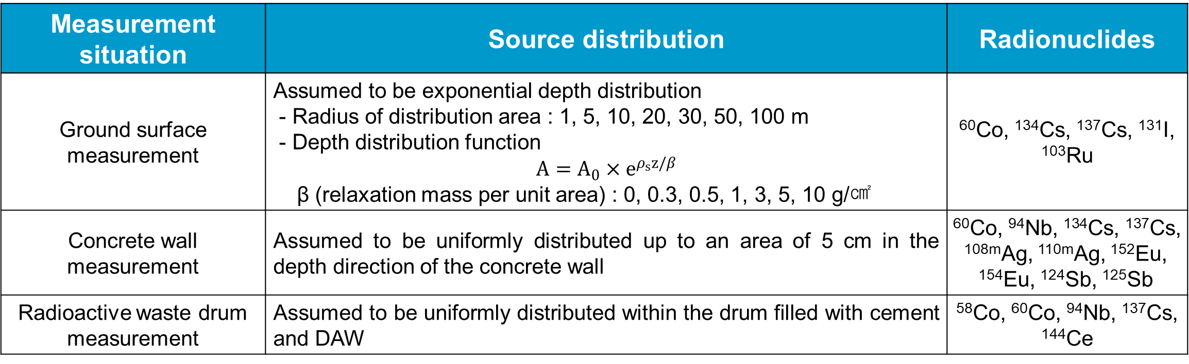
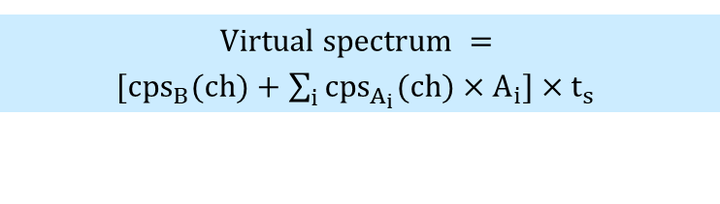
Transactions of the Korean Nuclear Society Spring Meeting, Jeju, Korea, May 18-20, 2022
Development of virtual gamma-ray energy spectrum database under various conditions using MCNP simulation
Yoomi Choi*, Young-Yong Ji, Sungyeop Joung
Radiation Safety Management Division, Korea Atomic Energy Research Institute, 989-111, Daedukdae-ro, Dukjin-dong, Yuseong-gu, Daejeon , Republic of Korea
* Email : cym1031@kaeri.re.kr
Introduction
Result and Discussion
Gamma-ray spectrometry can be applied to in-situ measurements for various field, such as decommissioning, environmental monitoring and radioactive waste management etc.
As the demand in the field of application increases, a training system for technical profession is also required.
To increase the proficiency of spectrometry, it is necessary to experience directly analyzing the measured spectra of artificial radionuclides which are difficult to obtain under the in-situ measurement condition.
In this study, a database for generating a virtual gamma-ray energy spectrum of artificial radionuclide under various in-situ measurement conditions was developed by computational simulation.
Background spectrum
Theoretical spectrum
Virtual spectrum for in-situ measurement
Material and Methods
Selection of measurement situation and conditions
Measurement situation
  Ground surface measurement (for environmental monitoring) : detect the radiation energy spectrum at 1m above ground surface
  Concrete wall measurement (for facilities decommission) : detect the radiation energy spectrum at a distance of 1 m from the wall
  Radioactive waste drum measurement (for radwaste management) : detect the radiation energy spectrum at a distance of 1 m from the center of drum
Verification of virtual spectra
Peak location and FWHM verification
  Comparison of differences between real and calibrated energies and FWHMs of main gamma peaks between measured and simulated spectra
^{Natural radionuclides} |  |  |  |  | ^{Artificial radionuclides}
^{Nuclide} | ^{Gamma-ray} ^{energy (keV)} |  | ^{FWHM} |  | ^{Nuclide} | ^{Gamma-ray} ^{energy (keV)} |  | ^{FWHM}
 | ^{Calib.} | ^{Diff.} | ^{keV} | % |  | ^{Calib.} | ^{Diff.} | ^{keV} | %
^{212Pb} | ^{239.0} | ^{0.42} | ^{1.28} | ^{0.54} | ^{131I} | ^{365.0} | ^{0.54} | ^{1.60} | ^{0.44}
^{214Pb} | ^{352.1} | ^{0.19} | ^{1.26} | ^{0.36} | ^{134Cs} | ^{605.2} | ^{0.47} | ^{1.74} | ^{0.29}
^{214Bi} | ^{609.2} | ^{-0.51} | ^{1.74} | ^{0.29} | ^{137Cs} | ^{662.1} | ^{0.42} | ^{1.75} | ^{0.26}
^{228Ac} | ^{910.7} | ^{-0.2} | ^{1.23} | ^{0.13} | ^{134Cs} | ^{796.3} | ^{0.4} | ^{1.91} | ^{0.24}
^{40K} | ^{1460.6} | ^{-0.22} | ^{1.96} | ^{0.13} | ^{60Co} | ^{1173.1} | ^{-0.06} | ^{2.06} | ^{0.18}
^{208Tl} | ^{2614.7} | ^{0.23} | ^{2.52} | ^{0.10} | ^{60Co} | ^{1332.6} | ^{0.06} | ^{2.09} | ^{0.16}
Detector type
  HPGe detector, 3"φ×3" NaI(Tl) scintillation detector, 2"φ×2" LaBr₃(Ce) scintillation detector
Radioactivity analysis result
  Using EPR Program
  Using ISOCS
Radionuclides and source distribution
 |  |  | HPGe
Nuclide | Input |  | Output-Virtual gamma-ray spectrum
 | β (g/cm²) | A_In (Bq/cm²) | Energy (keV) | Net cps (s⁻¹) | A_Cal (Bq/cm²)
¹³¹I | 0 | 1 | 364 | 24.3 | 1.041
 | 0.3 |  |  | 18.3 | 1.045
 | 0.5 |  |  | 16.9 | 1.079
 | 1 |  |  | 14.5 | 1.117
 | 3 |  |  | 9.55 | 1.137
 | 5 |  |  | 7.31 | 1.138
 | 10 |  |  | 4.84 | 1.168
¹³⁷Cs | 0 | 1 | 662 | 15.7 | 0.916
 | 0.3 |  |  | 13.1 | 1.010
 | 0.5 |  |  | 12.2 | 1.043
 | 1 |  |  | 10.5 | 1.073
 | 3 |  |  | 7.09 | 1.097
 | 5 |  |  | 5.56 | 1.108
 | 10 |  |  | 3.84 | 1.161
¹³⁴Cs | 0 | 1 | 605 | 18.9 | 0.906
 | 0.3 |  |  | 15.3 | 0.970
 | 0.5 |  |  | 14.2 | 1.001
 | 1 |  |  | 12.1 | 1.031
 | 3 |  |  | 8.00 | 1.020
 | 5 |  |  | 6.09 | 1.003
 | 10 |  |  | 3.99 | 1.000
 |  |  |  | LaBr₃(Ce) |  | NaI(Tl)
Nuclide | Input |  | Output-Virtual gamma-ray spectrum |  |  | Output-Virtual gamma-ray spectrum
 | β (g/cm²) | A_In (Bq/cm²) | Energy (keV) | Net cps (s⁻¹) | A_Cal (Bq/cm²) | Net cps (s⁻¹) | A_Cal (Bq/cm²)
¹³¹I | 0 | 10 | 364 | 247.0 | 11.7 | 585.9 | 11.2
 | 0.3 |  |  | 183.4 | 11.6 | 436.3 | 11.2
 | 0.5 |  |  | 168.0 | 11.9 | 400.2 | 11.4
 | 1 |  |  | 146.3 | 12.5 | 347.3 | 12.0
 | 3 |  |  | 85.2 | 11.3 | 201.5 | 10.8
 | 5 |  |  | 66.2 | 11.5 | 156.0 | 11.0
 | 10 |  |  | 42.5 | 11.4 | 99.1 | 10.8
¹³⁷Cs | 0 | 10 | 662 | 150.5 | 10.4 | 405.1 | 10.6
 | 0.3 |  |  | 119.6 | 10.9 | 319.9 | 11.1
 | 0.5 |  |  | 110.3 | 11.2 | 296.0 | 11.4
 | 1 |  |  | 96.9 | 11.8 | 260.2 | 12.0
 | 3 |  |  | 58.3 | 10.7 | 155.7 | 10.8
 | 5 |  |  | 45.9 | 10.8 | 125.1 | 11.2
 | 10 |  |  | 29.6 | 10.6 | 81.4 | 11.1
¹³⁴Cs | 0 | 10 | 796 | 128.8 | 10.1 | 346.0 | 10.2
 | 0.3 |  |  | 104.6 | 10.8 | 279.5 | 10.9
 | 0.5 |  |  | 97.1 | 11.1 | 263.4 | 11.3
 | 1 |  |  | 85.6 | 11.7 | 230.3 | 11.8
 | 3 |  |  | 52.9 | 10.8 | 141.2 | 10.9
 | 5 |  |  | 42.0 | 11.0 | 113.0 | 11.2
 | 10 |  |  | 27.9 | 11.0 | 74.3 | 11.1
Measurement situation | Source distribution | Radionuclides
Ground surface measurement | Assumed to be exponential depth distribution - Radius of distribution area : 1, 5, 10, 20, 30, 50, 100 m - Depth distribution function $A=A_{0}×e^{ρ_{s}z/β}$ β (relaxation mass per unit area) : 0, 0.3, 0.5, 1, 3, 5, 10 g/㎠ | ⁶⁰Co, ¹³⁴Cs, ¹³⁷Cs, ¹³¹I, ¹⁰³Ru
Concrete wall measurement | Assumed to be uniformly distributed up to an area of 5 cm in the depth direction of the concrete wall | ⁶⁰Co, ⁹⁴Nb, ¹³⁴Cs, ¹³⁷Cs, ^{108m}Ag, ^{110m}Ag, ¹⁵²Eu, ¹⁵⁴Eu, ¹²⁴Sb, ¹²⁵Sb
Radioactive waste drum measurement | Assumed to be uniformly distributed within the drum filled with cement and DAW | ⁵⁸Co, ⁶⁰Co, ⁹⁴Nb, ¹³⁷Cs, ¹⁴⁴Ce
Methodology of virtual gamma-ray energy spectrum generation
Background radiation energy spectrum
(measured spectrum)
From natural radionuclides
Measured under the predetermined situation
Format : count rate for each channel, cps_{B}(ch)
$$Virtual spectrum =$$
$[{cps}_{B}(ch)+\sum_{i}{{cps}_{A_{i}}(ch)×A_{i}]×t_{s}}$
Radiation energy spectrum of artificial radionuclides
(simulated spectrum)
Calculated for considered radionuclides
Simulated under the same conditions as the background radiation measurement
Format : count rate for each channel per unit activity(Bq), cps_{A}(ch)/A
Desired source condition
Radionuclide
radioactivity
Virtual radiation energy spectrum
(counts)
Nuclide | Input |  | Output-Virtual gamma-ray spectrum |  |  | Nuclide | Input |  | Output-Virtual gamma-ray spectrum
 | β (g/cm²) | A_In (Bq/cm²) | Energy (keV) | Net cps (s⁻¹) | A_Cal (Bq/cm²) |  | β (g/cm²) | A_In (Bq/cm²) | Energy (keV) | Net cps (s⁻¹) | A_Cal (Bq/cm²)
¹³¹I | 0 | 1 | 364 | 24.3 | 1.114 | ⁶⁰Co | 0 | 1 | 1173 | 12.4 | 1.029
 | 0.3 |  |  | 18.3 | 1.083 |  | 0.3 |  |  | 11.1 | 1.110
 | 0.5 |  |  | 16.9 | 1.117 |  | 0.5 |  |  | 10.1 | 1.133
 | 1 |  |  | 14.5 | 1.159 |  | 1 |  |  | 8.89 | 1.165
 | 3 |  |  | 9.55 | 1.190 |  | 3 |  |  | 6.25 | 1.190
 | 5 |  |  | 7.31 | 1.197 |  | 5 |  |  | 4.99 | 1.195
 | 10 |  |  | 4.84 | 1.246 |  | 10 |  |  | 3.55 | 1.230
¹³⁷Cs | 0 | 1 | 662 | 15.7 | 1.075 |  | 0 | 1 | 1333 | 11.7 | 1.044
 | 0.3 |  |  | 13.1 | 1.102 |  | 0.3 |  |  | 10.1 | 1.102
 | 0.5 |  |  | 12.2 | 1.133 |  | 0.5 |  |  | 9.57 | 1.134
 | 1 |  |  | 10.5 | 1.161 |  | 1 |  |  | 8.38 | 1.161
 | 3 |  |  | 7.09 | 1.183 |  | 3 |  |  | 6.04 | 1.197
 | 5 |  |  | 5.56 | 1.197 |  | 5 |  |  | 4.80 | 1.192
 | 10 |  |  | 3.84 | 1.256 |  | 10 |  |  | 3.42 | 1.236
¹³⁴Cs | 0 | 1 | 605 | 18.9 | 1.115
 | 0.3 |  |  | 15.3 | 1.113
 | 0.5 |  |  | 14.2 | 1.134
 | 1 |  |  | 12.1 | 1.158
 | 3 |  |  | 8.00 | 1.175
 | 5 |  |  | 6.09 | 1.181
 | 10 |  |  | 3.99 | 1.226
Background radiation measurement
  Performed at a height of 1 m from the ground (Daejeon and Busan(Gijang) and Jeju) and the floor of laboratory inside the building
  Detector : HPGe detector (Canberra GC4019 model), 3"φ×3" NaI(Tl) detector, 2"φ×2" LaBr₃(Ce) detector (KAERI MARK-B)
MCNP simulation
  Geometry
  Output format
    Channel number : 1k for NaI and LaBr₃, 16k for HPGe for high-accuracy linear interpolation
HPGe
LaBr₃
NaI
Nuclide | A_In (Bq/g) | Output-Virtual gamma-ray spectrum
 |  | Energy (keV) | Net cps (s⁻¹) | A_Cal (Bq/g)
¹³⁷Cs | 0.1 | 662 | 3.45 | 0.119
⁶⁰Co | 0.1 | 1173 | 3.21 | 0.113
 |  | 1333 | 2.94 | 0.109
Inner material | Nuclide | A_In (Bq/g) | Output-Virtual gamma-ray spectrum |  |  | Inner material | Nuclide | A_In (Bq/g) | Output-Virtual gamma-ray spectrum
 |  |  | Energy (keV) | Net cps (s⁻¹) | A_Cal (Bq/g) |  |  |  | Energy (keV) | Net cps (s⁻¹) | A_Cal (Bq/g)
DAW | ⁵⁸Co | 1 | 811 | 2.13 | 1.042 | Cement | ⁵⁸Co | 1 | 811 | 4.27 | 1.051
 |  | 10 | 811 | 21.6 | 10.54 |  |  | 10 | 811 | 42.8 | 10.92
 | ⁶⁰Co | 1 | 1173 | 1.81 | 1.057 |  | ⁶⁰Co | 1 | 1173 | 3.99 | 1.067
 |  |  | 1333 | 1.72 | 1.076 |  |  |  | 1333 | 3.97 | 1.089
 |  | 10 | 1173 | 18.1 | 10.59 |  |  | 10 | 1173 | 40.8 | 10.88
 |  |  | 1333 | 17.1 | 10.69 |  |  |  | 1333 | 39.7 | 10.91
Verification of virtual spectrum
Conclusion
  To verify the adequacy of the generated virtual spectra, radioactivity analysis was performed with the previously developed program
  - ERS(Environmental Radiation Survey) program – only ground surface measurement
  - ISOCS with Genie 2000 - only Canberra HPGe detector
  Compare the radioactivity analysis results and input radioactivity values
Verify the validity of the virtual gamma-ray energy spectrum with differences within about 20% from the true values
The developed database can be used for educational gamma-ray energy spectrum simulators
It will be improved to generate a spectrum more similar to the actual measured spectrum and expanded by adding various measurement conditions in the future
Acknowledgements
This work was supported by KOREA HYDRO & NUCLEAR POWER CO., LTD (No. G20IO02)

